Slide 1
Culturale Guide LKCA
Januari 2015

Slide 2
Nederland
4 locations
Amsterdam
Arnhem
Assen
Lelystad

Slide 3
Amsterdam
Partners
Amsta -The healthcare provider in Amsterdam for the elderly people with dementia
Zona’s Kiosk-art organization
Laurien Mulder-artist

Slide 4
Targetgroup elderly people with dementia

Slide 5
Table of wonders

Slide 6
Training Amsta
8 volunteer
Ethics of being volunteer
Ethic of being artist
Open ears and eyes in the moment
Use materials as communication middle
Be playful
Its all about attention
Respect for life environment
To document
Practice and reflection

Slide 7
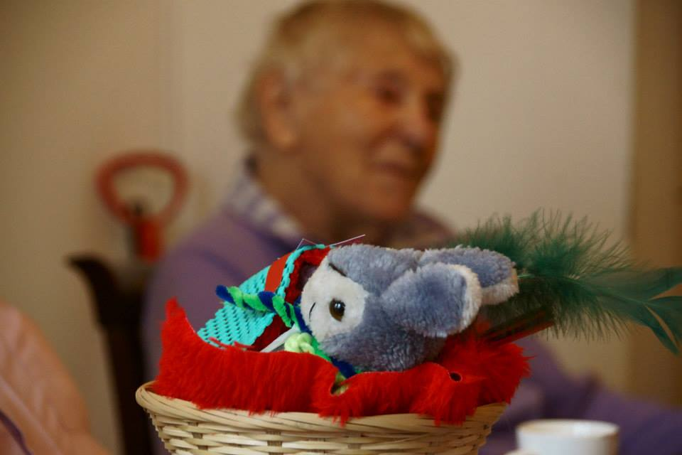
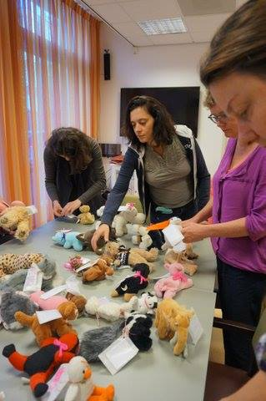
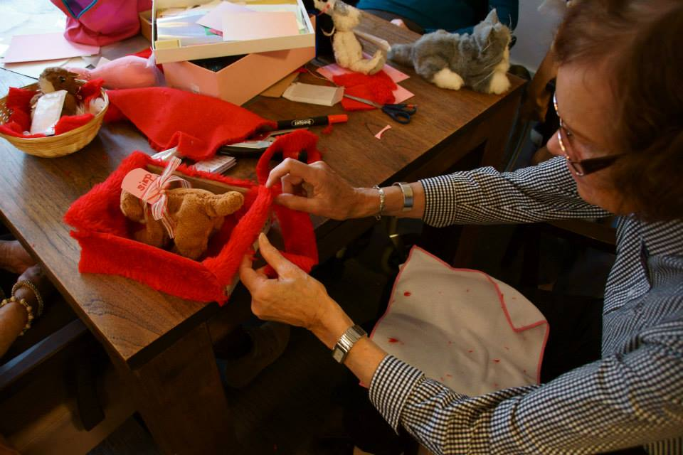
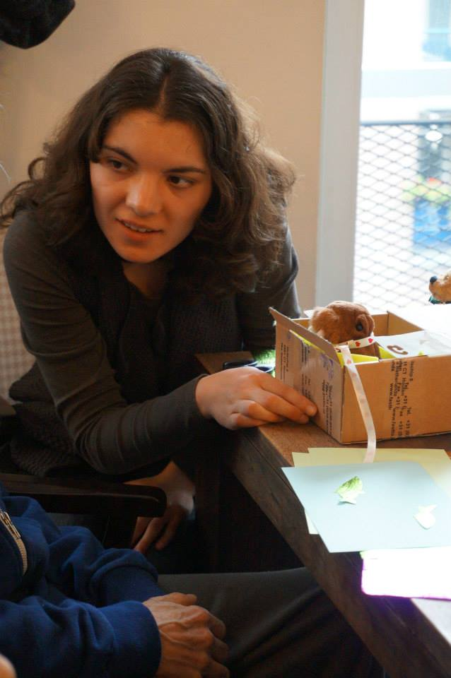
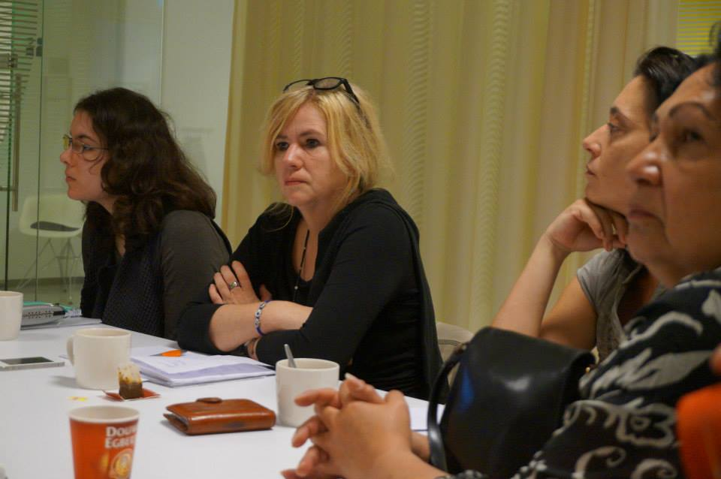
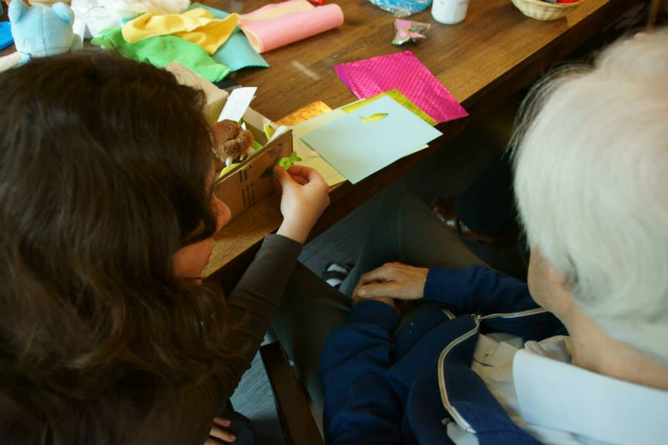
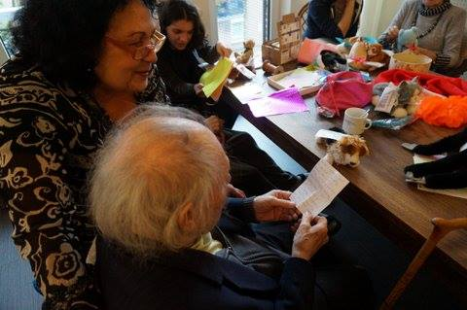

Slide 8
Lelystad
Partners
Kwintes-de waterspiegel-organisation for people with psychiatric illness
Kubus-centre of arts education
Marjolijn Zwakman-artist

Slide 9
Targetgroup People with psychiatric past and present

Slide 10
Training Lelystad
10 volunteers who are practice based experts
7 meetings
Training
Empowerment
Ambition
Motivate
Knowledge transfer

Slide 11
Coach and manager
Ambition to make 7 presentations for bookweek with theme Madness

Slide 12
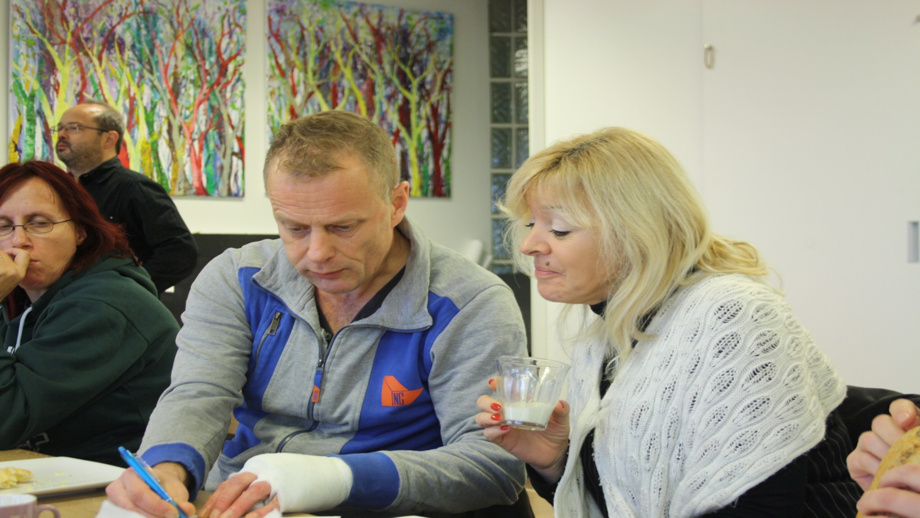
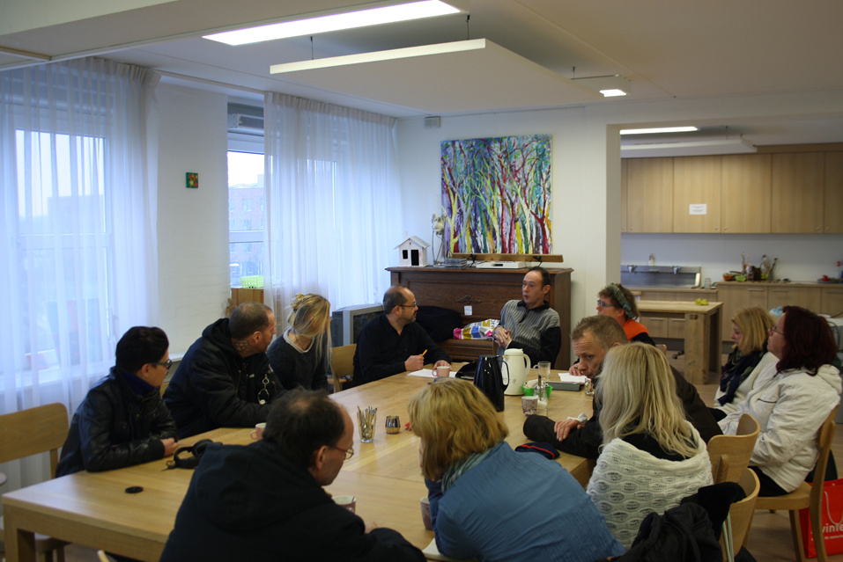
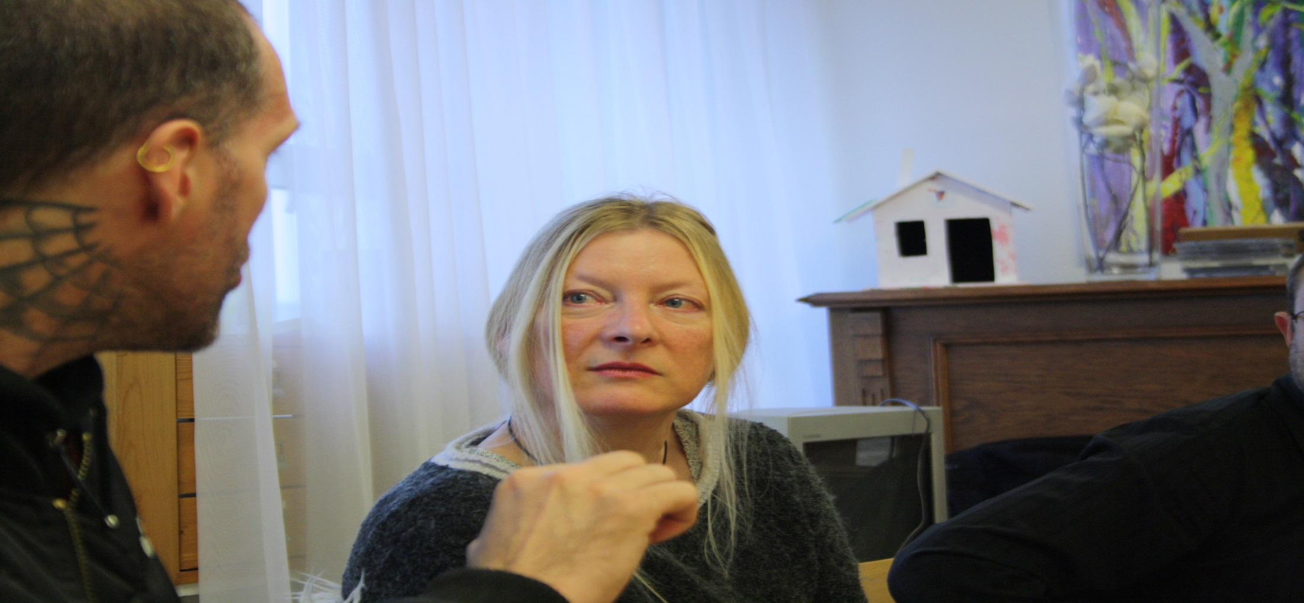

Slide 13
Nijmegen/Arnhem
Partners
De lindenberg-Nijmegen
Art centre
Kunstbedrijf Arnhem
Art centre

Slide 14
Training Arnhem/Nijmegen
10 volunteers
Ethics of being a volunteer
Knowledege of target group
Inspiration
Power of people
Get out of the comfort zone

Slide 15
Targetgroups
People with disabilities
lonely elderly

Slide 16
ambition
Get lonley elderly people to the art cafe 55 +

Slide 17
Drenthe
Partners
Kunst en Cultuur Drenthe-art centre- coloured grey
Drents Museum
Drents Archief
Hunnebedmuseum

Slide 18
Training
10 volunteers
Ethics of being a volunteer
Knowledege of target group
Where to find the lonely elderly
How to work together with local organisations

Slide 19
targetgroup
Lonely elderly people
Ambition
Make programma’s for lonely elderly and include them in the arts/history

