Slide 1

Mapping essential competences of culture volunteers in sparsely populated areas Hungary
Prepared by: the team of HFHSS Katalin Varga, Tünde Tóth and János Szigeti Tóth

Slide 2
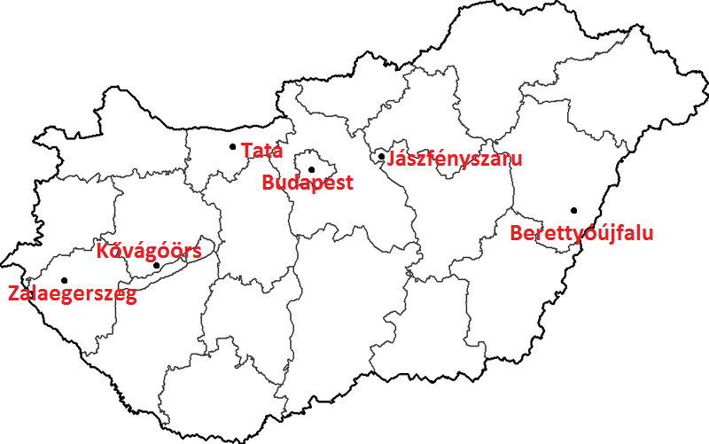

Slide 7
Successful competences:
-social and communication skills
- knowledge of the area where they live
- ability to plan and organise

Slide 8
Successful recruitment
- highlighting personal development to motivate
- doing something for community well-being
-informal contact with an experienced mentor

Slide 9
Training programme
- strengthening local identity
- making a difference
- awareness of one’s own competence profile

Slide 10
Support
- guidance of a more experienced volunteer
- financing cost-demanding activities
- supportive attitude of local governments and authorities

