Slide 1
Second partner meeting
19 – 20 April 2017 in Copenhagen
OUTLINE OF CURRICULA FRAME
Hans Jørgen Vodsgaard
Interfolk
Institute for Civil Society

Slide 2
The methodological approach
The Curriculum Guidelines proceed from
the learner-centred approach, and
the principles of outcome-based learning.
Outcome-based learning focuses on assessable learning outcomes
that learners are supposed to achieve as a result of the learning process.
Not
Grundtvig’s view of the mission of the Folk High Schools:
To find the song behind the plough

Slide 3
Adult learning
Teaching adults is different from teaching children.
Adult learners have higher self- consciousness and more previous experiences.
Focus on their own experiences (as culture volunteers)
Focus on their expressed needs (as culture volunteers)
Include problem-based learning (as culture volunteers)

Slide 4
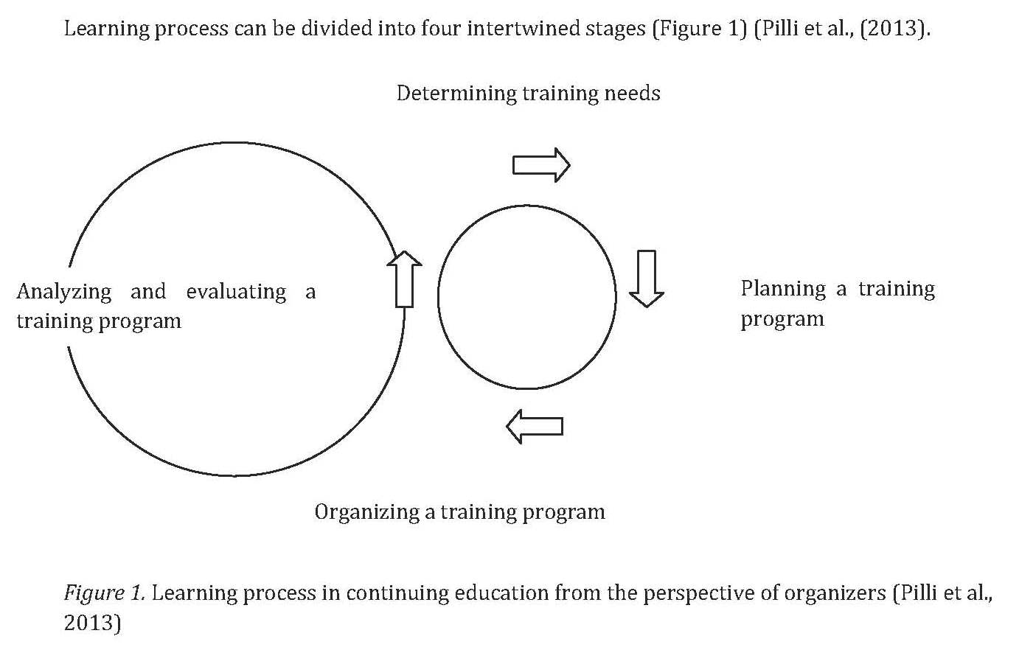
The learning process

Slide 5
Planning the curriculum
In the best of world:
- A training program is carried out according to the curriculum
The curriculum should includes at least the following information:
Title of the curriculum
The learning outcomes
Possible requirements / qualifications to be met by the learners
Total volume of the course, measured in academic hours (45 min)
Content of the studies: Main topics and activities.
Teaching methods: Learner-centred methods / participatory and activity-
based methods, integrating theory and shared experience
Learning environment: Lecture room, group rooms, lab, equipment, etc
Study materials, if these are intended for the completion of the curriculum
Course certificate or notice of participation
Profile of learning providers and trainers

Slide 6
Re 2: Learning outcomes in general
Learning outcomes
are formulated according to the objective of the learning process
and have to be measurable, assessable and achievable
within a limited period of time
Generally, 4-6 outcomes are included
These outcomes serve as a basis for selecting appropriate teaching and learning methods, as well as deciding upon the assessment methods and the structure and content of studies.

Slide 7
Re 2: Specific Learning objectives
Possible specific learning objectives:
Self insight and validation of own prior learning and lifelong developed transversal skills and key competences,
Insight knowledge and shared experiences of the possibilities of arts and culture to help to revive villages and remote areas.
Insight knowledge and shared experiences of the sector of amateur arts, voluntary culture and heritage in sparsely populated areas.
Insight knowledge and shared experiences of local stakeholders that may support cross-culture activities in the local communities.
High level skills in planning and managing culture activities with an added value for civic participation and community bonding.
Enhanced communication skills to reach different audience groups and use a variety of dissemination channels in local communities.

Slide 8
Re 2: Specific learning outcomes
On completion of the course, the culture volunteers will be able to
Recognise and validate their prior learning and articulate their competence profile and its relevance for working as culture volunteer.
Interpret and understand the main activities in the cross-cultural sector of voluntary culture associations and its interactions with main stakeholders in the local communities.
Explore issues about the relations between local culture activities and civic participation, local identity and community bonding
Apply the team-leading skills necessary to plan, implement and communicate cross-culture activities within a local community context.

Slide 9
Re 6: Teaching methods
Teaching methods:
Learner-centred methods / participatory and activity-based methods, integrating theory and shared experience.
It will include a blend of short concise lectures, plenary discussions, workshops on case studies, pair work and individual learning.
Short presentations on the topic prepared by participants themselves will be part of the course.
Validation procedures* is embedded in the content of the course, because an integrated validation contributes both to the recognition of the outcome for the participants and to the quality assurance of the course.
*) The learners must at the end of the course validate the outcome / their own possible competence development

Slide 10
Re 9: Certification or?
A course certificate or notice of participation can be issued to the learner after completion of the course
A course certificate can be issued to a person if the learning outcomes was assessed and the person accomplished all the required learning outcomes for the completion of the curriculum
A notice of participation can be issued to a person if the accomplishment of the learning outcomes was not assessed or if the person did not accomplish all the required learning outcomes.
A notice may only include information about those topics that were actually covered by the learner during the course

Slide 11
Time schedule
No | Who | Key activities | Deadlines
1 | P3, IF ActKn | The lead partner, IF outlines the curricula frame (with support from ActKnowledge re assessment framework?) | 20.05.2017
2 | All | The partners will be engaged in a shared dialogue on refinements of the draft Curricula frame | 25.05.2017
3 | P3, IF | IF present draft curricula compendium, English ed. | 05.06.2017
4 | All | The partners gives feedback | 10.06.2017
5 | P3, IF | IF prepare the final English Master edition | 15.06.2017
6 | P1, VA | VA proof-reads the manuscript | 20.06.2017
7 | P3, IF | IF layouts the English edition using visual identity of the project, and publish the reports as a PDF-publication. | 30.06.2017
8 | All | Evaluate the work packages / process evaluation | 30.06.2017

