Slide 1
Landsforeningen Kulturelle Samråd i Danmark
Spar
Partner meeting
Copenhagen
19 – 20 April 2017
General secretary
Bente von Schindel

Slide 2
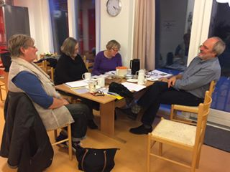
Landsforeningen Kulturelle Samråd i Danmark
Competence report
Aim:
The overall aim is to present the results of the series of field research in a multilateral baseline report, stating the competence baseline as well as the state of art examples and providing common guidelines for the subsequent development work.

Slide 3
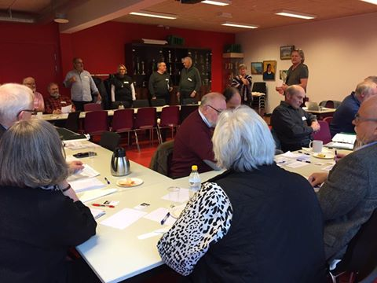
Landsforeningen Kulturelle Samråd i Danmark
Outline The Report will present the series of field research with this possible outline:
Foreword (preface) on background and aims for the series of five local field surveys (½ - 1 page)
Introduction of used methodology and variations of local approaches (4-5 pages)
Presentations of the five field surveys (5 x 6 pages, 30 pages)
Moreover…

Slide 4
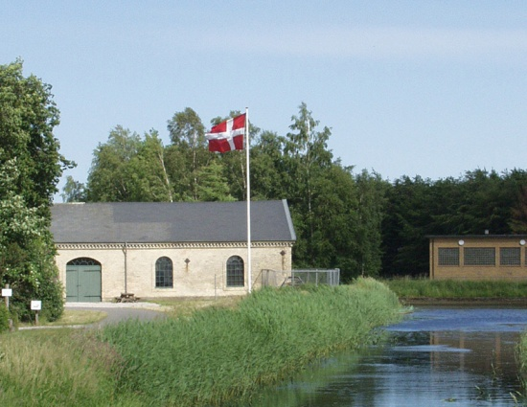
Landsforeningen Kulturelle Samråd i Danmark
Outline
Outline:
Essentials of competence profiles
Needs for learning opportunities
Means of outreach to culture volunteers
Means of the needed capacities of the voluntary associations to provide outreach, tailored training and support, and to apply the appropriate assessment framework (15 pages)
Concluding perspectives on common needs and challenges
Recommendations on how to initiate new pilot work in the field (4-6 pages)

Slide 5
Landsforeningen Kulturelle Samråd i Danmark
Extent of the report
The text of the multilateral report will be approx. 55 – 60 standard pages (like 2400 characters per page, 40 lines of 60 characters).
The illustrations will include at least two exemplary photo per country plus some extra.

Slide 6
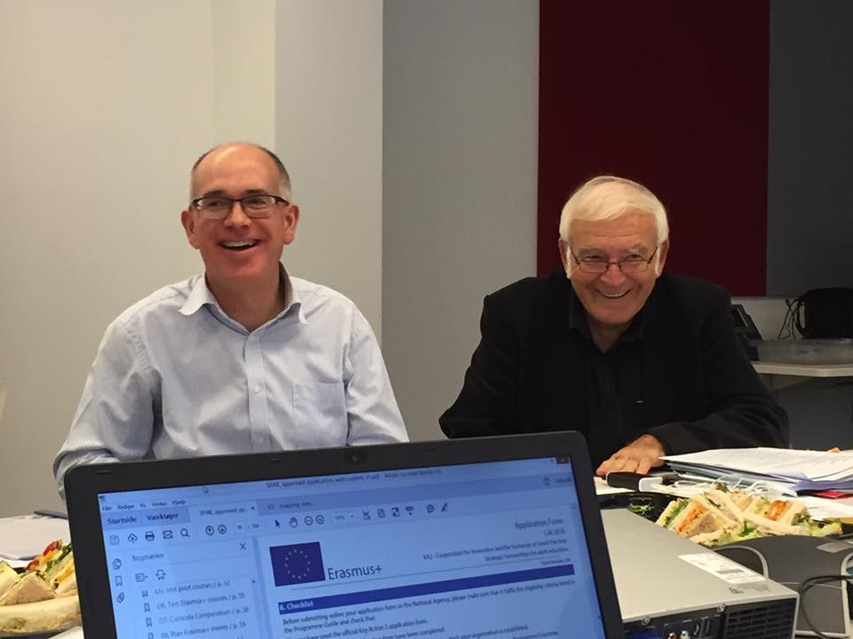
Landsforeningen Kulturelle Samråd i Danmark
Before publication
VAN will proof-read the manuscript
KSD will prepare the layout of the English master edition using the visual identity of the project
The partners will be engaged in a shared dialogue on refinements of the draft editions of the English master report
The layout will be used in the other four languages editions

Slide 7
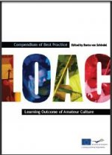
Landsforeningen Kulturelle Samråd i Danmark
Publication
The Research Report will be published in the five partner languages:
Danish
English
Hungarian
Polish
Portuguese
The five reports will have the same layout, using the adopted visual identity of the project, including the Erasmus+ logo.
The colophon will also acknowledge the European Union’s support.
Published as PDF-publication for wide dissemination

Slide 8
Landsforeningen Kulturelle Samråd i Danmark
Reports in national language
All partners (except the UK partner) translate the English master edition to their national languages, adjust the common layout, complete proof-reads, and publish the reports as PDF-publications.
Sparsely populated areas
Gyéren lakott területeken
Àreas pouco povoadas
Obszary słabo zaludnione
Tyndt befolkede områder

Slide 9
Landsforeningen Kulturelle Samråd i Danmark
No | Who | Key activities | Deadlines
1 | P3, IF - ActKn | The lead partner, IF outlines the curricula frame, with support from the external evaluator, ActKnowledge regarding the assessment framework. | 20.05.2017
2 | All | The partners will be engaged in a shared dialogue on refinements of the draft Curricula frame | 25.05.2017
3 | P3, IF | IF present draft curricula compendium, English ed. | 05.06.2017
4 | All | The partners gives feedback | 10.06.2017
5 | P3, IF | IF prepare the final English Master edition | 15.06.2017
6 | P1, VA | VA proof-reads the manuscript | 20.06.2017
7 | P3, IF | IF prepares the layout of the English edition using the visual identity of the project, and publish the reports as a PDF-publication. | 30.06.2017
8 | All | Evaluate the work packages / process evaluation | 30.06.2017

Slide 10
Landsforeningen Kulturelle Samråd i Danmark
No | Who | Key activities | Deadlines
1 | P3, IF - ActKn | The lead partner, IF outlines the curricula frame, with support from the external evaluator, ActKnowledge regarding the assessment framework. | 20.05.2017
2 | All | The partners will be engaged in a shared dialogue on refinements of the draft Curricula frame | 25.05.2017
3 | P3, IF | IF present draft curricula compendium, English ed. | 05.06.2017
4 | All | The partners gives feedback | 10.06.2017
5 | P3, IF | IF prepare the final English Master edition | 15.06.2017
6 | P1, VA | VA proof-reads the manuscript | 20.06.2017
7 | P3, IF | IF prepares the layout of the English edition using the visual identity of the project, and publish the reports as a PDF-publication. | 30.06.2017
8 | All | Evaluate the work packages / process evaluation | 30.06.2017

