Slide 1

State of the Art Report
Overview of co-creative and participatory activities in the sector of amateur arts, voluntary culture and heritage

Slide 2
Overview
Main Findings
Recommendations

Slide 3
Main findings
Different perspectives
Two models of respondent groups:
Older groups of organizers with high cultural activity (in total: 84 people in the UK, 262 in the Netherlands, 64 people in Denmark)
Younger groups of participants with low cultural activity (in total: 88 people in Slovenia, 60 people in Poland)
Three models of contextual bias
A more liberal model (UK, Netherlands)
A more funded cultural sector (Slovenia, Denmark)
A sector with no specific public measures for cultural associations / no network (Poland)
Notes:
The context of the sector given by each partner and the profile of the participants given by the questionnaire allows to draw some “profiles” representing different perspectives. These perspectives are worth mentioning as they often help to explain several statistics in the report. Consequently, the report do not show a full scope of each of these countries.

Slide 4
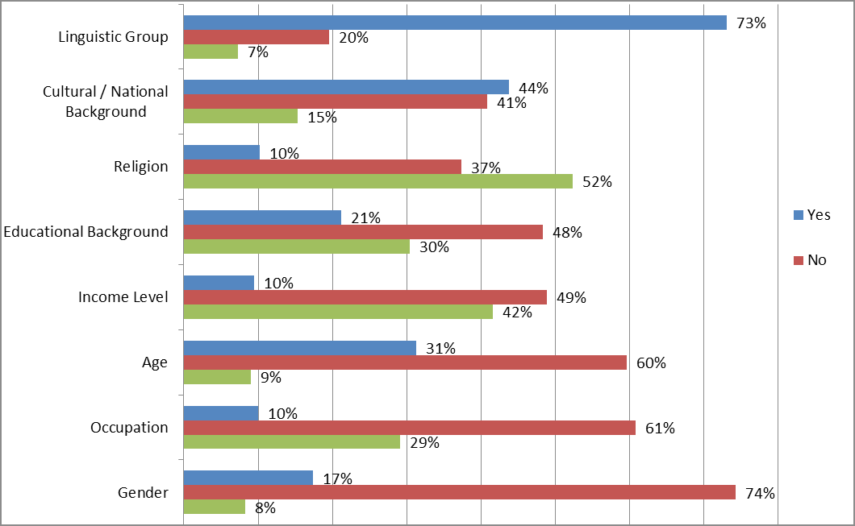
Main findings
Creative activities would not be efficient to bridge different linguistic groups and different national groups
Chart: Thinking about the participant of the creative activities, are the majority of them of the same… (The Netherlands)
Notes:
General agreement for all of the countries in the questionnaire. There are some small differences over the importance given to the social value of the activities, but generally there is an agreement. Consequently, we can conclude that the language barrier and the national cultural backgrounds are characteristics that are not bridged by the activities.

Slide 5
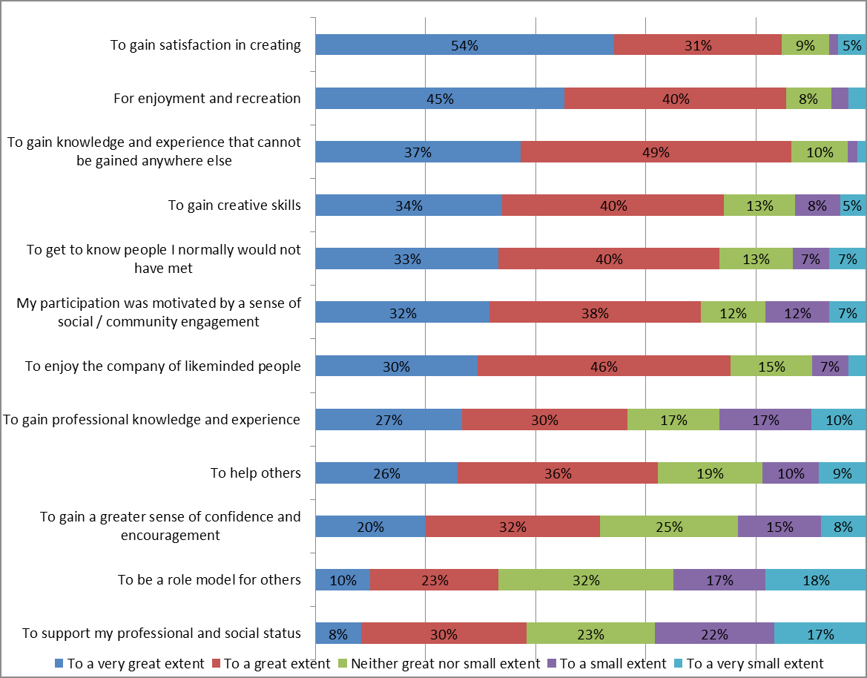
Main findings
These activities are not professionally motivated and do not have professional gains
Chart: What was your main motivation to participate in the creative activities? (Poland)
Notes:
The professionnal gains and motivations are also some general agreement that should be noted. The main effects (= motivations/gains) are socially or personnally related.

Slide 6
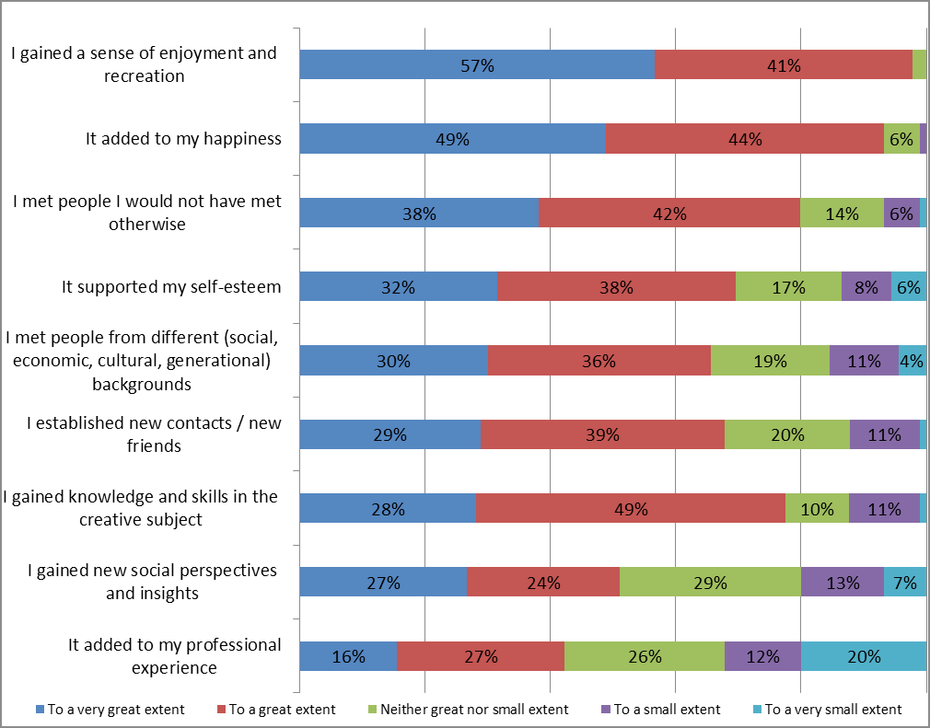
Main findings
Personal and social gains / motivations are high in all of the countries (except for the UK and the Netherlands with a lesser importance of the social answers)
Chart: What did you gain from these creative activities? (United Kingdom)
Notes:
The social gains and motivations are lower in the UK and in the Netherlands. The hypothesis we made in the report is that the liberal context of the cultural sector in these two countries could hinder the social role of the co-creative activities.

Slide 7
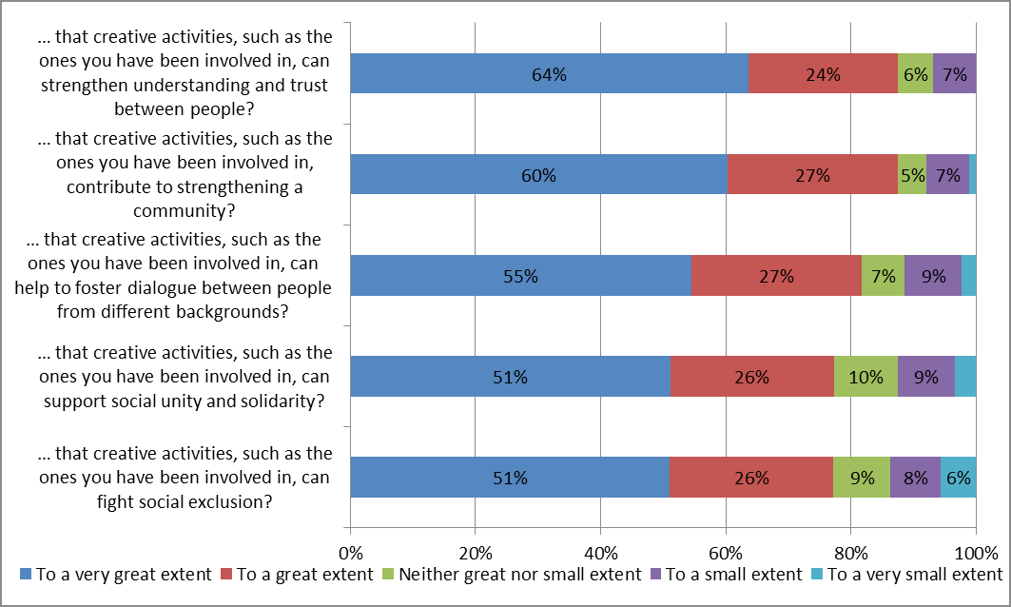
Main findings
The activities are recognized in each country as having a social value
Chart: Social value (United Kingdom)
Notes:
The last point we can note from the questionnaire is that in each country, co-creative activities are recognized as social activities, even though they do not necessarly have this effect.

Slide 8
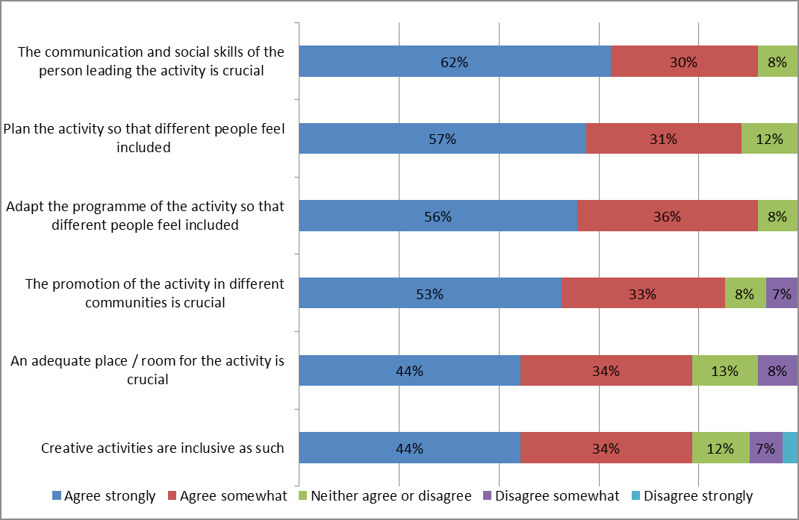
Main findings
Everyone agreed on the different aspects to make the activity successful
Chart: What aspects are helpful in order to make a creative activity successful in bringing together people from different backgrounds? (Poland)
Notes:
The last point from the questionnaire is how to improve co-creative activities; as y ou can see from the chart. General agreement on the different aspect in every country/ the interviews also give an overview of this improvement, the interviewees mainly mentioned the financial aspect, as well as the training aspect, to have a learning provider adapted to co-creation, able to communicate with the participants.

Slide 9
Main findings
Distinguishing co-creative activities from simple participation
The example of the dancing classes in ARTez Arnhem
The example of the project “Generation to Generation”
Notes:
The interviews were useful for this point. Unlike with the questionnaire, we had a lot of different situations, opinions. Generally, they helped us to distinguish activities with a social impact and without.
We chose to present these two examples as they show these two opposites.

Slide 10
Main findings
In the co-creative activities, the learning provider becomes less of a teacher, more of a manager: a bottom-up approach is optimal to include participants and to create sustainable relations
“It is important for them to make an obligation not to a project or a director but to a group. The group works as a correction environment (self-regulation with the group). At the final stages, a mentor (with the group) puts their individual pieces to a final production.”
Quote from a learning provider of the “Generation to Generation” project (Slovenia)
Notes:
Importance of the social skills of the manager, he is coordinating the activity in order to not have a participant taking over the whole project. But ideally, the group is creating his own project, with the avalaible technical and material support from cultural organizations.

Slide 11
Recommendations
Changing the definition of “Voluntary culture”
Original: “These sorts of associations are not so much known, even though they constitute a great deal of the sector and provide/organize a lot of more professional arts and culture to the local communities especially outside the bigger cities.”
Proposal: “Local associations where volunteers organize, create frames, etc. for activities within arts, culture and cultural heritage. The local member associations are theater associations, art associations, music associations, film clubs, cultural centers, local history associations, museum associations and literary companies. The “actors” in these activities are always professional and they consist of touring theaters, visual artists and musicians. In the movie clubs, which can be adult movie clubs as well as children's movies, the professional touch are the movies. In the museums and cultural centers, the staff of the professional museums and cultural houses is involved, and for the literary companies the professionals are actors and libraries responsible for reading events. The local history associations are of great importance to researchers from universities, who could not in the same way gather the local storytelling without these volunteers. And finally, local cultural politicians and cultural administrations in the municipalities are collaborators for cultural councils - the local umbrella organizations advocating local cultural associations.“

Slide 12
Recommendations
Changing the definition of “Amateur Arts including Folk Arts”
“Local and national associations for different kind of arts on amateur level (where the participants are active as amateurs in music, choir, theatre, dancing, visual arts, folk dance, folk music, etc.).”

Slide 13
Recommendations
Add data about the status of promoting social capital as a formulated objective / part of the missions of the associations
Add quotes of stakeholders if they see possibilities of promoting the field
Add demographic data of the participating countries
Add the survey questionnaire
Add the interviews summaries

Slide 14
Recommendations
Any suggestions in terms of the contextual bias? (like FAIE)
Do you see points not raised in the questionnaire / interviews, but should be mentioned?
Are there some points that need more in-depth analysis in the report?

