Slide 1
Welcome to the conference „Micropolis – the power of strong local community”

Slide 2
Conference program:
Presentations: (around 20 minutes each)
Małgorzata Smoczyńska (Poland) will introduce the Micropolis concept and guidebook, showcasing the project’s achievements and insights.
Hans Jørgen Vodsgaard (Denmark) will discuss practical implementations and the value of international cooperation in community building.
Pentti Lemmetyinen (Finland) will explore how to empower active citizenship and community engagement.
Space for Networking

Slide 3
Micropolis project:
An Erasmus+ small-scale partnership (Key Action 2, Adult education), May 2023 – September 2024
Partners:
Wawerskie Centrum Kultury – main coordinator [Poland]
Interfolk Institute + Middelfart Municipality + Kulturoen + Volunteers Center – [Denmark]
The Finnish Federation of Settlement Houses [Finland] + the International Settlement Federation (IFS) [international]

Slide 4
Małgorzata Smoczyńska - Micropolis – the concept and the Guidebook

Slide 5
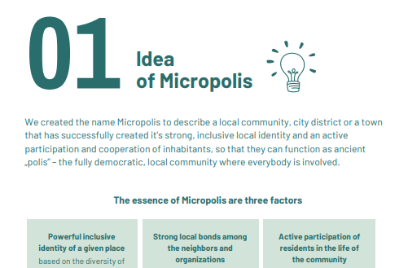

Slide 6
1. Presentation of dr Magdalena Gawrych from the conference during Partners’ meeting in Warsaw:
The phenomenon of community and social connectedness (the subjective awareness of being in close relationship with the social world) is a subject to numerous scientific research
It’s scientifically proven that feeling the connectedness with some community is very important for our mental health
2. Guidebook:
„A human being is a social being – we absolutely need relationships with others to survive, fully develop our potential, enjoy mental and physical health, and ultimately be happy.”
„People have always formed groups and communities to provide essential support. Today, however, this seems more challenging than ever before.” [we are lonely and anonymus in big cities, we live increasingly faster and are massively abandoning social life in reality in favor of the virtual];
„while living in an information society, we gain awareness but are also connected to all global problems (the most stressful seems the climate crisis and various war conflicts).”
„We suffer from isolation, alienation, and loneliness, which consequently leads to widespread depression (according to the WHO, currently the second most common illness in the world and the most common in the near future)”

Slide 7
„As institutions closely related to culture and education, we believe that the best remedy for these problems is a well-functioning local community, symbolically named Micropolis. Like the ancient "polis," it is based on interpersonal bonds and the engagement of community members, providing a mutual support system that offers a sense of belonging and security.”
Creating and strengthening inclusive local communities results in:
counteracting isolation and loneliness, and consequently depression, by creating a friendly space, engaging situations, opportunities to be together, and a sense of security and belonging.
strengthening of democracy and civic participation, as people who feel connected to their community are more likely to engage in actions for its benefit (e.g., participating in elections and other forms of civic activity
cooperation and mutual assistance that help solve many problems, increase the efficiency of actions for the common good, integrate social groups, and build interpersonal bonds.

Slide 8
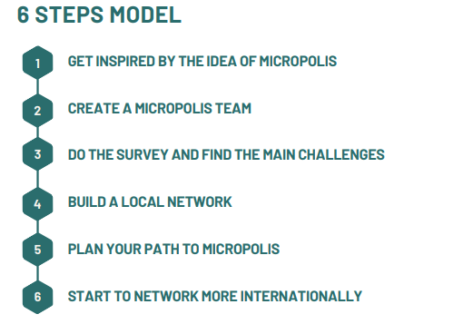
„Community is the foundation of healthy and sustainable human life on both micro and macro scales. It meets the psychological, emotional, and physical needs of individuals and forms the basis for a democratic and active society. Therefore without a shadow of a doubt, it is worth investing in building and strengthening local communities!”
the 6 Steps Model: we hope it may be an universal and useful tool for NGO’s but also for Municipalities, Culture Centers, Libraries, Schools and the individual activists who want either to start with well-planned community works or want to be more effective and advanced in their community-developing efforts.
During the 16-month Micropolis project, we gathered knowledge and experience from various international organizations and experts, tested all 6 steps of the model and we observed the positive effects of this designed way of working with the local community.

Slide 9
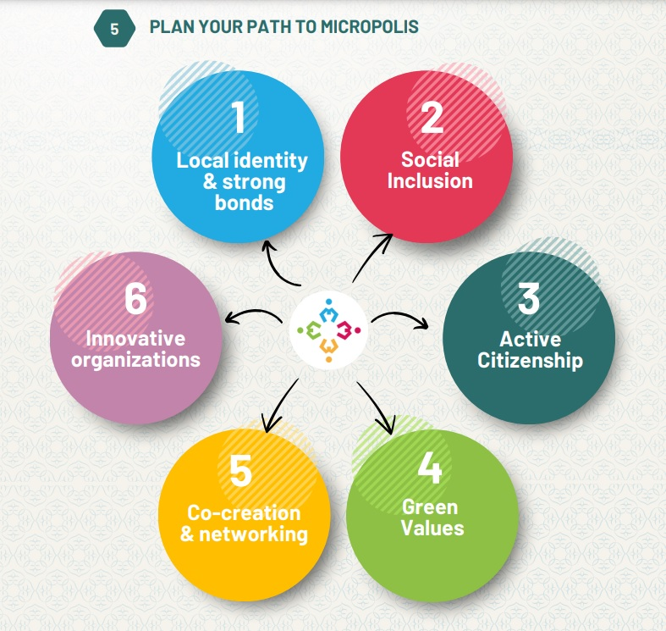
There are various paths that you can follow to build strong (in the meaning – powerful, vibrant and well-functioning) local communities.
The names of paths are more like hashtags# - showing the main element of the path but all the presented methods and Case Studies work with various elements of the paths, so it’s just a way in which we organized the know-how (and not very precise and separated methodologies).
Here are the paths that we find the most effective and of strategic importance in building strong local communities. Choose the paths that you find the most suitable for your organization and for the local community

Slide 10
Examples and Case Studies in the Guidebook
Middelfart-Building Identity that Creates Bonds, Denmark
Film Club in Wawer Culture Center- how the local identity is connected with the local community, Poland
The "Culture Guides for Marginalized Social Groups" project, coordinated by Interfolk, Denmark
All Activity Houses in Malmö, Sweden
Examples of local activities in Middelfart that have strengthened active citizenship, Denmark
Neighborhood Volunteers in Debrecen, Hungary
Local Activity Spots in Wawer district, Poland

Slide 11
Examples and Case Studies in the Guidebook
IFS Survey: Most successful ways to foster participation and active citizenship
Green values and initiatives in Middelfart (Sustainable Clothes Production Workshops, Green Menu at Volunteer Centre, Stall at the People’s Climate Festival), Denmark
Co-Creation Across Three Societal Sectors in Middelfart, Denmark
Biggest challenges for the organizations (according to IFS Survey)
Transferring the ESG Framework to NGOs in Middelfart, Denmark

Slide 12
Follow us on the project Website: www.micropolis.club/ Join the Micropolis Club! ☺

