Slide 1


First-time international project realisers’ support network
EUROPEAN CONFERENCE: International cooperation. How to start it well?
21st - 22nd of September 2020
“Key competences and needs for support.
Report II on international projects management
in the civil society sector of adult education”
Hans Jørgen Vodsgaard
hjv@interfolk.dk
(+45) 51 300 320
Interfolk
Institute for Civil Society

Slide 2
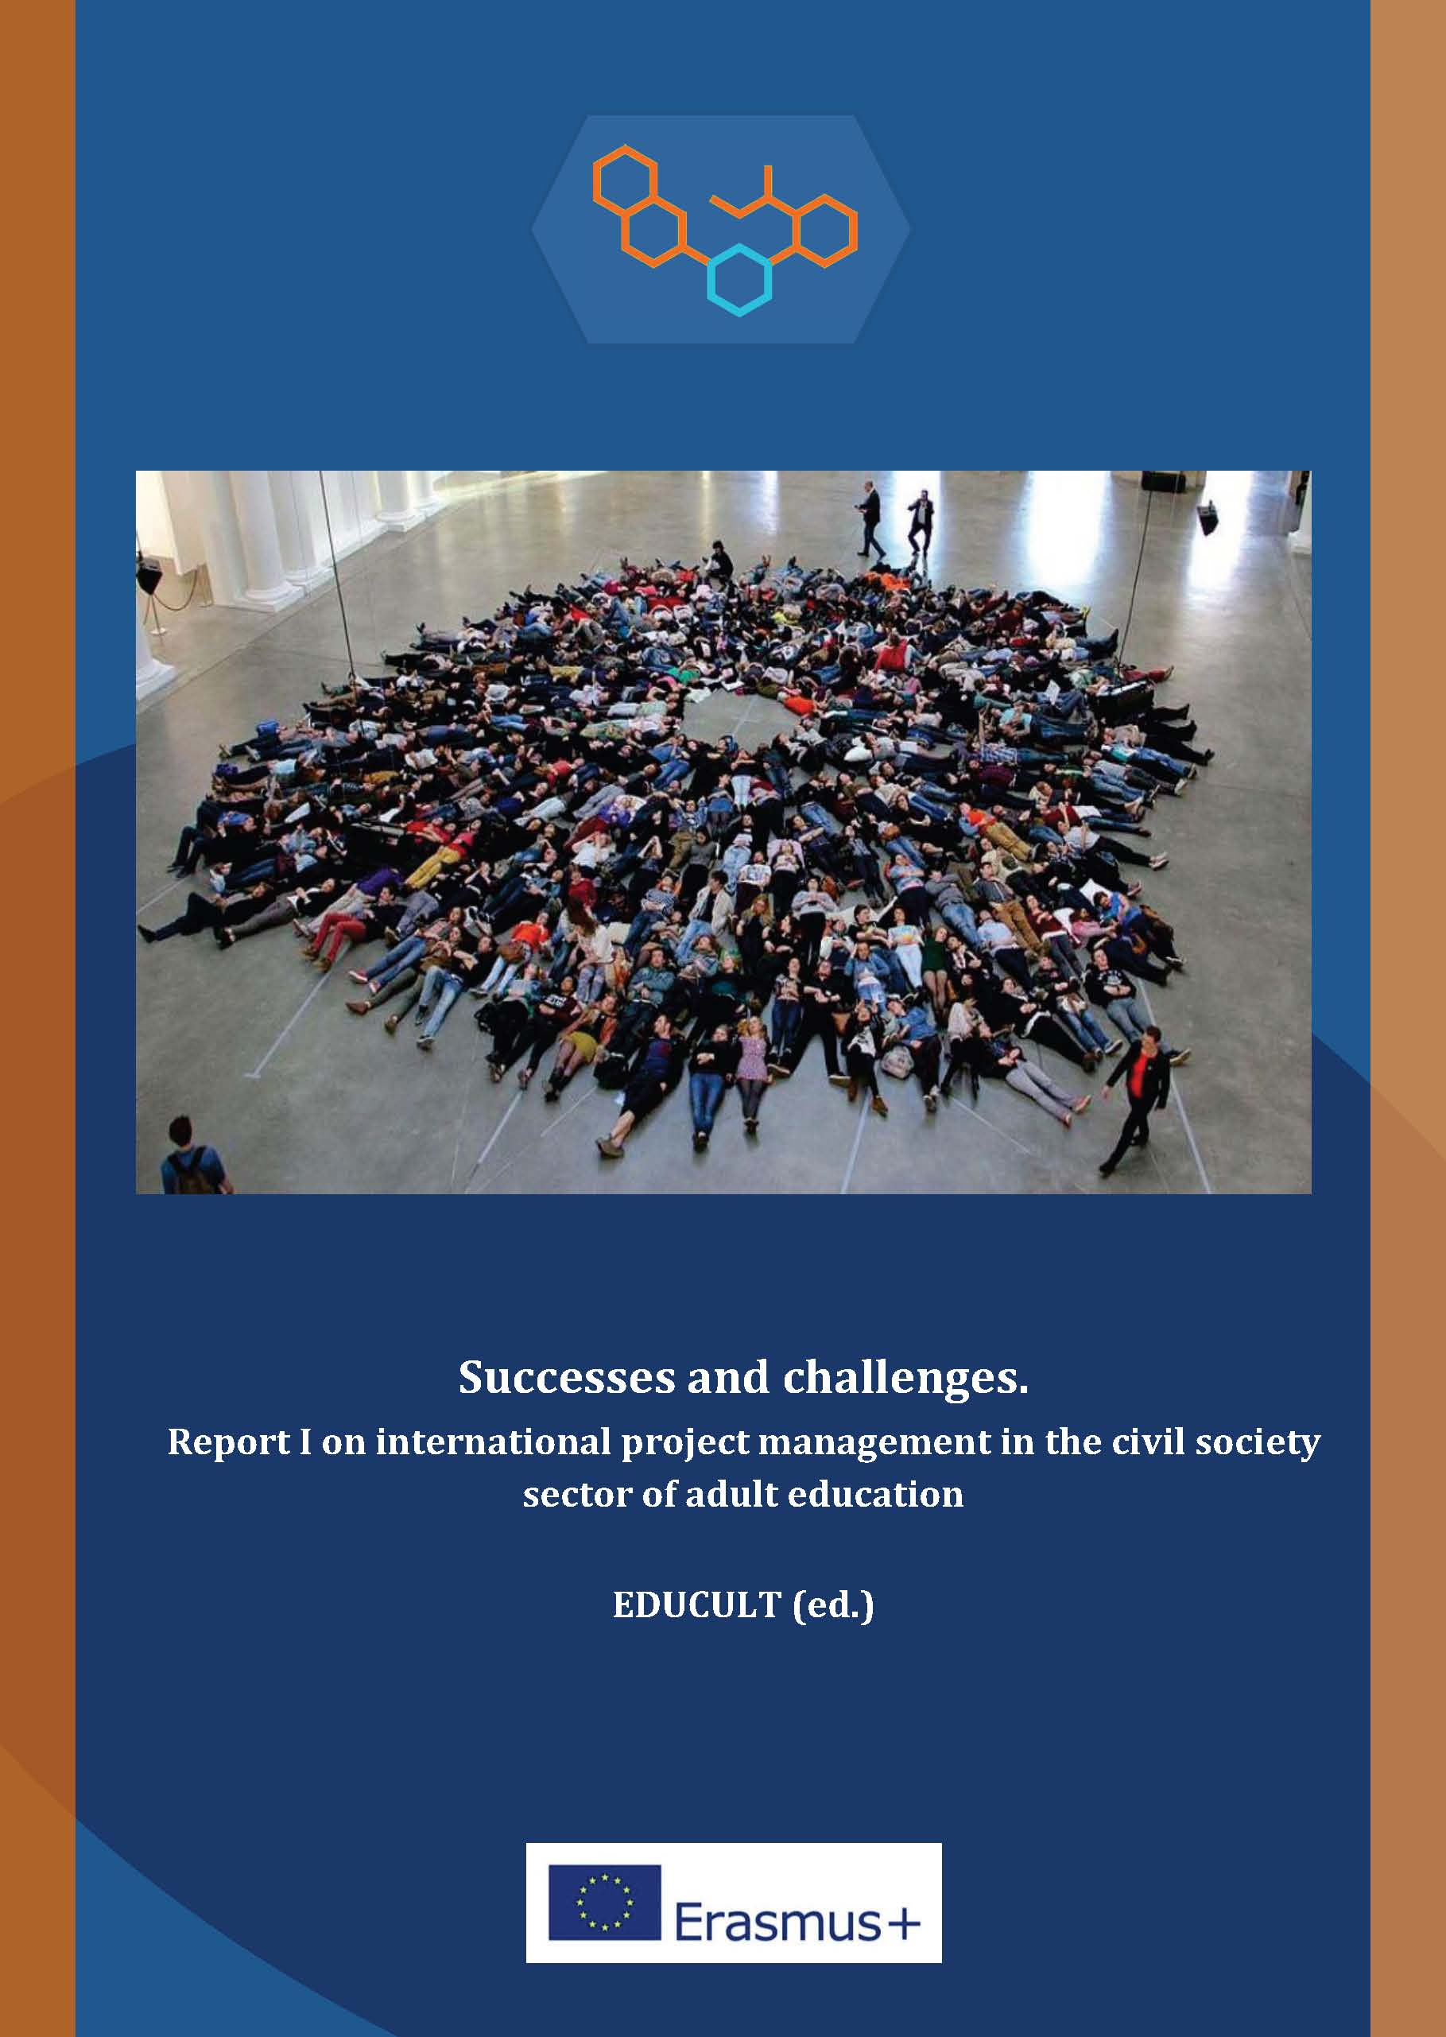
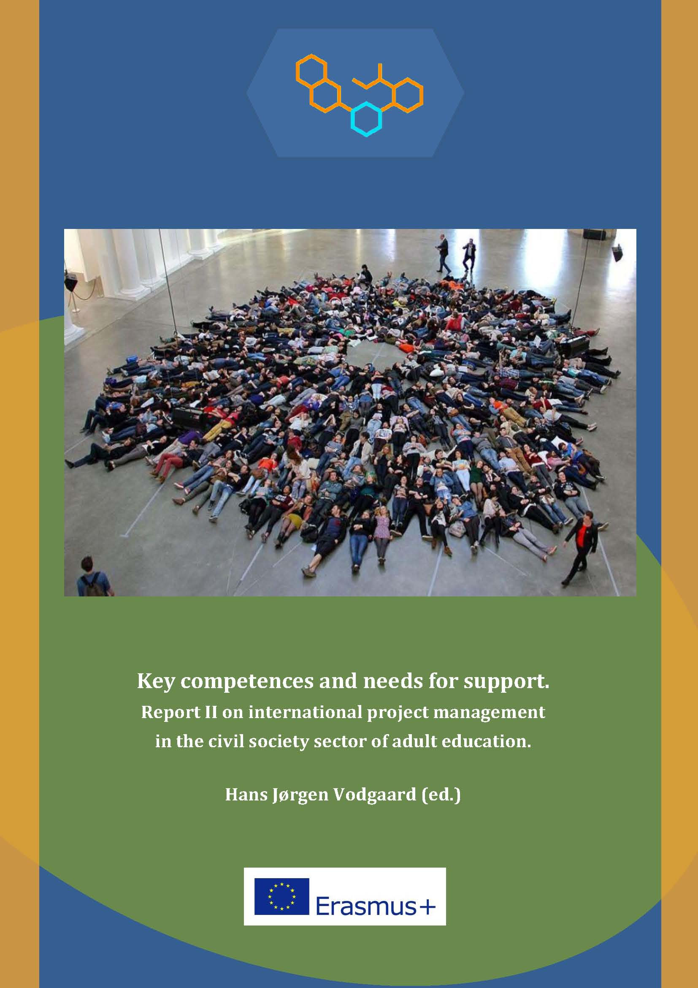
The two baseline reports

Slide 3
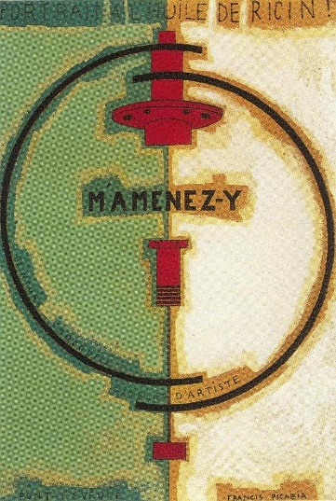
The initial problem definition for the project work
In general - the initial problem definition, which the project intended to address:
the relative low degree of international partnership cooperation and networking by the lifelong learning associations in the civil societies of the EU member states..
Many reasons, why the CSOs have a relative low degree of international activities.
Not due to lack of will, but rather lack of resources.
Difficult conditions for the CSOs compared to
other professional public and private organisation
that also apply for support from the same programmes..
Full time employed fund-raisers in big public or private organisations
contra voluntary staff in smaller civil society associations..
Picabia, M`Amenes-y, 1919

Slide 4
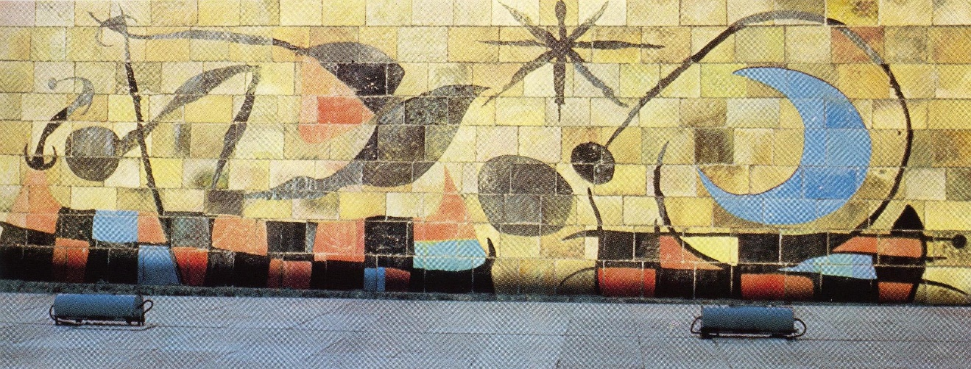
The objectives of the report
The objectives of the baseline Report II were:
to gain knowledge about key competences of successful project leaders engaged in international project work.
To clarify the beginners’ needs for support in general and especially from a new international network.
The survey used a combination of questionnaire and interviews with project managers and organisational managers in the civil society sectors within all participating countries (Poland, Italy, Austria, Hungary and Denmark)
Miro, The wall of the moon, 1958

Slide 5

Priorities for this presentation
The survey had many topics and presented many interesting differences of competence profiles and different needs of support between the
partner countries,
priorities of staff (project leaders) and board members (organisational leaders),
beginners and experienced project leaders.
Don’t have time to present all these differences.
Instead I will here focus on 4 topics:
The competence model
Important competences to improve
Needs for support from an international network
Supplementary ways to begin to work internationally
Delaunay, First disc, 1914

Slide 6
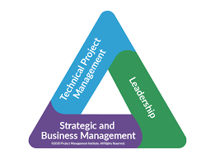
1st topic: The competence model / inspiration
For the survey we elaborated a draft / a preliminary competence model, that helped us to structure the questionnaire and interview guide.
This draft model was inspired by the PMI Triangle,
developed by the Project Management Institute
with main office in Philadelphia, USA
– see www.pmi.org
It focuses not only on the two typical sides,
technical and leadership skills,
but includes a third strategic and context conscious side
According to the PMC triangle, the ideal competence set for project managers include three main areas of competences:
Technical project management: Technical competences to function as manager
Leadership: Ability to build team spirit, present visions for your team members and inspire them to achieve the goals.
Strategic & business management: Expertise in the area of activity that enhances the strategic planning and performances.

Slide 7
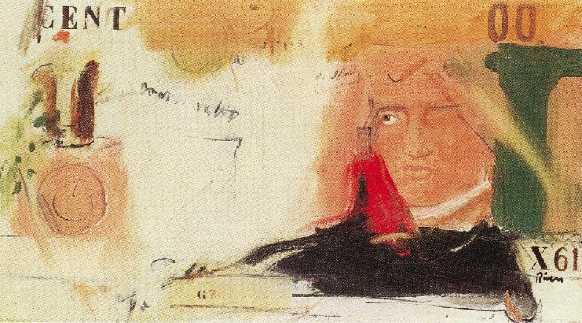
2nd topic: The competence model / must be adapted
The third strategic side is important not least for Civil society Organisations (CSOs)
Because the civil society (third sector) is organised by another logic and based on other values, than the public sector (first sector) and the market (second sector).
It is based mostly on voluntary work by engaged people that are active in their free time. They do it as “amateurs”; it means con amore and not for money (salary).
The activities is not based on whether the products can be sold and give a profit (economic rationale) or based on legal regulated services (bureaucratic rationale)
So the coordination of volunteers’ work must be different from coordinating
paid public servants or private employees.
All in all it must change the needed
competence profile
not only for the strategic planning,
but also for parts of the technical skills
and leaderships skills.
Rivers, French money, 1962

Slide 8
2nd topic: Competences to improve
For our adapted PMC Triangle, we from own experiences listed the most important competences to have for project managers engaged in European collaboration in the area of non-formal and informal adult education,
We constructed the triangle with 10 competences in each leg, in all 30 competences, where the respondents should tick 3 of the 10 competences in each leg, they found most important for themselves to improve to become a better international project manager in this CSO field.
NB1: We discussed, if we should reduce the numbers, for examples to only 6 competences per leg; but we decided to have quite many, so the respondents had more options to choose among.
Furthermore, we added and open question, where the respondents could propose an extra competence for each leg, which they missed or also saw as important to have.
NB:2 We did not develop the model to clarify the ideal competence profile, but just to clarify the respondents’ possible needs for improvement. Fx English as working language!
The model is preliminary, a draft we still need to develop and refine,
so it can stand in its own right (instead of being a analytic mean for a survey)
- maybe in a later project for the new network.

Slide 9

2nd topic: Competences to improve / conclusions
The survey indicated that
The respondents expressed clear needs for competence improvements to become successful project leaders in the international CSO field.
But the needs for competence development vary a lot between the groups of respondents, both regarding experience, position, area of activity and country.
So it seems difficult to provide a common course programme or other support services that suits all groups.
Instead it seems more appropriate to offer some general topics for all
  as well as offer specific courses and services to meet special needs of some of the groups.
Arthur Dove distraction 1928 - 610
Picabia, M`Amenes-y, 1919

Slide 10
2nd topic: Technical skills to improve / all groups
Baseline report 2: page 11

Slide 11
2nd topic: Leadership skills to improve / all groups
Baseline report 2: page 12

Slide 12
2nd topic: Strategic skills to improve / all groups
Baseline report 2: page 12

Slide 13
3rd topic: Needs for support from new network
The report also tried to clarify, what kind of support
the project leaders and organisational leaders could want from an international network
The main question about need of support presented three types:
  common development of international projects,
  networking opportunities, and
  training services.
All three proposed services got a high value in average for all partner countries :

Slide 14
3rd topic: Needs for support / priorities
Overall, the respondents seem interested in all the three mentioned types of support. However:
it is noticeable that the networking and common planning overall got a higher score than the training services,
and it may indicate that the design of possible training courses should try to integrate the networking and shared project planning in the programmes of the international courses.
Likewise, the interviews confirmed in varied ways this high priority of getting a forum, where it can be possible on a peer-to-peer level to develop new contacts and to exchange experiences and knowledge with partners from other countries.
This need was especially expressed by the inexperienced or first-time international project managers that wished to be engaged in international project cooperation.

Slide 15

4th topic: Other ways to begin to work internationally
It was not examined in the survey,
but there is other and easier ways
to start with international work
than being an successful applicant
and subsequent project coordinator,
Other ways or entrances can be:
a) Local, bilateral, regional funding
b) Mobility instead of projects
c) Being partner instead of coordinator
Klee, Hauptweg und Nebenwege, 1929

Slide 16
4th topic: Other ways – A: national, bilateral or regional funds
  1) National funds:
    Fx: There are approx. 12,000 private Danish foundations, many supporting cross-border activities, and cultural exchange and study trips abroad, both for individuals and groups
  2) Bilateral funds for cross-border cooperation
  In the Nordic region, but also with bigger countries, fx Danish - German cooperation: -
  Kurskultur : http://www.kulturfokus.dk/kulturregion/kurskultur-tilskud/
  3) Regional funds, fx in the Nordic region
  Nordic Culture Fund / Nordic Culture Point
  NGO cooperation in Baltic Sea region / NGO cooperation in Nordic – Russian region
  Nordplus Adult
  NB: It is in general
  easier to make applications and report activities in these local, bilateral or regional funds than in the bigger EU programme,
  And the success rates are better.

Slide 17
4th topic: Other ways – B: EU mobilities
Mobility funding can be an easier way than project funding to gain new input and exchange of experiences!
  The success rate for Danish Erasmus Mobility applications is approx. 80 pct, while it for Erasmus projects is below 20 pct.
  It is also easier to manage and to report
  The application can be made by a consortium, where more organisation from the same country apply together.
Type of mobilities (from 2 days to 2 months stay in other EU country)
  Teaching/training assignments: Allows staff of adult education organisations to teach or provide training at a partner organisation abroad.
  Structured courses* or training events abroad: support the professional development of adult education staff;.
  Job shadowing: provides an opportunity for adult education staff to spend a period abroad in any relevant organisation active in the adult education field.
  *) 2nd option: Structured Courses :
  can include 3-6 days study visits for a group of staff
  to partner associations abroad to experience and learn from what they are doing.
  NB: This was also an issue in pilot mentoring with focus on preparing mobility applications

Slide 18

4th topic: Other ways – C: try to be partner
It can be another way to try to be a partner instead of coordinator
Be aware that 4 out of 5 organisations working internationally do it as partners.
And it is easier to try to be partner than coordinator
The preparatory work to be a partner
demands that an applicant organisation will be aware of your existence, so you must promote your organisation to potential applicants.
in partner search databases of the programmes and relevant social media platforms for project managers
Find names of former applicants in databases of relevant programmes and send direct mail; -more times iand n good time before the deadline of relevant programmes.
Develop contacts and network by being engaged in transnational mobility activities or more simple bilateral or regional projects
Or join the Erasmus+ transnational info- and contact meetings.
Bb
Dette billede efter Ukendt forfatter er licenseret under CC BY-NC

Slide 19

4th topic: Concluding – many entrances
  You can start your international work in many ways!
  You can start with small or big programmes, or start start as coordinator or partner
  But the choice doesn’t need to be an either – or; it can be both – and:
  You can promote yourself as partner at the same time as you initiate a new project application with yourself as coordinator.
  It is always good to have more baskets with eggs.

Slide 20

Perspectives – final remarks
These other ways to international cooperation emphasise
there are more entrances to international activities than just being a good project leader, and thereby also a need for a multifaceted support
  Both to be coordinators and to be partners
  Both to make project applications and to make mobility applications
  Both to be a good coordinator and a good partner in ongoing projects
  Both to prepare big EU applications and smaller national and regional applications
So a new network should plan a multifaceted support,
because there are many ways and entrances to start to begin and develop the international work!
Klee, Ad Parnassum, 1932

Slide 21

Thank you for your attention!
Time for questions!

