Slide 1


Good practice of co-creation:
3-day European pilot course
9 – 11 October 2019 in Copenhagen
3rd day: 10:15 – 12:00 / introductions
Competence profiles
of successful co-creators
Hans Jørgen Vodsgaard
Interfolk
Institute for Civil Society

Slide 2
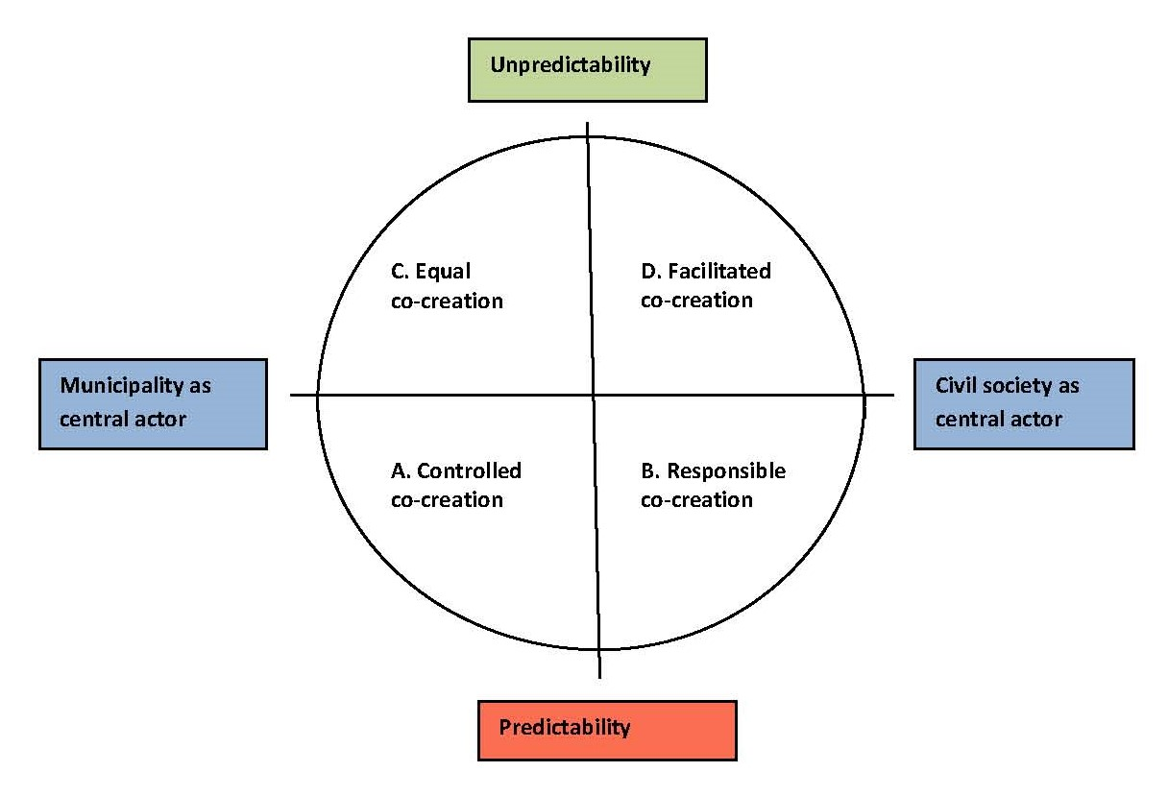
Competence need
  It seems clear that co-creation – especially in the form of citizen-driven co-creation - requires new competences both of the municipal officers and the civil society actors.
  See the survey report
  http://co-create.one/survey%20report/index.html

Slide 3

Competence need
  It is a challenge to find valid research on the needed key competences for successful co-creation, and the few examples I have found are mainly elaborated from the municipal point of view! (see the reference list at the end of this presentation).
  Below I present two examples of competence sets,
  provided by Danish researchers:
  Two master's theses in 2017, Roskilde University Centre
  The Leadership Academy, LEAD +

Slide 4
Two master’s theses / citizen-driven co-creation
  Two master's theses in 2017 from Roskilde University Centre (DK (Poulsen, Færch, 2017)
  acknowledge as methodological starting point that there are several models for co-creation, but they focus on the form of co-creation, in which the central actors are citizens and civil society associations.
  This form of co-creation is termed "citizen-driven co-creation".
  Defining citizen-driven co-creation
  Citizen-driven co-creation means, the citizens identify a problem, design the solution and initiate the project on their own. It is thus the citizens, who are the driving force throughout the project.
  The role of the municipality is here to support the project with the resources and knowledge that are crucial for the project to succeed.
  The municipality accepts that content, form and goals for co-creation are defined by the citizens and the outcome of co-creation is not possible to predict in advance.
  Citizen-driven co-creation implies new competences
  The case studies of the two master’s theses indicate
  the civil servants cannot play their traditionally role and take control and set the direction on the basis of the directives of the management and politicians,
  Instead they now must facilitate the citizens' work.

Slide 5
Two master’s theses / four new competences
In order to succeed in this new role, as facilitators in "citizen-driven co-creation“, the case studies identified four new competences, which the civil servants must master:
1. Facilitating
The civil servant should be less governing in the process to avoid to weaken the motivation of the citizens (avoid to weaken their sense of ownership):
Must be seen as a process facilitator rather than as a project manager
2. Build equal relationships
Have the ability to meet the citizens and other actors in a more equal and dialog-based relationship.
Must be able to motivate the citizens to share attitudes, experiences, resources and ideas.
3. Act as liaison
Can act as a liaison between the citizens and the municipality.
Must secure a balance between the interests of citizens and the politically agreed guidelines.
4. Adapt to changing situations and needs
With citizen-driven co-creation, every situation and project is different - therefore the official must continually adapt his own role and effort and assess which resources are needed.
the official must have a large individual responsibility in relation to managing and shaping his own role, because it cannot be defined in advance.

Slide 6
Two master’s theses / the institutional framework
The two master’s theses point out that the success of the civil servants also implies that the municipalities adapt to the following three requirements:
Drop the zero-error-culture to gain more room to experiment and to go new ways, so it is accepted that not all new projects succeed in the first attempt.
Introduce short decision-making procedures to make it possible to quickly help citizens further, so that they do not get tired and demotivated during the project
Provide a free framework for the civil servants, so they are able to pursue the citizens' needs by having a more fluid role in the municipal institution.
In conclusion the master’s theses
mention that the need for new competence profiles of the civil servants, should not replace the former more traditional competence profiles.
The new co-creative role functions more like a supplement to the old roles, and can be used when the municipality aims to involve the citizens and civil society associations more in providing local welfare services.
NB: The ability to work in unpredictable and changing contexts implies high competence levels (and higher salary?)
See the EU Commission’s European Qualifications Framework (EQF)
https://ec.europa.eu/ploteus/content/descriptors-page

Slide 7
The Leadership Academy, LEAD +
  LEAD+ divides the needed competences for co-creation into four abilities:
1. Analytical competence (to clarify the given context of co-creation)
  Aware of what type of co-creation you are a part of and thus also be consciously about your role in the concrete co-operation processes.
2. Strategic competence (to plan the most appropriate form of co-creation)
  Can work strategically - It means to be aware of the types of co-creation that are most appropriate in the given situation.
3. Risk willingness
  Can handle the unpredictability that is part of co-creation. Many public organizations are characterized by a degree of zero-error-culture - and managers and employees prefer to avoid taking chances than risking mistakes.
4. Attentive and responsive
  In equal co-creation processes, management is not just something that goes down from above. As a leader you must also be very attentive and responsive to the needs expressed by the actors involved in the concrete co-creation processes.
  .

Slide 8
The Leadership Academy, LEAD +
Final clarification
LEAD+ also point out that the new roles with co-creation must live side by side with the classical roles as civil servants based on authority and compliance
Therefore co-creation shall not replace, but rather supplement the classic objectives
“to made the services cheaper and more efficient", and
"to ensure that the rules are followed".
The key message in co-creation seen as a paradigm shift is:
The challenges in our society are so complex and resource-intensive that we must seek to complement the traditional approach of public services with new approaches.
Or even sharper: Governmental monopoly to solve societal problems is inadequate. We must also find ways to ensure that a wider range of actors can create welfare.

Slide 9
Possible competence for co-creation
References
Ulrich, Jens; Nielsen, Kim Martin & Bartram, Jan: Ledelse af samskabelse. In Offentlig Leadership Pipeline 2.0. Download: https://lead.eu/wp-content/uploads/2018/10/Den-Offentlige-Leadership-Pipeline-2.0-Ledelse-af-samskabelse.pdf
Bresser, Babette; Andersen, Sofi e Amalie; Kok, Sanne; Beuschel, Nikolaj; Billekop, Sofi e Marie (2013): Et magasin om samskabelse. Inspiration til velfærdsmagere. Udgivet af Frivilligrådet i forbindelse med Frivilligrådets årsmøde 2013
Ingerfair – udvikler bæredygtige frivilligmiljøer (2018). Grundkursus i Samskabelse. See https://www.ingerfair.dk/kursusportal/grundkursus-i-samskabelse/
Poulsen, Lea & Færch, Cæcilie (2017): Embedsmanden som samskaber: Her er fire afgørende kompetencer. Artikel RUC 04.09.17.

Slide 10
Municipal officer competences versus citizen competences
Unfortunately, I haven’t found any surveys that focus on and present competence profiles for citizens or volunteers from civil society associations.
My thesis,
we can transfer the new civil servants competences to citizen groups and civil society associations, especially regarding “citizen-driven co-creation”, where the citizens
must act both as resourceful co-initiators, co-designers and co-implementers
and the outcome is most unpredictable and demanding to manage.
In “citizen-driven co-creation” the citizens must have the resources and competences
To take the initiative and define a problem and thereafter engage the municipality and other stakeholders,
To facilitate the co-design of new solutions, and
To take part in the project as co-implementers to provide the planned services.

Slide 11
Possible set of competence for co-creation
The ideal competence set for persons involved in citizen-driven co-creative projects can include the following combination of knowledge, skills and behaviours in:
Knowledge:
General knowledge of co-creation - basic history, theory and practice.
Strategic knowledge – of different types of contexts and tasks of co-creation
Regulatory compliance - insight in legal and political limits for co-creation activities.
Skills:
Process facilitation
Moderation of idea workshop
Situational project management
Behaviours (attitude and values):
Attentive and responsive
Risk willingness
Open and dialogue oriented

Slide 12
Session A: Lead questions
Please discuss and clarify the ideal competence set for initiating new and/or facilitating ongoing co-creative activities.
  Which knowledge do you find most important for respectively
  a) to initiate new co-creative activities; and
  b) to facilitate already ongoing co-creative activities?
  2. Which skills do you find most important for respectively
  a) new co-creative activities; and b) ongoing co-creative activities?
  3. Which behaviours (attitudes and values) do you find most important for
  a) new co-creative activities; and b) ongoing co-creative activities?
  Which type of competences (knowledge, skills and behaviours) do you find most
  important for being a good initiator and facilitator of co-creative culture activities?
  Please mention 3-4 competences you find most important to strengthen to
  become a good co-creator.
  6. Other topics regarding needed competences you wish to mention?

Slide 13

Thank you for your attention!

