Slide 1

Co-Creation in
Guldborgsund Muncipality
Du finder forskellige
opstillinger af dias i fanen ”Startside” under ”Nyt dias”.
- On leveraging community as A KEY driver in wellfare DEVELOPMENTS/solutions

Slide 2
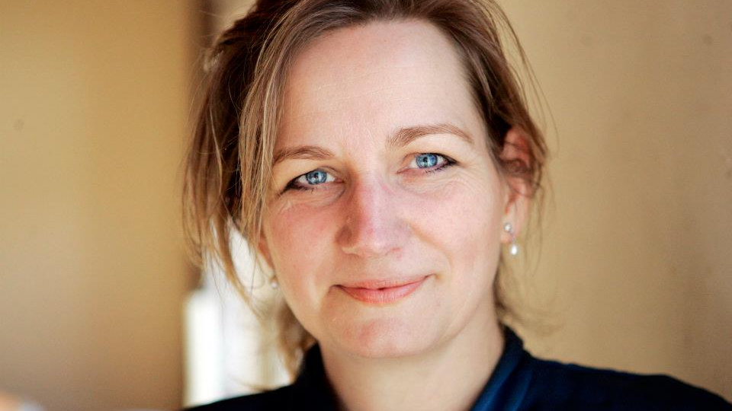
Helle Bertram
Special CONSULTANT CO-CREATION
Cand.mag (M.a. Degree)
BUSINESS COMMUNICATION
Business coach
WRITER
Fundraiser

Slide 3
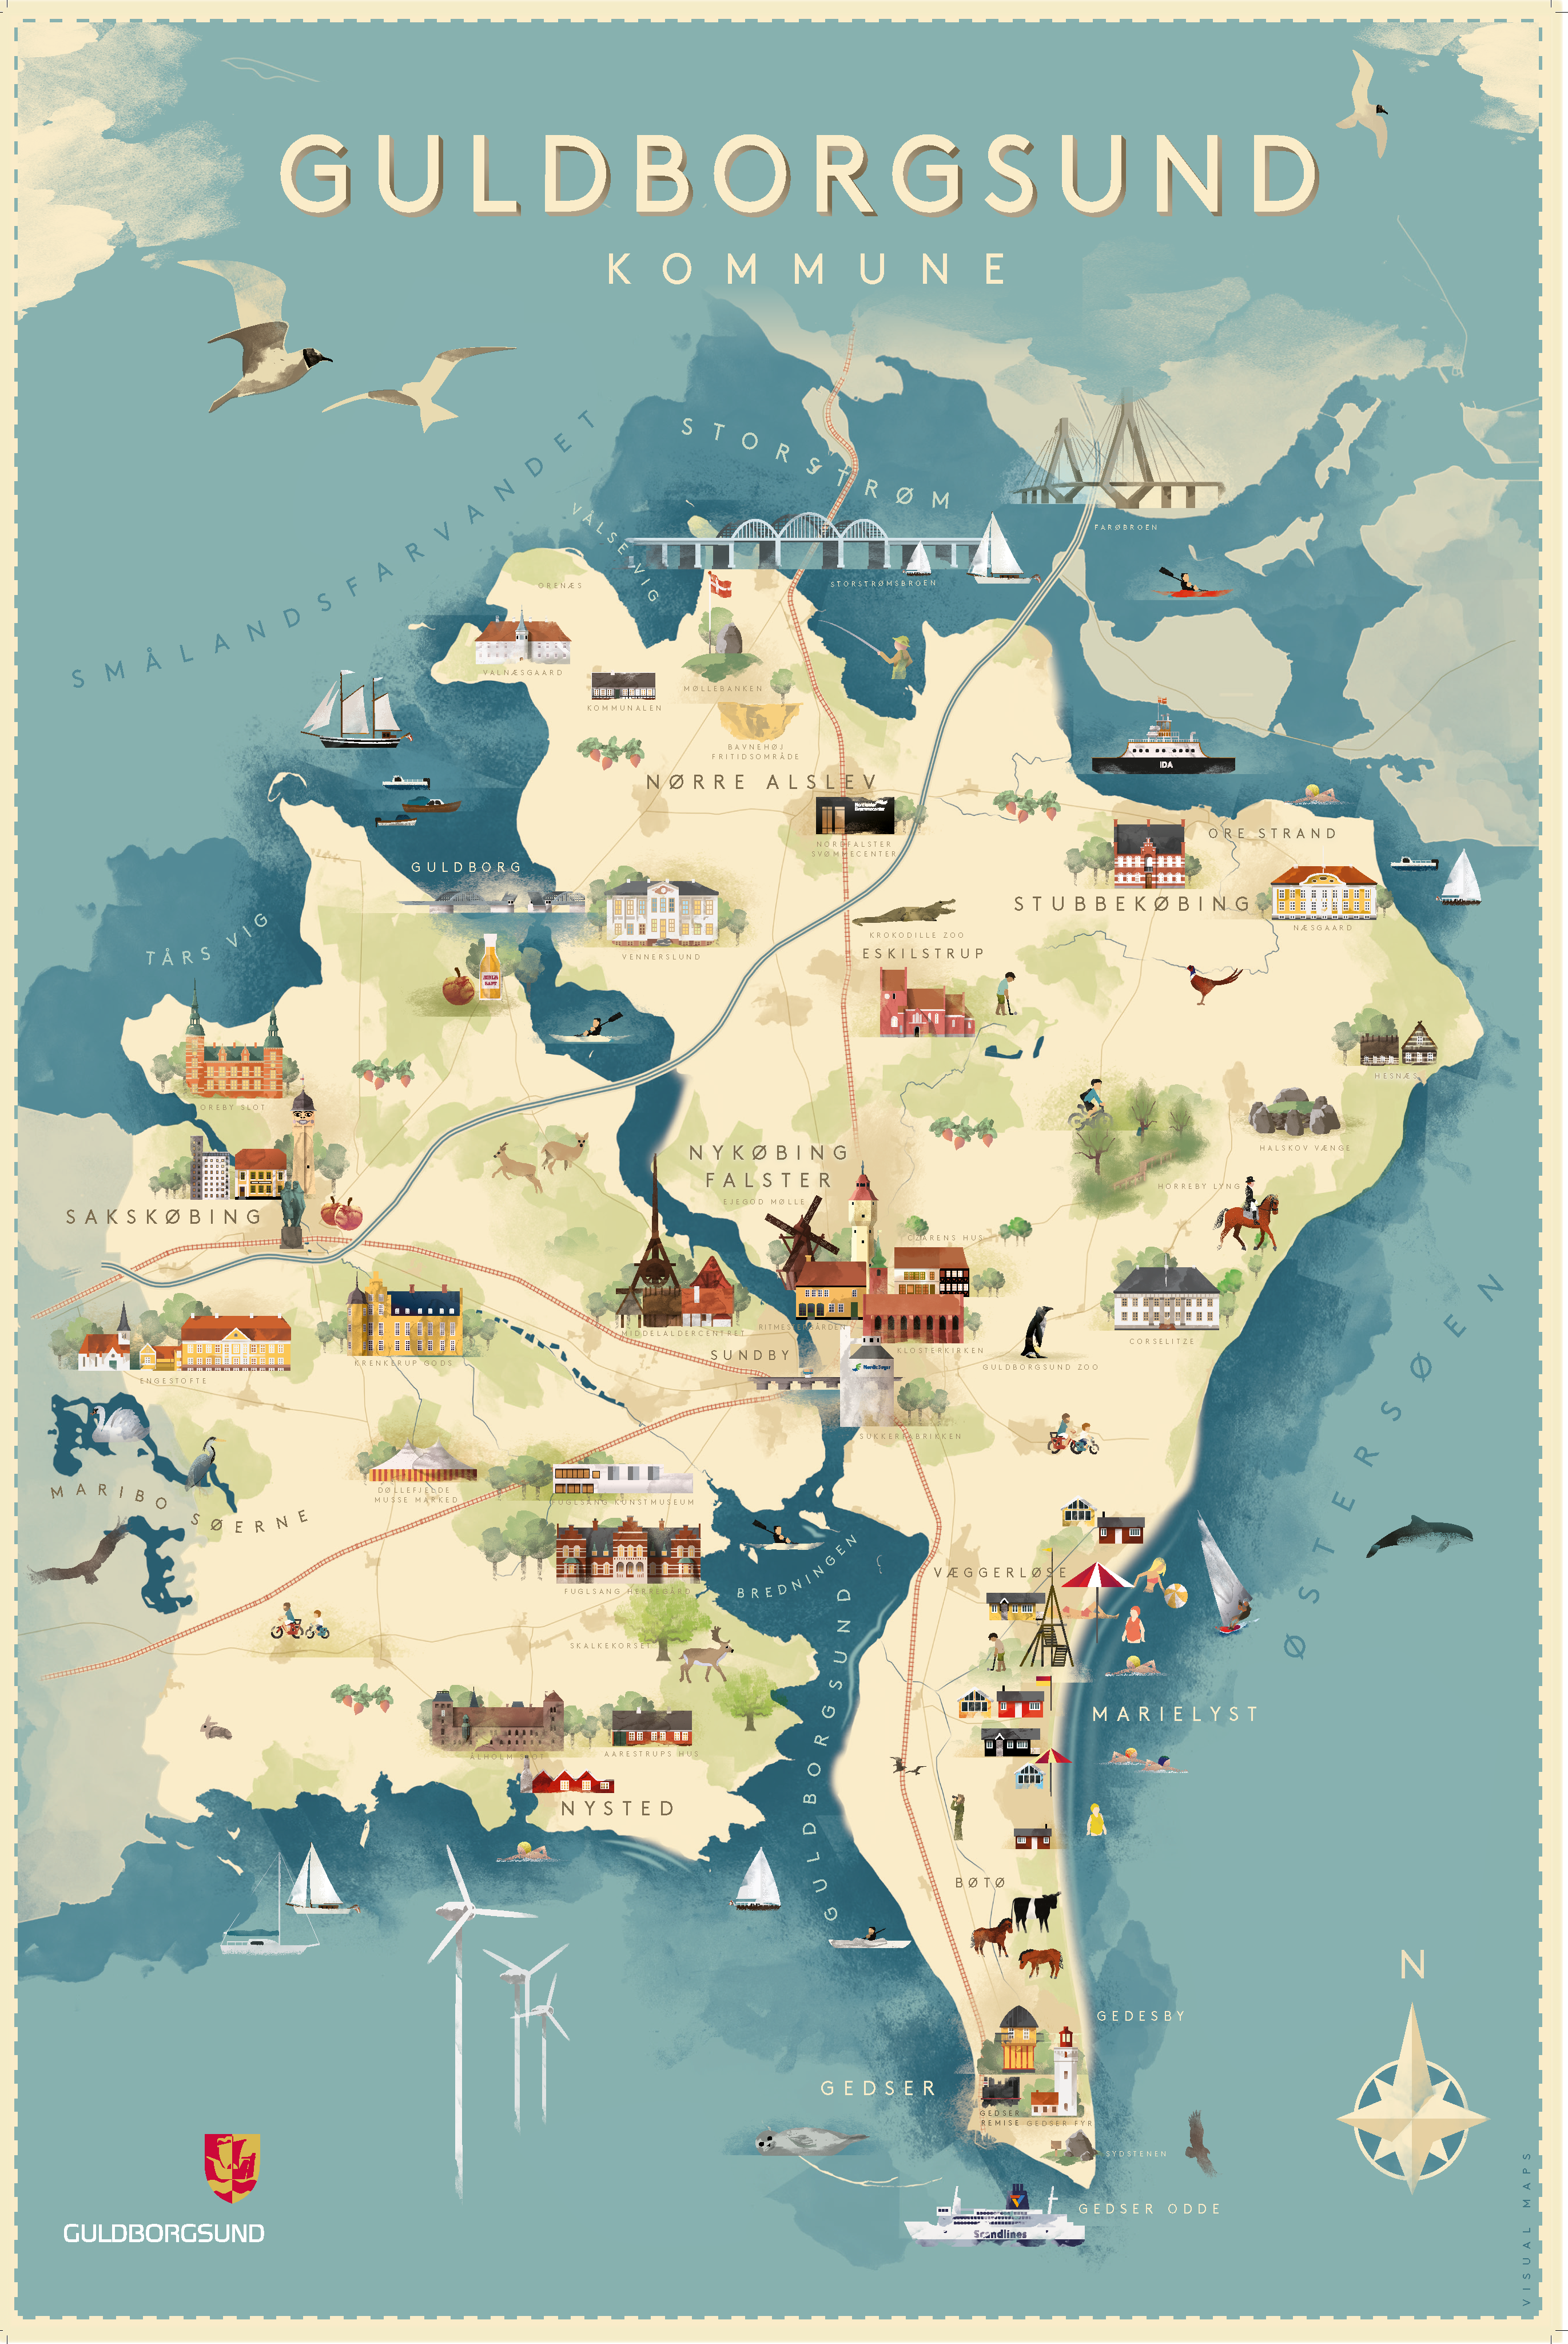
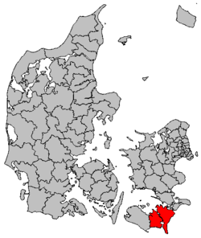
OUR LOCATION

Slide 4
WHAT IS CO-CREATION
IN YOUR UNDERSTANDING …?

Slide 5
BACKGROUND FOR CO-CREATION
At the edge; 100 DAYS WITH CO-CREATION
RECOMMENDATIONS FOR THE EXECUTIVE GROUP; BEGIN AT ”THE BOTTOM” AND LET THE PERSONS WHO REALIZE THE BENEFITS first RUN WITH THE BALL
Education and COMPETENCY BOOST through JOINT COMMUNITIES

Slide 6
”THE ROSTOCK CONCLUSIONS” (2015)
We want to get closer to the citizens to create a close community and involve the citizens in relevant decisions. We want to do this because we think that all citizens are an important resource with shared responsibility and having a role to play in our municipality. We accomplish this by being more facilitating and opening at an early stage a dialogue with citizens, clubs, associations and other actors. It is about creating small local communities and cross functional communities within the large community. ”The Guldborgsundske Mindset”

Slide 7
MOVE AWAY FROM | MOVE TOWARDS
Silo Thinking | Unities and coordination
Political micro management | Political framework control/ trust in management
Bureaucracy | Crossfunctional solutions
”Them” / ”Us” (citizens >< municipality) | Citizens participating and sharing responsibility
Monologue and one-way communication | True dialogue and participation
”The Right of the Authority” | Citizen involvement
Control | Trust
Standardization – same solution for all | Individualization – fits the individual
Ordering | Co-creation/co-production
Polarization | Getting together
Citizens = Customers in the service shop demanding their rights | Citizens = Active people with a lot of resoures contributing to our wellfare

Slide 8
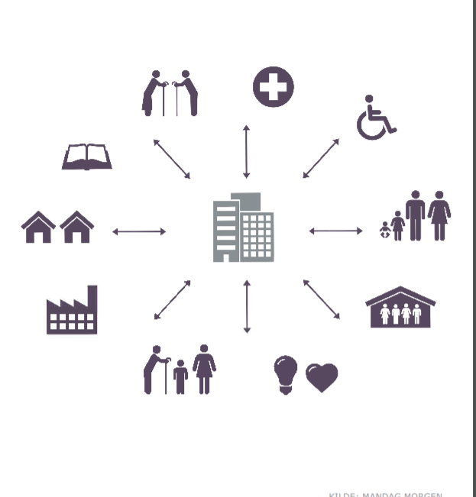
BEFORE

Slide 9
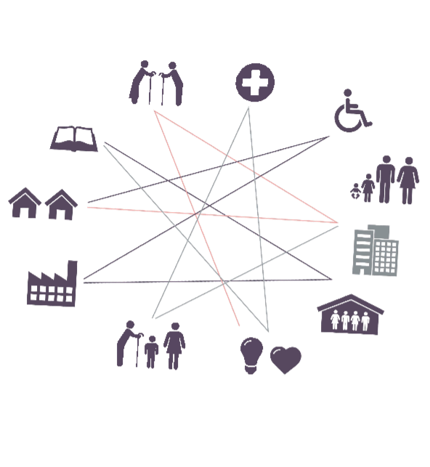
NOW

Slide 10
6 Principles
LEAD THROUGH PROCESSES INSTEAD OF LEADING THE PROCESS
BE A FACILITATOR AND NOT A MANAGER - LET GO OF THE CONTROL
EXPAND THE PROBLEM STATEMENT – START BY RE-EXAMINING THE PROBLEM!
Give up the right of initiative and prepare the ground for for other people taking the initiative. Be responsive to the need of your surroundings
Explore the unknown, support areas for co-creation and participation
Think big and start small by linking to what alreay exists

Slide 11

Actual Initiatives
Community – knowledge forum
community - workshops
community – facebook group
Diploma in co-creation - INTERNal
-presentation for management group
Academy training – internal
work environment day – 400 participants
management day – 400 participants
17,4-committee

Slide 12
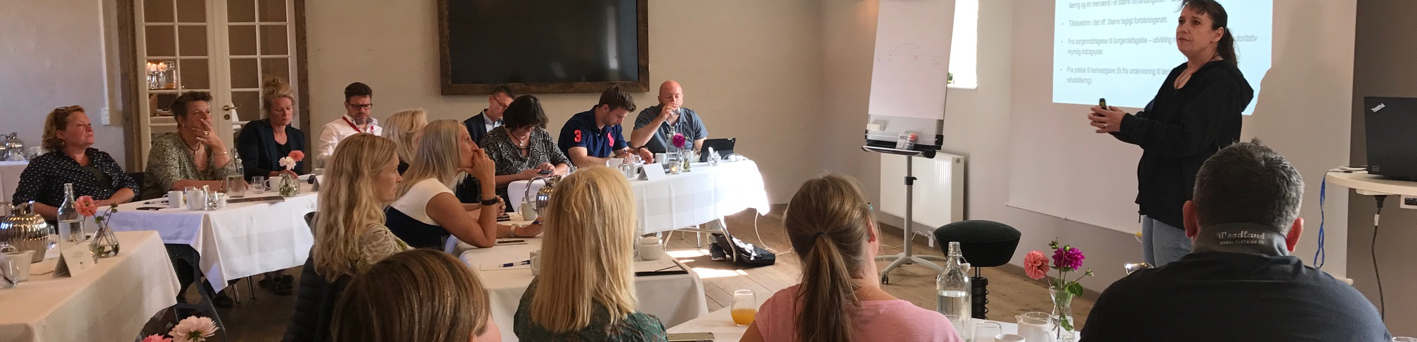
AHA´s
”not everything is co-creation. Many great welldriven collaborations should not be replaced by co-creation”
”trust is key to allow room for co-creating processes”
”the municipality must adjust physically and behaviourally in ways that open up for wellfare solutions, so other actors can offer their input and ideas”

Slide 13

”It is really great that you give your clubs and associations the opportunity to know more about what we think we do – including our self perception, and perhaps even to push us to the next level, if we change perspective just a little bit – ”Lykke & Fremgang” is based on co-creation, even if we did not really know it 😊 ”
mail 21 september 2018, Stine Pilt, ”Lykke & Fremgang”

Slide 14
The ”Difficult Stuff”
”what is co-creation – in real-life?!”
”we are already working together”
”it takes too much time, we also have to do our usual job”
”is it not just another way to save money?”
”I have worked here for years, this FAD will surely pass”
”but we are the ones with the knowhow and competencies”
”we can’t find any ”volunteers””
”what happens if they want something completely different than we want?”
”what is the role of the politicians if the citizens are the ones making the decisions?”

Slide 15
WHAT CHALLENGES DO YOU SEE?

Slide 16
THANK YOU FOR MAKING ME A PART OF THIS SESSION

