Slide 1


Good practice of co-creation:
3-day European pilot course
9 – 11 October 2019 in Copenhagen
The UN Sustainable Development Goals
Hans Jørgen Vodsgaard
Interfolk
Institute for Civil Society

Slide 2
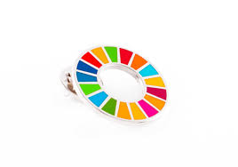

The UN pin
The pin is not a symbol for the Rainbow flag.
or the PRIDE festival or the LGBTQ movement
( lesbian, gay, bisexual, transgender and queer)
It is a symbol for UN’s Sustainable Development Goals

Slide 3
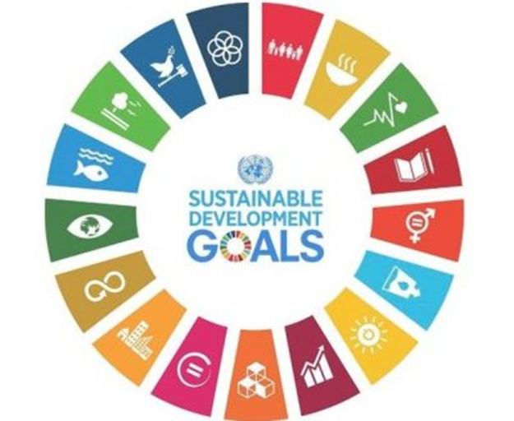
The UN Sustainable Development Goals
In 2015 the UN adopted 17 Sustainable Development Goals (SDGs) that establish a new framework a better and more sustainable future for all towards 2030. The SDGs are universal and apply to all countries
The 17 SDGs including 169 part goals replace
the eight Millennium Development Goals (MDGs).
With the SDGs the UN member states have committed
themselves in all countries by 2030 to:
  environmental development
  securing peace and security.
  poverty reduction and social development
  ending hunger completely,
  ensuring education for all,
  securing health
  promoting decent work and sustainable economic growth

Slide 4
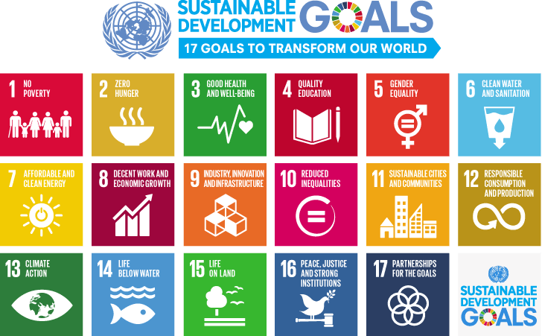

Slide 5
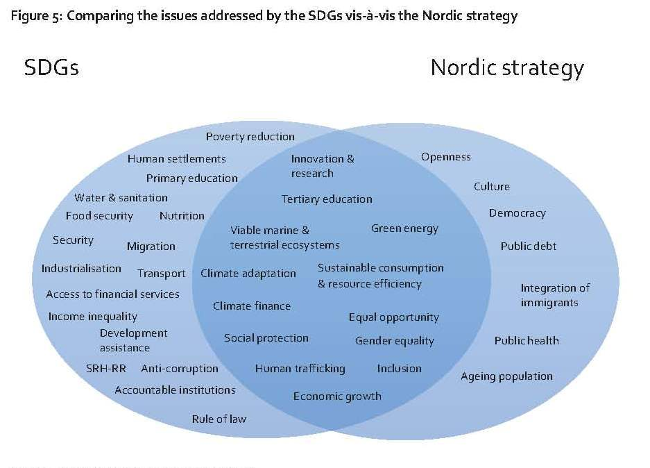
“Sustainable Development Action – THE NORDIC WAY
Implementation of the Global 2030 Agenda for Sustainable Development in Nordic Cooperation”
Nordic Council of Ministers 2017, page 70

Slide 6
Sustainable development goals
All member states have committed themselves to these goals.
Everyone is needed to reach these ambitious targets. The creativity, knowhow, technology and financial resources from all of society is necessary to achieve the SDGs in every context.
Achieving the SDGs requires the partnership of governments, private sector, civil society and citizens alike to make sure we leave a better planet for future generations.
Sustainable development goals can / should be
part of all areas of NGO activities, also in the cultural field.

