Slide 1
Middelfart
Cultural Activities and Sustainable Communities

Slide 2
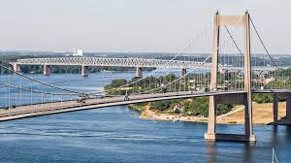
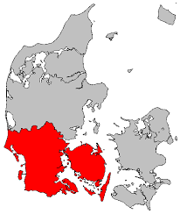
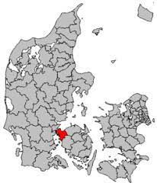
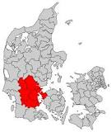
Middelfart Municipality
Located on Funen (1)
Two Bridges
Covers an area of 297 km²
Approx 41.000 inhabitants
Part of The Triangle Area (2)
Part of the Region of Southern Denmark (3)
1
2
3

Slide 3
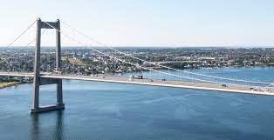
Strategy and political ambitions
Vision of the City Council 2030: We built bridges
Create active and healthy communities
Strengtening involvement/a strong ”we”
Easier for citizens, associations and
companies to take the initiative for
activities that promote communities
Support associations, cultural players
and the unorganized and sometimes
spontaneous cultural life
All citizens to feel pride
Cultural and leisure life must be
based in local communities

Slide 4
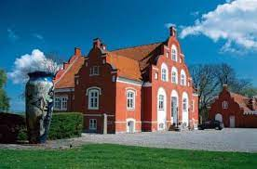
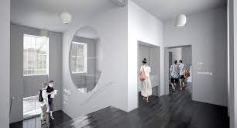
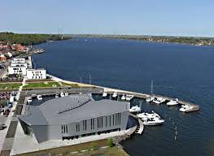
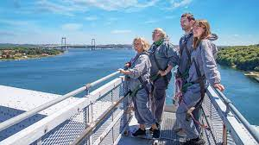
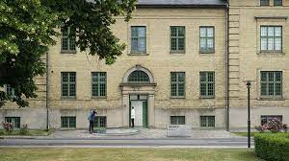
Popular cultural attractions
CLAY Ceramic Museum
Bridgewalking
MIND Museum
KulturØen

Slide 5
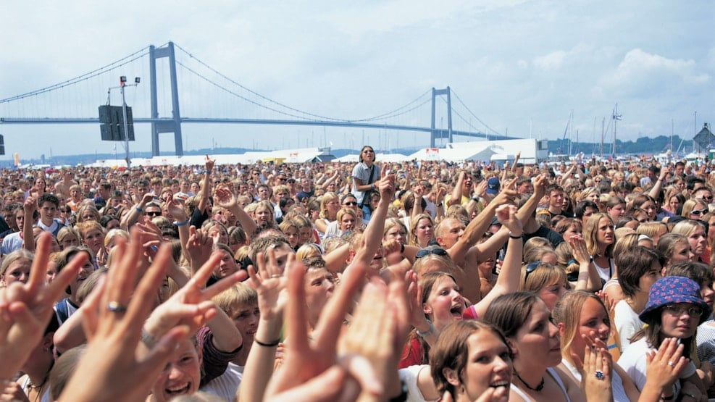
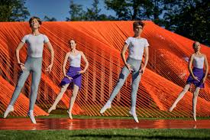
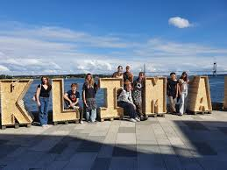
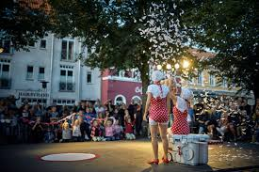
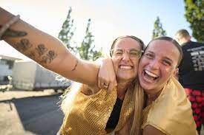
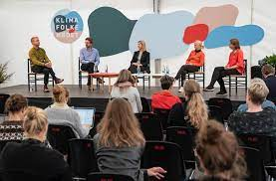
Significant events
Rock under the Bridge
Strib Winter Festival
The Triangle Festival Week
The People’s Climate Festival

Slide 6
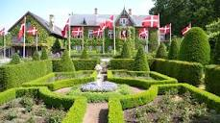
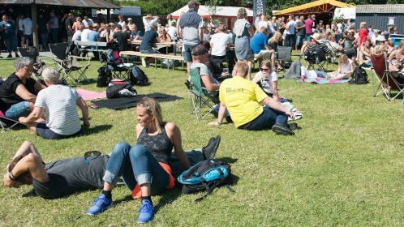
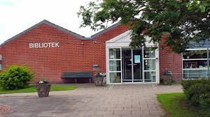
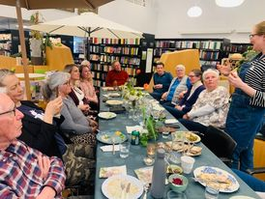
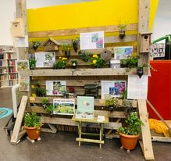
Cultural communities throughout the municipality
Humlemagsinet i Harndrup
Balslev Festival
Four public Libaries: Ejby, Nørre Åby, Strib, Middelfart

Slide 7
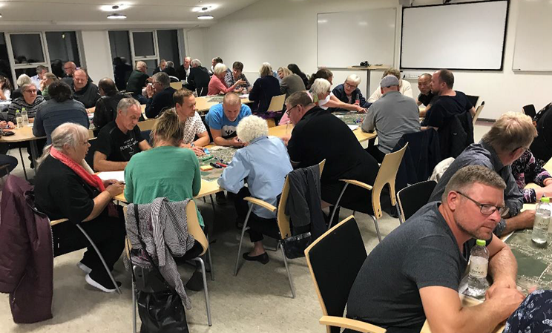
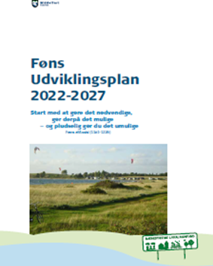
Local substainable communties
12 local committees in Middelfart Municipality has been settled in 2019
Goal:
making local communities in Middelfart Municipality stronger
An open dialogue with citizens about issues of local importance
How:
Strategic local development plans (LUPs)
The city council invites the local committees min. once a year for a dialogue meeting
8.000 DKK pr. year to support the committees work
Examples: Fælleden in Føns, Outdoor facilities in Varbjerg Welcome to new citizens in Fjelsted Harndrup

Slide 8
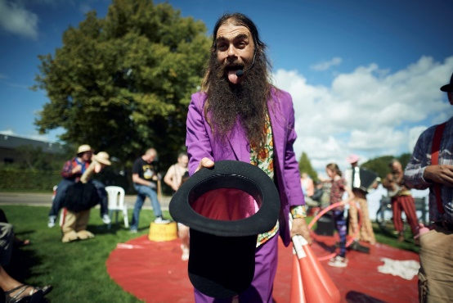
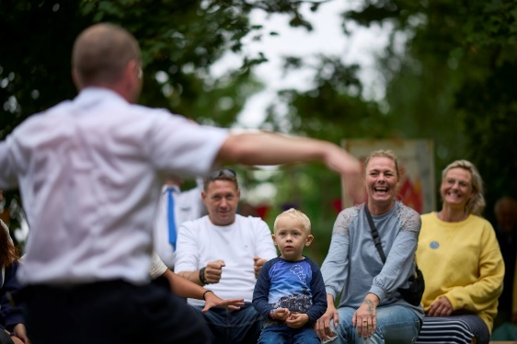
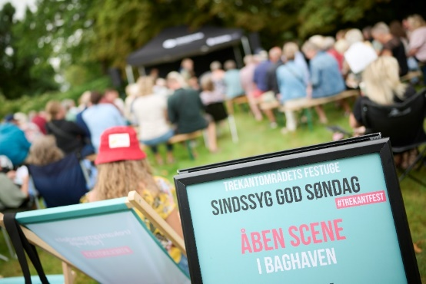
Crazy Nice Sunday
Part of the Triangle Festival
Take place in Teglgårdsparken/at the old psychiatric hospital in late august
Established in 2016
Focus on mental illness and mental health
Goal: de-taboo mental illness
Lots of cultural activities: concerts, walks, readings, debates, art exhibitions, street theatre, workshops etc.
It’s free and everyone can join
Behind: MIND museum, Middelfart Kultur & Bibliotek (the library ) and the Mental Health Services in the Region of Southern Denmark

Slide 9
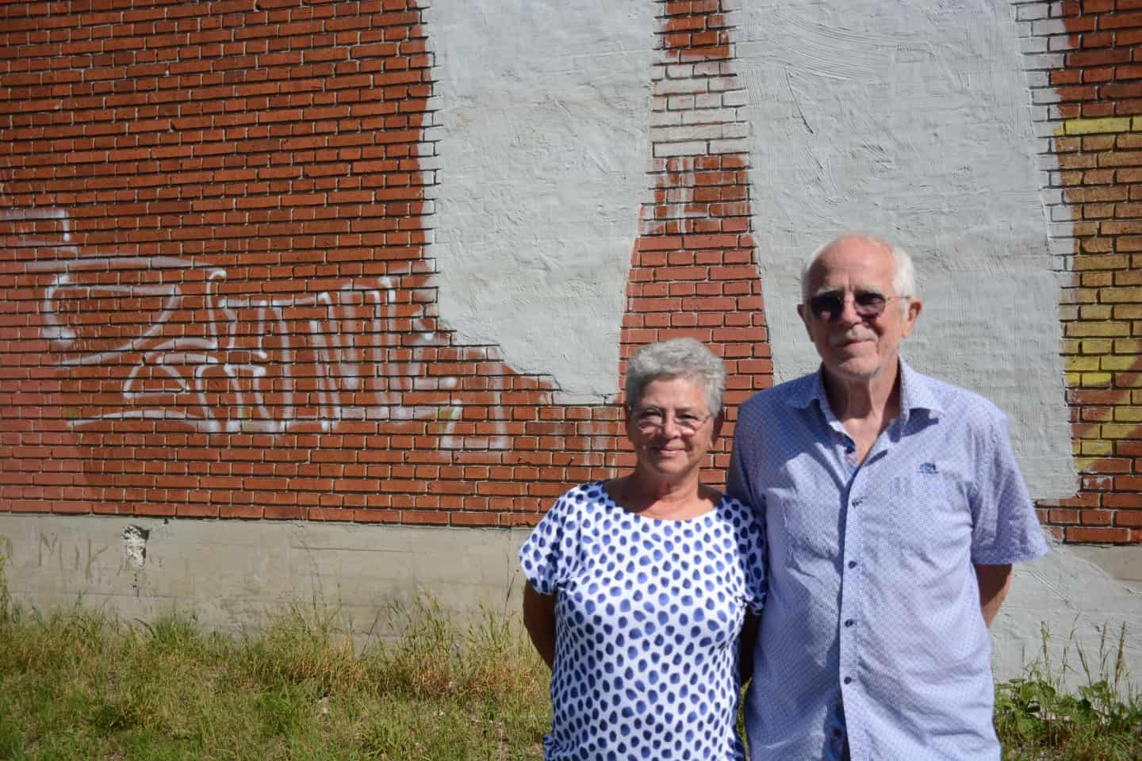
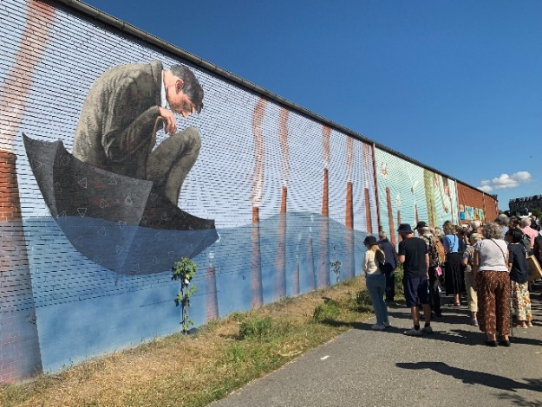
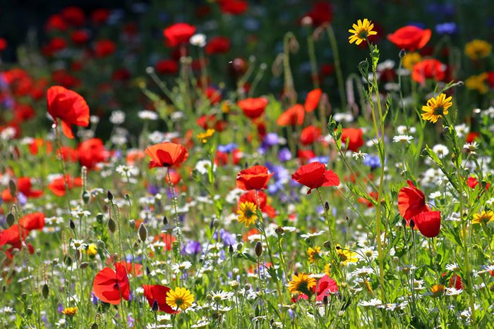
TRÆKBANEN (towpath)
Established in 2022
Behind: A local couple took the intiative
Goal: transform an urban space, an old towpath, into cultural and sustainable space for all citiziens passing by
Results: fruit trees and wild flowers was planted, mural artworks has been established and the work continues
Financed: though local sponsors and local committees

