Slide 1
Experiences from co-creation in the field of culture and cultural heritage in Finland
Dr. Kati Nurmi, project manager,
Association of Cultural Heritage Education in Finland /
Suomen Kulttuuriperintökasvatuksen
seura ry.

Slide 2
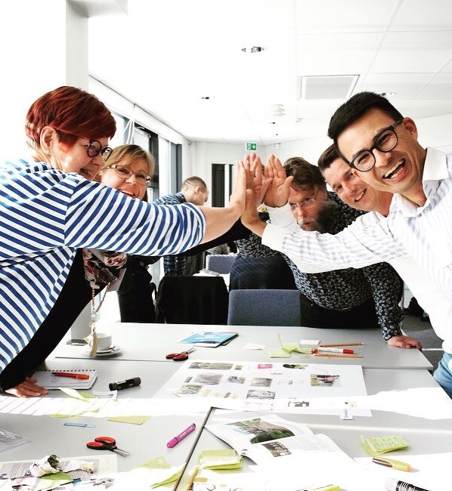
Co-creation in Finland
Co-creation = “yhteiskehittäminen”
→ co-development
Closely linked to participation and engagement (inc. National Core Curriculum)
The concept of co-creation is more widely used in service and product design, health and social care, urban and regional planning, spatial design, innovation projects and educational policies
Used to facilitate change, solve problems, and to develop fresh action models
Also EU-projects such as Culture Labs and Future Divercities

Slide 3
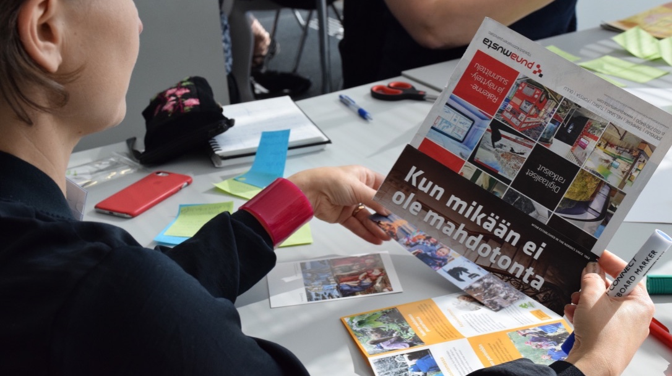
Shared features in the Finnish case studies
The concept of co-creation was not consciously used
Co-creation at different levels and different ways
Combining different ’models of co-creation’
Partially initiated by civil society but co-creation processes started with the support of the public sector
Some form of puplic funding

Slide 4
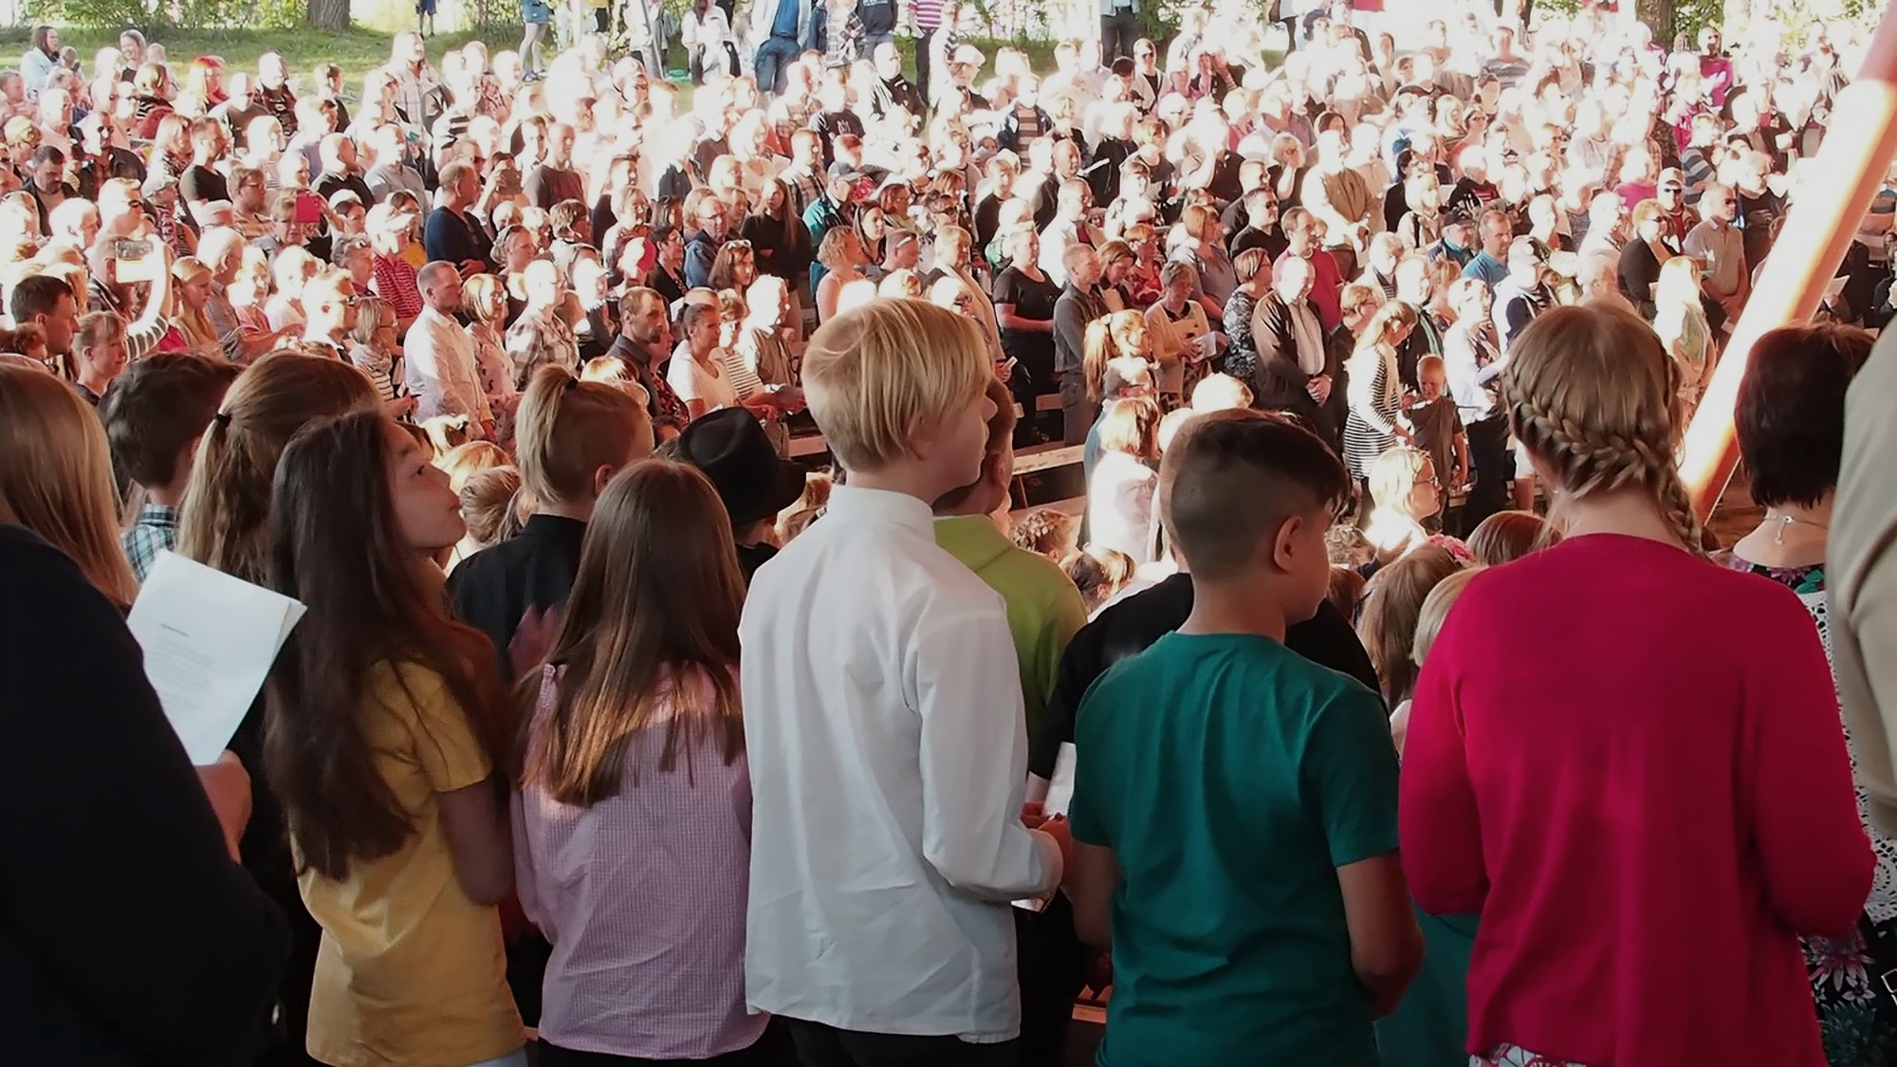
Needs and goals:
    To revitalize musical tradition amongst young residents of Kaustinen and to safeguard local musical traditions
    A communal singing event to celebrate the 150th anniversary of Kaustinen as a municipality
Based on citizen initiatives and cooperation between the local education providers, Kaustinen city council and a number of local third sector cultural organisations
In addition, local residents from young children to the elderly were closely involved with the project
Project started with an open-to-all planning meeting
Case 1: Kaustinen Sings – Spring singing event

Slide 5
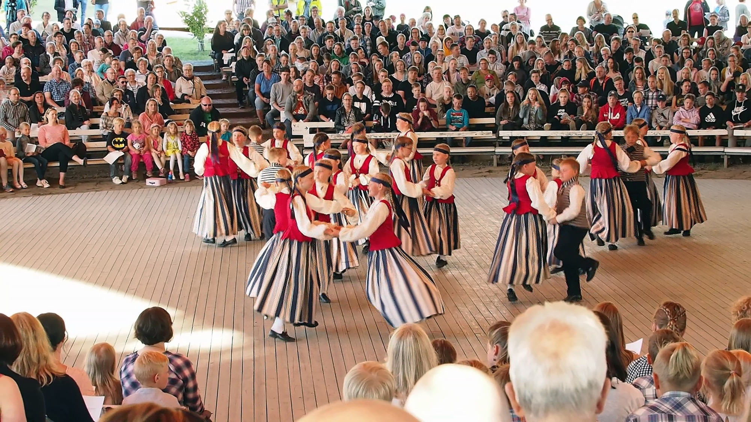
Lessons learnt: What was important for successful co-creation?
  Involving all stakeholders closely with the project planning (equal opportunities to be heard and to voice opinions)
  Participation and wide engagement
  A wide network of different stakeholders and actors (variety of skills and experiences)
  Local communal strenght and spirit
  A shared belief in the project’s importance
  Dealing with any conflicting situations communally in ways that ensures the end result is as pleasing as possible to all parties

Slide 6
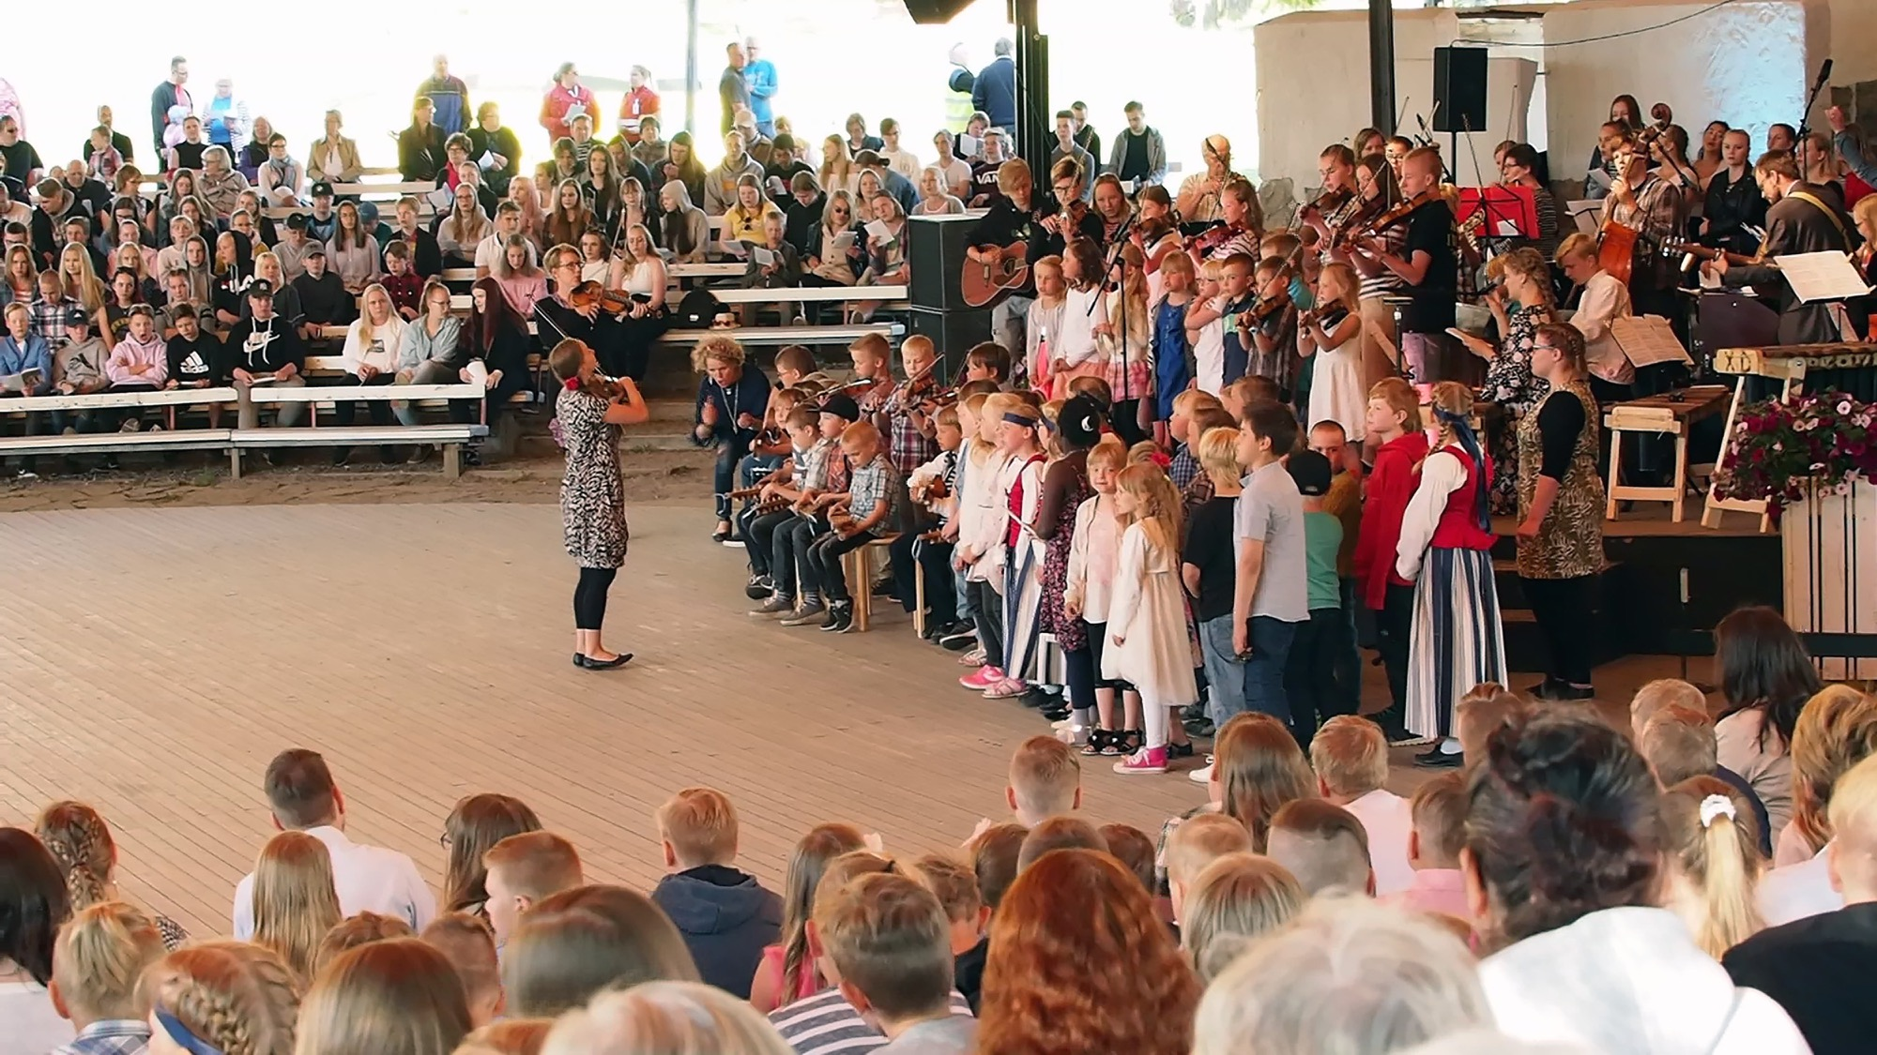
Some successes and results
Much of the local community was involved with the project in one way or another (performers, organizers, parents, audience etc.)
Locally a deeply meaningful and unique event that united generations
Producing something unprecedented with children and the young people
Confirming the idea that co-creation is a well-functioning model for various types of cultural projects
Deepening of existing networks and trust between the actors and stakeholders

Slide 7
Case 2: World Heritage Sites’ Boost to Local Industries
Goals: To increase the visibility and appeal of the two local World Heritage sites and the surrounding areas, and to generate local interest in the sites, and cooperation between the two sites and the local community
To be achieved by creating new know-how and competences, by creating cooperation outside the current domain, by strengthening existing networks and marketing, and by regenerating and productising the sites themselves
Partnership consisted of HUMAK University of Applied Sciences, two Leader groups (JyväsRiihi and Vesuri), local entrepreneurs (e.g. in travel industry, catering), third sector organisations, expert organisations, schools and education providers

Slide 8
Lessons learnt:
What was important for successful co-creation?
Development from below and inside out
Initiatives based on local needs and development demands (two preliminary discussion meetings)
A large number of local actors and stakeholders
A project advisory board and (inter)national experts (for larger scale projects)
Developing a sense of communality and supportive atmosphere where space was given to all views and voices
Generating trust and creating working relationships

Slide 9
Some successes and results
Five ’skills workshops’ → spreading competences and know-how
A final international conference (Hygge and Heritage, 2018)
Development of networks at local, regional and international level
No real competitive structures were formed
Spin-off projects
Development of local products and services (e.g. Struve soup, World Heritage in One Day -guided tour, Full Moon Climbing event)

Slide 10
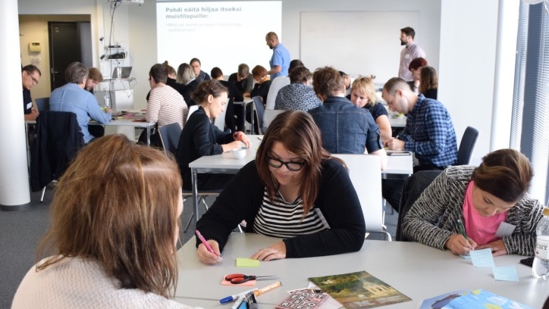
Sum up: What made successful co-creation possible?
A wide network of stakeholders and actors (a mix of knowledge, skills, values, attitudes, backgrounds)
Equality and participation: all participants as equal co-initiators, co-designers and co-implementers
Commitment to doing things together (co-creation) and a shared goal
Belief in the importance of the project
Openness, accepting uncertainty and willingness to do things in new ways
Shared respect, trust, understanding and communality
Realistic but flexible timetable
External facilitators, experts etc.
Some public funding
Understanding and accepting that co-creation takes time!

