Slide 1
Musisk Oplysnings Forbund – DK/ National Association of Adult Education in Art and Culture
Co-creative cooperation and participatory culture
Baltic Sea 3-day Symposium
11th – 13th September 2019
in Lithuania

Slide 2
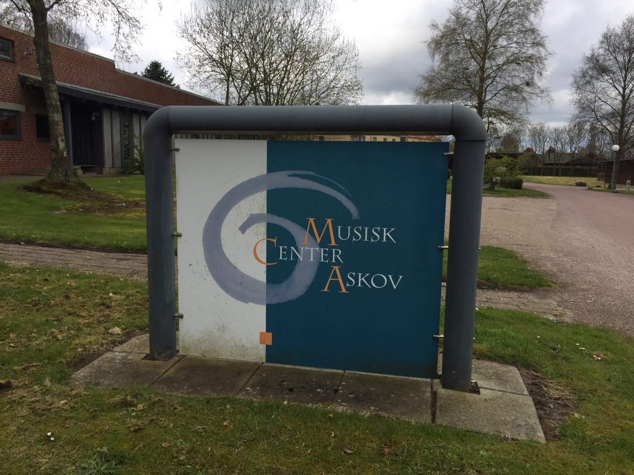
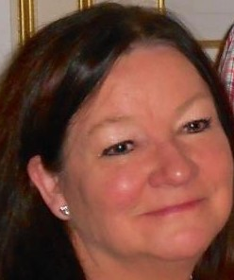
Musisk Oplysnings Forbund – DK/ National Association of Adult Education in Art and Culture
Presentation of good practice in Denmark regarding start of co-creative activities
Bente von Schindel,
president

Slide 3
Musisk Oplysnings Forbund – DK/ National Association of Adult Education in Art and Culture
General situation in Denmark
When was co-creation introduced as a concept in Denmark?
What is the purpose?
How will they do it?

Slide 4
Musisk Oplysnings Forbund – DK/ National Association of Adult Education in Art and Culture
Manifest for Collaboration
What is co-creation about?
Why co-creation?
How is the term “co-creation” understood in Denmark?

Slide 5
Musisk Oplysnings Forbund – DK/ National Association of Adult Education in Art and Culture
Good practice in Denmark regarding start of co-creative activities
How do we start?
Who are involved?
Relate to the four types of co-creation
The co-creation Process
Network approach

Slide 6
Musisk Oplysnings Forbund – DK/ National Association of Adult Education in Art and Culture
Succes
Trust and understanding
Empowerment
Support
Collectively established rules/ legal framework to reach the desired goal
Knowledge

Slide 7
Musisk Oplysnings Forbund – DK/ National Association of Adult Education in Art and Culture
Succes
Visibility
Transparency
Transformation
Challenges
Competences

Slide 8
Musisk Oplysnings Forbund – DK/ National Association of Adult Education in Art and Culture
Thank you for listening!

