Slide 1


.
Pilot courses for culture managers and volunteers
2nd – 7th October 2017 in Lousada
Culture in sparsely populated areas
with added values
Hans Jørgen Vodsgaard
Interfolk
Institute for Civil Society

Slide 2
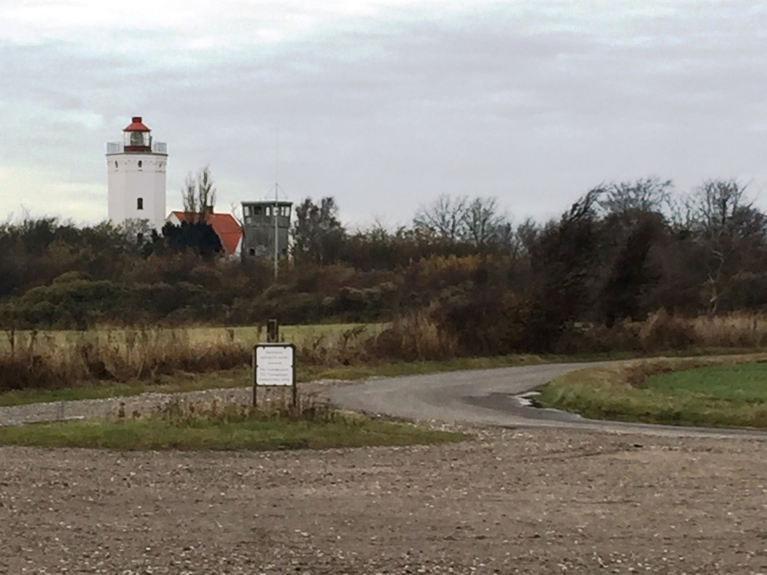
The project aim
Promote competences of culture managers and volunteers
in sparsely populated areas
to provide enlivening arts and culture opportunities
with an added value for civic participation, community bonding and local identity.
Why do we intend this
– what is the problem?

Slide 3
The towns pulls Denmark offbeat Background
Denmark becomes steadily more unequal.
Thousands of people move every month into the country's largest cities and empties slowly the smaller municipalities for citizens.
At the remote areas they stand with a declining number of inhabitants, and often worse, fewer people of working age.
  "We get a breakdown of Denmark, where the winners are the big cities with their education, good job opportunities and attractive culture. The losers can look forward to closures of schools and other welfare institutions. They have fewer resources to maintain the level of service we know today. There are more holes in the roads, and a longer time before they are repaired“
Lea Louise Holst Laursen, Associate Professor at the Department of Architecture, Design and Media Technology at Aalborg University.
(Monday Morning, 08/02/2013)

Slide 4
What’s the problem
The challenge is URBANISATION / internal immigration
The purpose is in our area to help to counter the current trend,
where citizens are moving from rural to urban areas.
  in 1950 - 29% of the world population lived in major cities
  In 2012 - 50 % of the world population lived in major cities
  in 2050 - 75% of the world population will live in larger cities
  (UN estimate)
  This creates unbalanced countries - it weakens
    the social equality and inclusion
    the cultural cohesion
    the economic sustainability

Slide 5
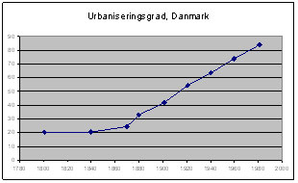
Urbanisation in Denmark
Year | Pct of population in cities
1840 | 20 pct
1870 | 25 pct
1900 | 40 pct
1921 | 50 pct
1950 | 66 pct
1960 | 73 pct
1970 | 80 pct
1980 | 82 pct
2000 | 85 pct
2005 | 86 pct
2016 | 88 pct
2050 | ?

Slide 6
Urbanisation in Denmark and EU
In a European context, Denmark is one of the least urbanized countries.
21.9 pct of Danes lived in 2012 in very densely populated urban areas.
The proportion of urban dwellers is far greater in fx
France (35.0 pct.), Germany (41.5), Spain (59.2), Netherlands (72.4)
and the UK (73.8).
Denmark is the country in Western Europe, where the lowest proportion live in big cities. Only some Eastern European countries is less urbanized.
However, If we include Eurostat’s definition of middle areas, which in Denmark especially consist of the larger provincial towns, so 70.8 pct. of the Danish population lives in urban areas. It is relatively high in the EU.
It means, the sparsely populated areas include 30 pct of the population.
(The European Commission's statistics office Eurostat)

Slide 7
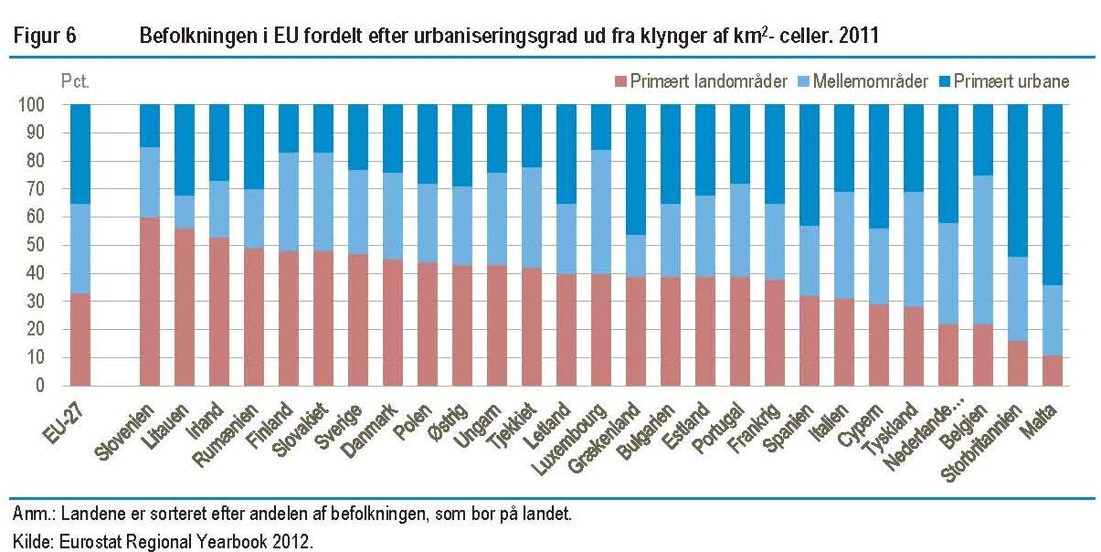
Urbanisation in EU
There are significantly more people in rural areas in Denmark than in the EU as a whole. Conversely, there are significantly less in the most urban areas.
- But a high level of commuting (pendling) in Denmark

Slide 8
The political factor Background
It is neither the fault of the market or globalization that Denmark is about to break in half. The centralization is strengthen by a series of political decisions:
The replacement of the Danish regional development schemes by the EU's regional aid scheme in 1990, where the nation state was sidelined and regional development was pulled out of the national agenda.
The overall centralisation of governmental administrations, education, cultural institutions in Copenhagen and other big cities as well as reduced public transportation in rural areas as part of new public management.
The municipal structural reform in 2007 – centralised 271 municipalities to 98, with an increase of inhabitants in average from 20,000 to 55,000. Here the new municipalities tend to centralise the public services in the main town and emptied the outskirts of activity: such as administration, schools, culture institutions, etc.
In short: The policy on a European, national and local level have all promoted urbanisation / deteriorating life opportunities in remote areas.

Slide 9
Higher education Background
“For many decades, the smart kids were sent off to the city;
the less smart stayed back on the farm. It was normal for individual to move from the farm to the city, but nobody grew up in the city to become a farmer..... The land was something you left behind”.
(Dr. Dickson Despommier)
Yes, but the centralisation makes a difference. For example the education as a grammar school teacher.
In1970s we had 29 independent teachers' colleges.
During 1980s the number of colleges were reduced to 18.
Since 2007, the teacher education is located at the 8 university colleges, and it is now defined as a profession Bachelor's degree.

Slide 10
Higher education as a one-way ticket Background
Young people from the rural areas needs to move to the bigger University Cities to get a higher education – and it’s typical a one-way tickets.
Just 16% of the young people return to their home areas.
The remote areas have
fewer young well-educated and skilled workers.
more with a short or no education, especially a surplus of young men.
and a lot of pensioners.
The well skilled don’t wish to live there, because it seems as boring places with few leisure time activities and available arts and culture opportunities. . A place to leave for the young and bright.
The countryside, the province gets low status

Slide 11
Centralisation of governmental jobs Background
Since 1997,
In Copenhagen 1 out of 25 governmental jobs has been cut, while
outside Copenhagen more than 1 out of 5 has been cut, and
in an areas like West and South Zealand 2 out of 5 jobs were cut.
Today, there is 1 state job for every 10 citizens in Copenhagen, whereas outskirt municipalities as Langeland, Rebild or Vejen only have 1 state job for every 100 citizens.
If we should make an equitable distribution of government jobs in the country, then 57,000 state jobs had to be moved from Copenhagen to the province.
This year the new government has started to moved 3,900 state jobs from Copenhagen to the province
Even though, in the fourth largest city, Aalborg, you can for the same costs have 333 employees compared to 279 in Copenhagen.
(Udkantstmyten, Dybvad 2015)

Slide 12
The myth of the remote areas Background
The remote areas
Have an undeserved bad reputation
Unfair myths and biased narratives strengthens the low status.
The concept “Udkants-Danmark” (Peripheral Denmark )
was introduced in 2009, and it was i recognized in 2010 by the Danish Language Council (Dansk Sprognævn).
The last 5-10 years a new narrative has be promoted by opinion-formers, writers and filmmakers about the hopeless life at the countryside,:
where single mothers, welfare recipients, drug addicts and morally corrupt beings live a ignorant life and are unable to rectify their own situation;
A life in the middle of nowhere, where even the crows are turning
A loser country that are held up by support from the thriving urban areas.

Slide 13
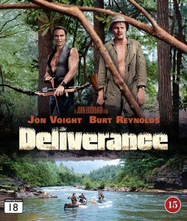
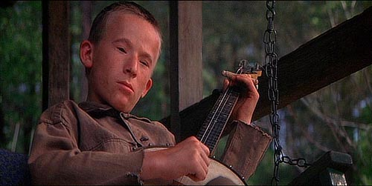

The myth of the hillbilly
A visit to the remote areas is
“An excursion with death” (udflugt med døden)
You meet Inbreeds, hillbillies, swamp-billies and other creatures from the last step before the animal Kingdom.
Inbread

Slide 14
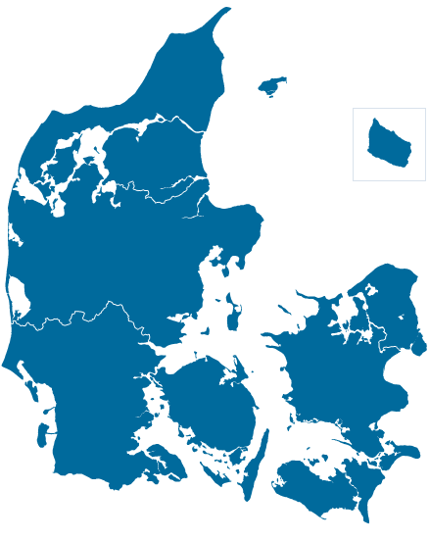
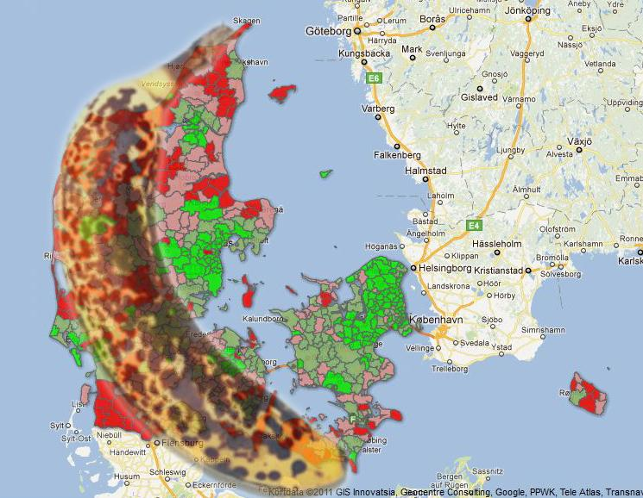
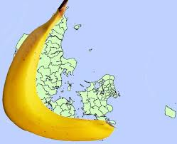
The myth - the rotten banana

Slide 15
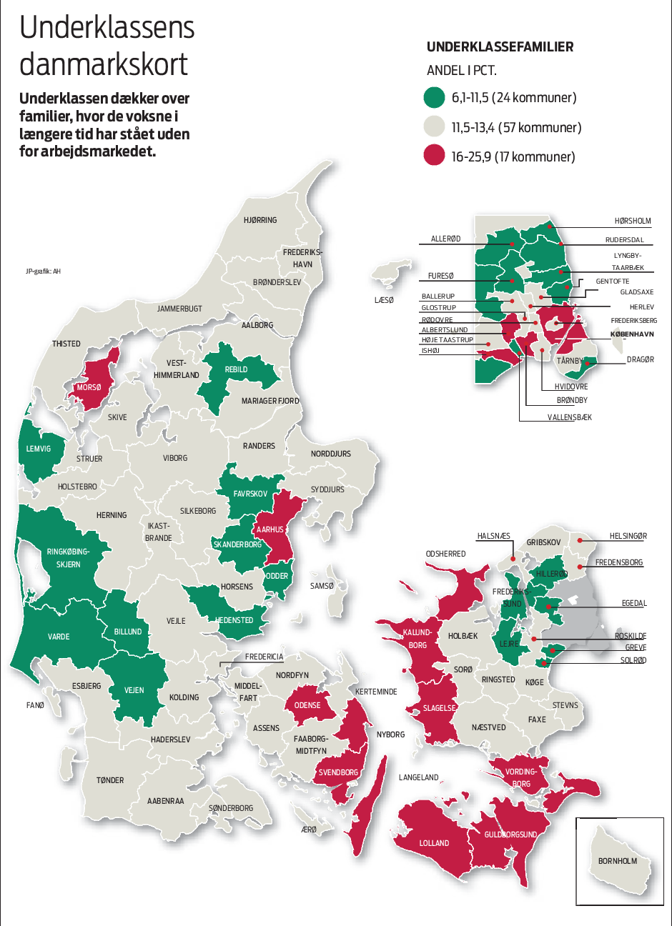
Reality - Index of high unemployment

Slide 16
Both economic and cultural reasons Need
The reasons for the internal immigration
are not so much economic as political and cultural.
Cause and effect is self-reinforcing:
Most businesses opt out to establish new activity in these areas,
not because of logistic problems, but because it is difficult to attract employees
with the needed competences despite the lower living costs here.
Because well-skilled and higher-educated younger people seek to bigger cities,
not only due to the need for education and lack of well-paid job opportunities,
but also due to lack of culture and leisure time opportunities.

Slide 17
A part of the answer
"Culture is the modern industrial policy .. The transformation from industrial to knowledge society is on-going. One of the prerequisites to attract skilled labor is well-functioning cultural and recreational opportunities.“
Development Manager Rune Larsson, Hjørring Municipality
“One of more ways to counter this trend is to promote better culture and leisure time opportunities, and here new initiatives in the third sector by voluntary culture associations and culture volunteers can make a difference.”
The SPAR application

Slide 18
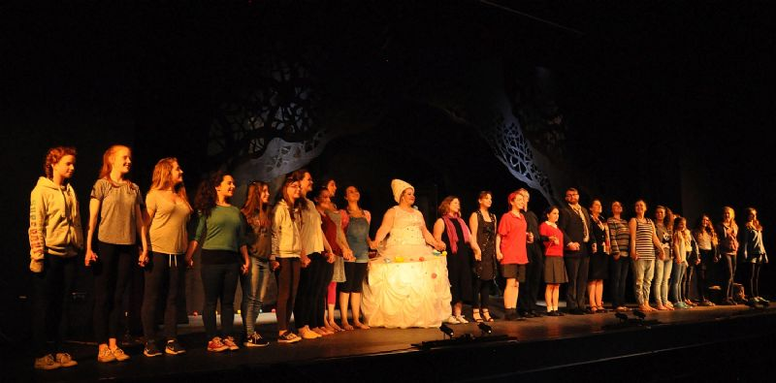
Good practise – Orkney Islands as example
A splendid example of how culture can make a difference in remote areas
has been documented in the report by
Francois Matarasso: "Stories and Fables - Reflections on culture development in Orkney" (The Highlands and Islands Enterprise*, January 2012, 89 pages),
* The Scottish Government's economic and community development agency for a diverse region which covers more than half of
Scotland and is home to around 450,000 people
An example on how a strong ethos of volunteering and working together combined with the natural archaeological and historical assets of the islands have helped to revive the local communities.

Slide 19
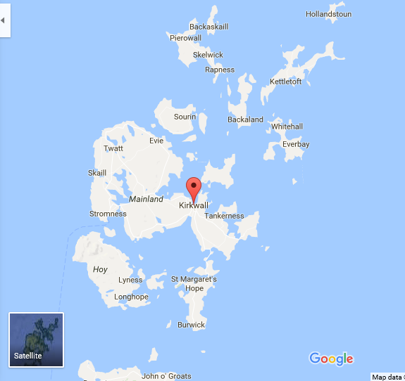
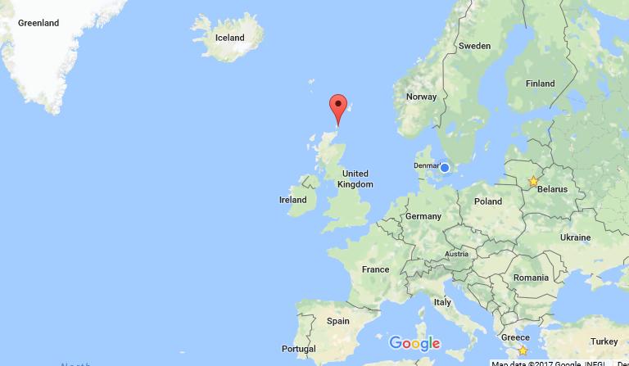
Orkney Islands – geography
Orkney is an archipelago of approximately seventy islands, which is about seven miles north of the far North-East coast of Mainland Scotland.
Around twenty of the islands are populated, and the majority of the around twenty thousand residents live on the largest island – called Mainland – and again the majority of them live in Kirkwall.
Population: 20,100

Slide 20
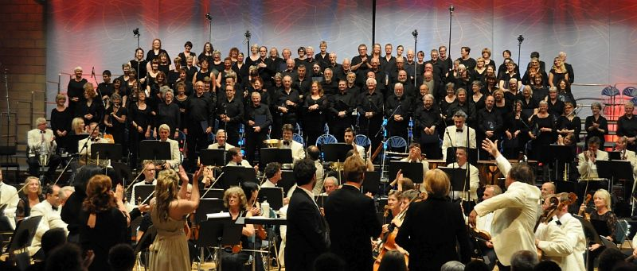
Orkney Islands – culture
Orkney is a vibrant, culturally rich place, with important archaeology sites.
A World Heritage Site – the Heart of Neolithic/stoneage Orkney – sits alongside important Norse, Viking and Pictish monuments, and even the 20th century wartime and maritime archaeology is unique and internationally recognised.
Orkney has been particularly successful in the cultural field since the 1970s.

Slide 21
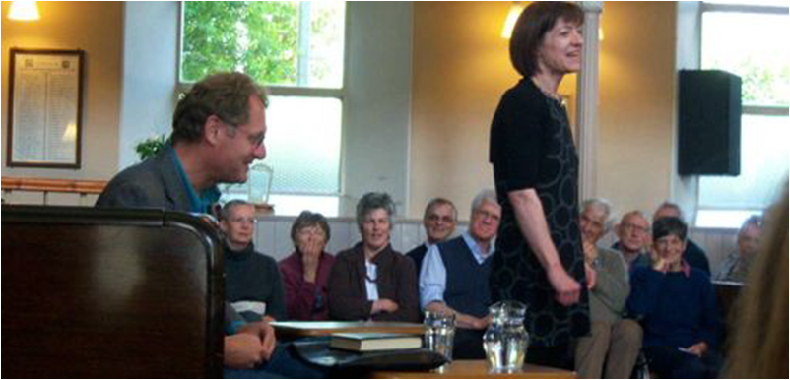
Mandate for the study
21
The study by Francois Matarasso was commissioned with the objectives
To understand how cultural life in the Orkney Islands has developed over the past 30 years
To recognise that Orkney has been particularly successful in this field, notably through St Magnus Festival, Pier Arts Centre & the craft industries
To clarify if there were any transferable lessons that other parts of the Highlands and Islands might draw on.
Andrew Motion poetry reading, St Magnus Festival 2009

Slide 22
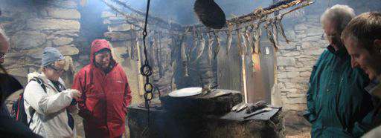
Key messages of the Report
Whilst Orkney is outstanding, it is not unique in developing a strong cultural sector
The answer lies in looking at what has happened in Orkney, in the wider context of arts and cultural development practice,
And to identify how people have created a strong cultural life, rather than focusing on what they have created
Kirbuster Farm Museum, August 2011

Slide 23
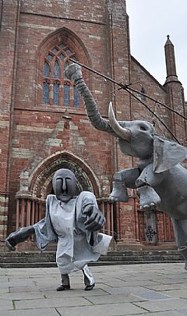
The Orkney Principles of cultural development
1. Leadership with a clear vision
2. Demonstrating value
3. A sustainable economic model
4. Valuing volunteers
5. Open, democratic governance
6. Flexible and responsive
7. Confidence and humility
8. Cooperative and competitive
9. Always positive
10. “Dig where you stand”
Especially five of the principles are important.

Slide 24
Orkney Principles
Re 1: Leadership with a clear vision
Successful projects need leaders with a strong idea of what they are trying to achieve and the ability to communicate that clearly to others
Good leadership builds trust and commitment.
Re 2: Demonstrating value
Cultural initiatives attract broad support when they are seen to benefit the community – social, economic, educational or a combination of all 3
The most successful initiatives not only have a real social value – they can also be told in a clear and simple manner for all to understand

Slide 25
Orkney Principles
Re 4: Valuing volunteers
Very little cultural activity would be possible without this gifted work… through them, Orkney’s arts and culture are inextricably woven into the social fabric of the community
Volunteering works well… when time, skills and other resources given are genuinely appreciated and when volunteers are treated not as unpaid workers but as small scale philanthropists who share the values of the organisations
Re 5: Open, democratic governance
Transparent governance and management processes that are seen to be fair by everyone involved are enabling.
They build internal and external trust and make organisations reliable partners; they also reduce the incidence of disputes.
They brings ownership for all involved.

Slide 26
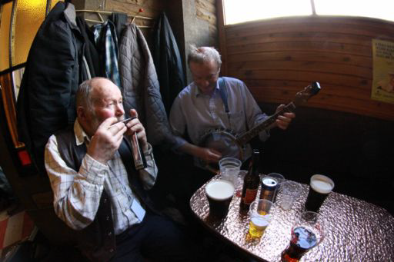
Orkney Principles
Re 10: “Dig where you stand” *
It remains the simplest expression of a basic tenet of good cultural development: to find the value in existing cultural assets.
Other dimensions can be brought in and interact with what is there, but understanding and recognising the qualities of local people, traditions and environments is always a good starting point for development.
* This is the motto of the Living Archive in Milton Keynes, a new city built on old towns in the English Midlands.
Orkney Folk Festival

Slide 27
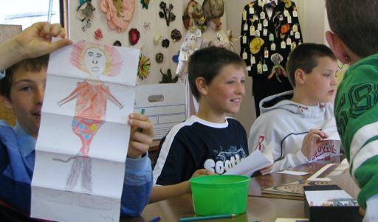
Why the principles work
Individuals working together to fulfil their enthusiasms make creative, resilient and flexible artistic development.
Public authorities have a vital supportive role to play, but it is an enabling not a directing one.
By providing sufficient and appropriate support, they can help to develop a strong, independent and diverse cultural ecology that plays a central role in every aspect of local life.
Artists’ residency Papdale School 2007

Slide 28
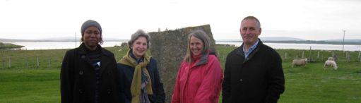
Conclusions of the survey
“Orkney’s culture is an important economic asset, both in terms of the employment and wealth it creates directly, and as an attraction for the tourists crucial to the local economy.
It is also a vital social asset, bringing people together in small and large gatherings, developing skills, experience and knowledge, fostering common purpose, and building social capital.
And perhaps most important a life asset: in opening up imaginations, building shared memories, raising aspirations, giving hope and delight – and simply making Orkney a place where people want to live. And Orkney’s future depends absolutely on that.”
Francois Matarasso: Stories and Fables - Reflections on culture development in Orkney, 2012.
Participants in Orkney Writers Course, 2011

Slide 29
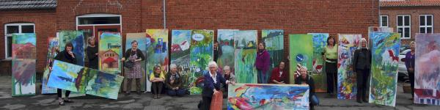
Summary – the role of voluntary culture
“Voluntary art and culture associations can play a major role to make our marginal areas more attractive to new residents, tourism and businesses, because:
Art and culture help to create the community and unity that can save a village or area from being emptied of content.
Inclusion in art and culture gives new life and creates responsible citizens.
A vibrant cultural life can create a more sustainable community, where all citizens are ready to take responsibility for their own and others' lives.
The SPAR application
Exhibition of amateur arts in Horbelev

Slide 30
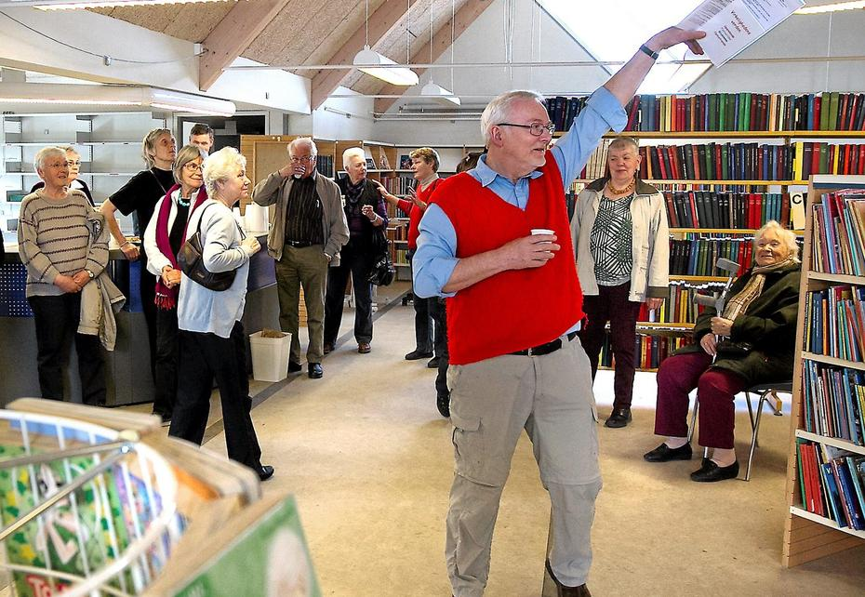
Summary – the role of voluntary culture
To secure cultural sustainability in these areas, we need to strengthen the “citizen help citizen“ where
Volunteers from civil society associations from amateur arts, voluntary culture and heritage are engaged to provide engaging arts and culture activities,
with an added value for civic and democratic participation, community bonding and local identity.
The SPAR application
Joy in Ejby Citizen House

