Slide 1

Interfolk
Institute for Civil Society
Micropolis conference,
13th of June 2013,
At Wawerskie Centrum Kultury
Presentation of
case studies from the civil society area
v3, 11.6.2023
By Hans Jørgen Vodsgaard

Slide 2
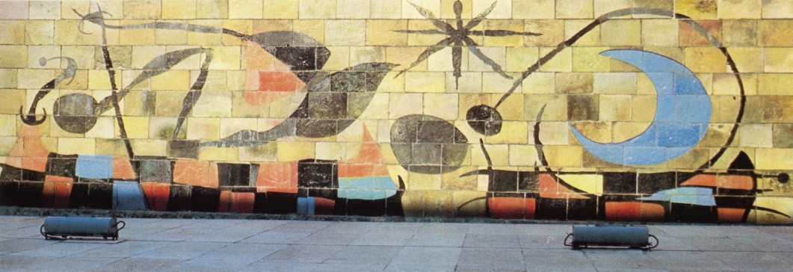
Interfolk at a glance
Interfolk is a
non-profit organisation founded in 2008,
based on individual members,
sharing an interest in the Grundtvigian tradition of liberal adult education.
The mission is
to promote democratic learning activities in a civil society context, mainly in the area of liberal adult education and participatory arts, culture and heritage.
The activities include
research, surveys and development projects, courses, seminars and debate
in a Danish, Nordic, and European context.
Miro, The wall of the moon, 1958

Slide 3
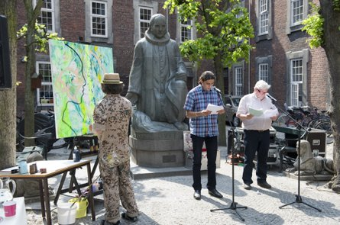
Project activity
Overview of international projects – see http://interfolk.dk/projects.html
Last 15 years been engaged in more than 30 international projects with support from
EU programmes like Erasmus+, Grundtvig, Creative Europe, and Europe for Citizens, both to projects and training courses.
Nordic Baltic programmes, like Nordplus Adult and Nordic Culture Contact.
The Nordic Council of Ministers’ support to NGO-cooperation in the Baltic Sea region.
Cultural project event in the yard of Vartov, Copenhagen

Slide 4

The three societal sectors
The partners in the Micropolis project represents in varied ways the three main societal sectors and their networking and cooperation:
The public sector, including local public social, educational, and cultural institutions as well as departments from the municipal Authorities.
The market sector, including local businesses, tourist services, trade associations entrepreneurs, etc.
The civil society, including associations and citizen groups from the social, educational, and cultural fields.

Slide 5
Habermas – Model of Society
Technical - instrumental rationality
(How - on effective means)
market state
Democracy
Public sphere
civil society
Private sphere
SYSTEM
LIFE WORLD
Communicative og expressive rationality
(Why - on purpose and meaning)

Slide 6
Habermas – Life spheres and life roles
System
State Market
Parliament
Democratic public
Civil society
Personal sphere
Life world
Employee
Customer
Client
Citizen
Fellowman
Person / human
Bourgeois
Citoyen
L’Homme
The good life implies
A balance between the roles as bourgeois, citoyen and l’homme

Slide 7
Habermas – The system colonises the life world
System
Market State
Spectator democracy
Civil society is reduced
Persons loose autonomy
Life world
The neoliberal system
The competitive state
New public management
Commercialization
Instrumentalisation
The colonised life world
Media: Public service to Infotainment
University: Free thinking to Invoices
Education: Bildung to competences
Culture: Experience economy
NGO’s: private volunteering
Key words:
One-dimensional society
Civil society looses learning capacity
Citizens loose autonomy

Slide 8
Survey of Danish Civil Society sector *
In total more than 100.000 civil society organisations / CSOs in Denmark , 2005
80 pct are locale member-based associations (the genuine NGO area)
4/5 of the activities are based only on volunteers
10 pct of the costs are for paid staff
8 pct are self-owned institutions (incl. kindergarten, care homes, adult education associations, folk high schools, museums, sports halls, town houses, culture centres, etc)
1/3 of the work are done by volunteers
50 pct of the costs are for paid staff
7 pct are funds with a general purpose
Here nearly all work are done by paid staff
5 pct are others (at or outside the area of the survey, like trade unions, housing ass.,
cooperatives, home guards, congregations, et al.
*) A central study of Danish associational life took place in 2003-2005, as part of the large International Johns Hopkins Comparative Non-profit Sector Project, where about 50 countries. took part.

Slide 9
Different NGO sectors
Area of sport, leisure and culture – 55 pct
Sport and dance: 25 pct; Leisure and hobby: 15 pct; Arts, culture and heritage: 15 pct
More than 50 pct of all organisations
More than 50 pct of the citizens
Here we have member-based democracy, and volunteering dominate
Only 25 pct of the self-own institutions and funds are here
Area of ideology: Policy, legal, religion, international, environment, etc – 10 pct
Nearly only member-based associations
Most work done by volunteers
Area of social, health and education – 15 pct
Social: 6 pct; Health: 5 pct; Education: 4 pct and adult education below 2 pct
Only 15 pct of the volunteers are here - most work are done by paid staff
60 pct of the self-own institutions are here
Other areas outside normal NGO activities – 20 pct
Organisations with relation to work life
Organisations with relation to housing and local community houses
Other organisations at the border of the CSO area

Slide 10
The third sector is in progress
In general, the civil society has progressed since the 70s and until now:
The voluntary engagement:
In 1993 a quarter of the population did a formal voluntary work (outside their own household and family network),
In 2005 it was about one third (maybe 40 pct today)
They were doing it for 17 hours a month on average.
Number of memberships
The average number of memberships has grown from 2.9 in 1979 to 3.5 in 1998, and probably more than 4 today.
Number of organisations:
25 pct of the member-based associations and self-governing institution has been formed within the last 15 years,
More than 50 pct of all existing organizations and institutions are formed after 1975.
The strongest growth in associations, members and activity are in the field of arts, culture and heritage – in probably all EU member states.

Slide 11

Who are volunteering
The John Hopkins Survey from 2005 confirmed results of previous studies:
Age
The middle aged was as before the most active
But a growth in engagement for all age groups.
And a strongest growth among the oldest.
Everyone has become more active, but the oldest have become relatively more active
Education
The ones with the highest education are still the most active, but other groups catch up.
But the progress is especially among those with practical training and without education
We witness a democratization of the voluntary engagement.

Slide 12
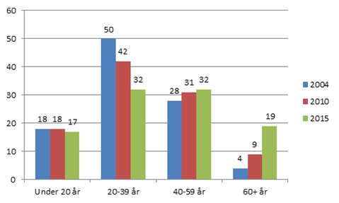
Older Danish citizens are more active as trainers and instructors
Fig. 1: Distribution of trainers and instructors on age, per cent, in NGO work
Source: Centre for Research in Sports, Health and Civil Society (CISC), 2015
Today probably more than 25 pct.

Slide 13
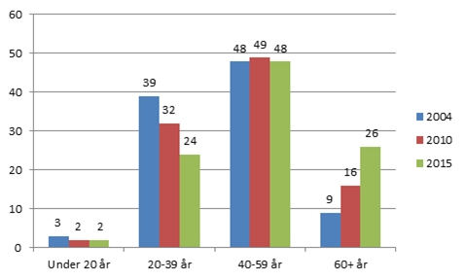
Older Danish citizens are more active as managers and leaders
FIG. 2: Distribution of managers by age, per cent, In NGO work.
Source: Centre for Research in Sports, Health and Civil Society (CISC), 2015
Today probably more than 33 pct.

Slide 14

Added community values of cultural activities
The huge cross-cultural sector in our civil societies include:
Heritage (where people are helping to preserve and disseminate all sorts of artefacts and heritage to a wider audiences)
Amateur arts (where amateurs are engaged in arts activities as choirs, music groups, dancing, theatre, visual arts, crafts, etc.)
Voluntary culture (where volunteers organise arts activities and events provided by professionals, like arts exhibitions, heritage events, guest concerts, touring theatres, film festivals, etc.)
The many different cultural activities
do not only provide joy, friendship, meaning for the participants,
but also added community values, like lifelong learning with personal empowerment and Bildung, social inclusion & cohesion, active citizenship & democratic values, trust and mutual recognition, green values, etc.
Noland: Ember, 1960

Slide 15
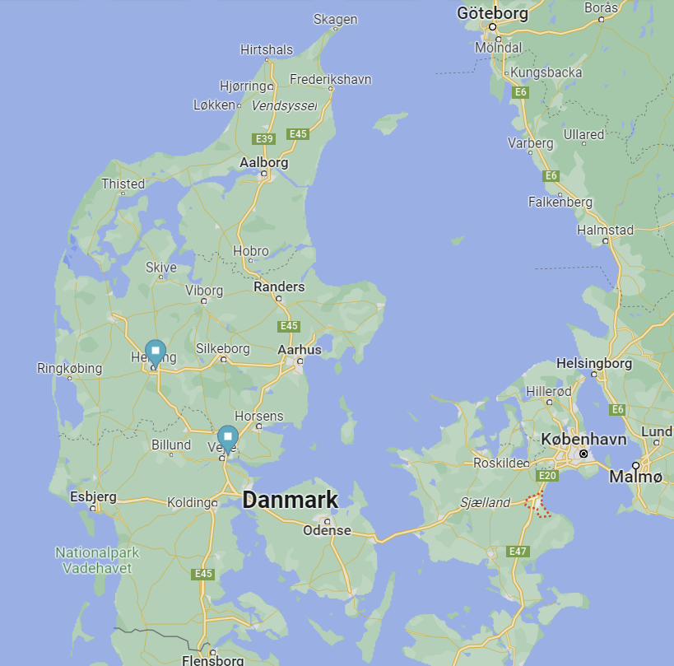
Case study I: Culture Guides and the Open School
Context – A GRUNDTVIG Multilateral project: “Culture Guides for marginalised social groups”, Oct 2013 – Dec 2015 with 6 partners from DK, NL, SI, HU and UK. Interfolk was coordinator.
Aim - to develop new culture guide services for current low- or non-users of art and culture among marginalised social groups.
Activities - included pilot works in each partner country, testing of European pilot courses, publication of a handbook, concluding national conferences and a European conference in Budapest, and other forms of dissemination.
The case study - a Danish pilot work, provided
by the National Association of Cultural Councils
with the Cultural Council in Køge Municipality;
entitled “The Open School Project in Køge”.

Slide 16
Case Study I: The objectives
The idea was to give marginalised children, who were non-users of the local cultural possibilities, a better access to culture and art in a more active and inclusive learning environment.
The objectives were:
To strengthen all children's access to art, culture, and heritage
To make the cultural association life known and interesting for the children
To strengthen the children’s experiences to be part of an inclusive local community and getting a shared local identity.
To take seriously the new school reform that the association should cooperate with the public schools – open the schools’ learning to the surrounding local communities.
To involve associations / volunteers, the schools and the municipality in solving this task.

Slide 17
Case Study I: the activities
The pilot activities provided by the member associations of the cultural council Køge during the spring 2024 included:
Skovbo Art Society provided art exhibitions with a guided tour adapted to several school classes, where artists became guest teachers and exhibition tour guides.
Apollonaris Teater association provided a theatre performance on bullying with a debate, as part of the schools’ integration/inclusion work.
Køge School Orchestra provided a lecture on school orchestra, including how to play in the orchestra and how it develops interpersonal skills and camaraderie.
The local history association made a guided tour at an art trail in the Køge area, where different types of arts, artefacts and architecture were presented and discussed.
The Denmark-Society provided a lecture on Dannebrog (the Danish flag, the world's oldest).
The Ejby Choir provided examples of classic song and opera, including information on being a soloist and working with choirs.
Ejby Cultural Center provided sessions on genealogy, where the children interviewed parents, grandparents and great-grandparents and found info on archives and Internet.
Culture Society of Skovbo provided a session on 'Peter and the Wolf', where trained flutist told the story and used recordings of the different instruments to describe the characters in the story. In the absence of an end to the story, the children themselves made poems and drew a conclusion, while the music played.

Slide 18
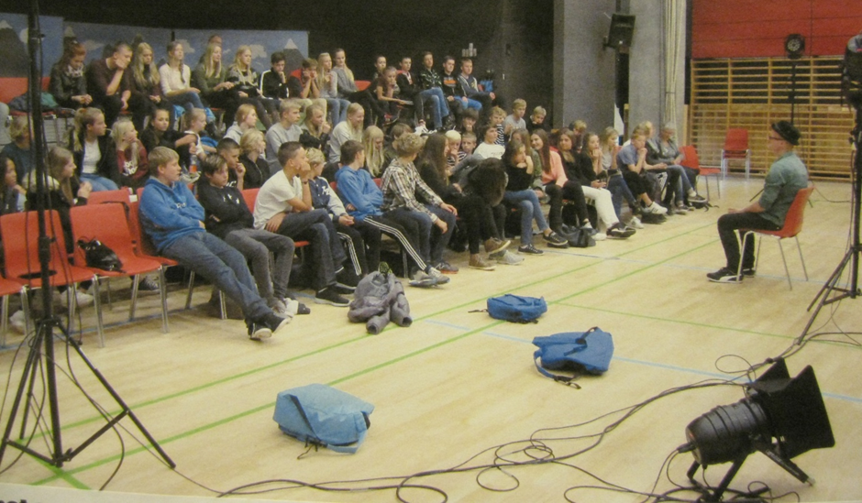
Case Study I: One example of the activities
Apollonaris Theatre Association provided a theatre performance on bullying with a debate.

Slide 19
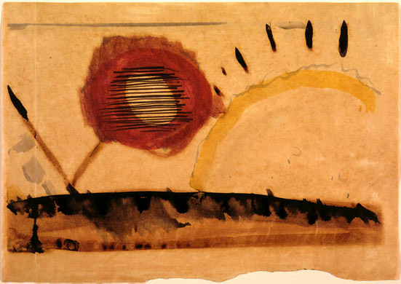
Case Study I: The Learning outcome
The learning outcome of the pilot work refers both
To the core values of arts and culture experiences, like
  develop cultural awareness and expressions,
  refine the register of emotions and sensations, ability to verbalise feelings
  get increased imagination and poetic expressions, refined taste, etc.
To the added value of cultural activities, like
  Strengthen the mutual recognition between the children of their different cultural backgrounds and developing tolerance in a social inclusive environment.
  More awareness of the local heritage and the possibilities to be engaged in free time cultural activities in their neighbourhood,
  Helped them to experience a shared community identity not only with their classmates but with gown-ups and other inhabitants in their communities.
  Hereby promoting the social inclusion, cultural cohesion, and local identity.
Arthur Dove ,
Distraction, 1928

Slide 20
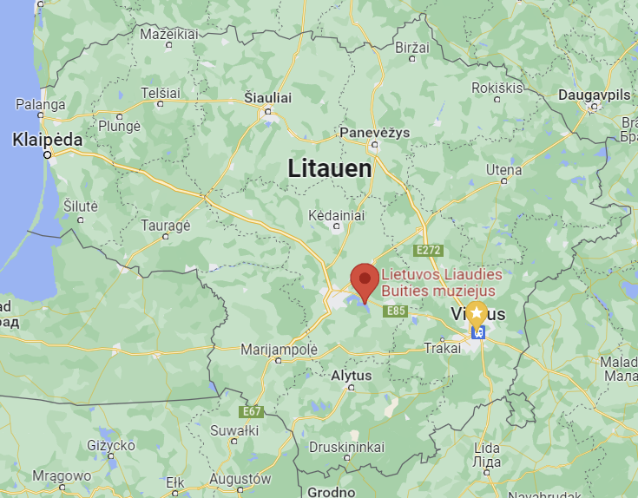
Case Study II: Time Travel in Lithuania
Context – A Nordplus Adult development project, entitled: “Culture guides for Active Ageing”, in the period: August 2013 – July 2015 with
5 partners from DK, LV, EE, and LT. Interfolk was coordinator.
Aim - to develop new culture guide services for current low- or non-users of art and culture among marginalised senior groups.
Activities - included pilot works in each partner country, publish a handbook, national conferences and other forms of dissemination.
The case study – Pilot work at Open-Air
Museum In Lithuania by elaborating the
“Time Travel” methods for older people,
in an inter-generational learning context.
The aim was to promote social inclusion,
cultural cohesion, and historical identity.
The event were planned at meetings in the spring 2014,
where representatives participated from
Kaisiadorys municipality,
the 3rd Age University in Kaunas,
the Lithuanian Association of Adult Education, and
the Lithuanian Open-Air Museum

Slide 21
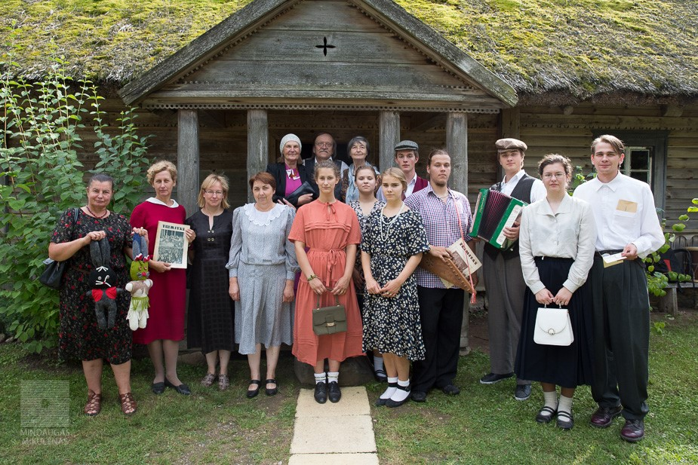
Casestudy II: Time Travel in Lithuania
The title of the time travelling programme was: „Holiday in the countryside of Lithuania in the 30s of the 20th century.” It took place with 4 events during the Assumption Day, 15th of August 2014.

Slide 22
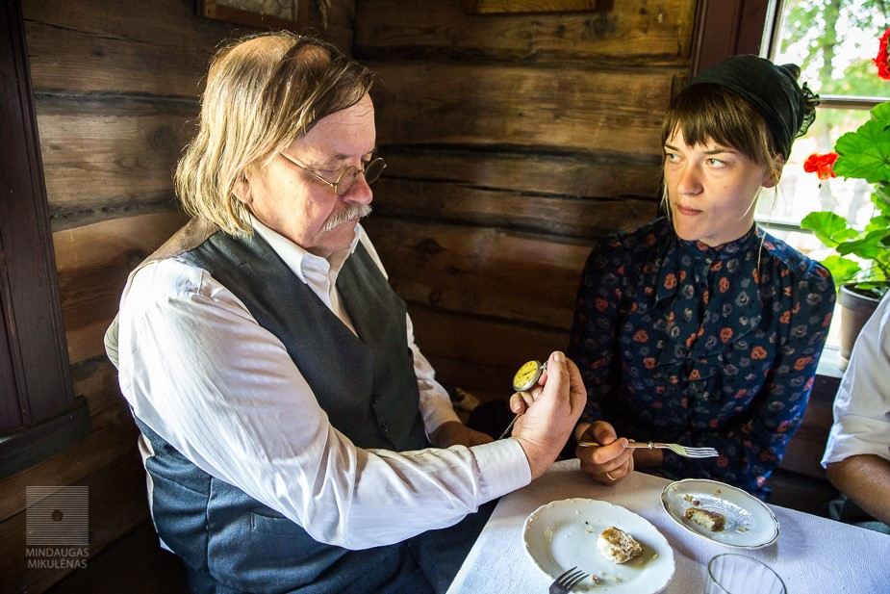
Case Study II: Methods and activities
The methodology:
Includes role plays based on local events and things from the past, where the group learning about historical facts is combined with involvement of values, feelings, attitudes, and capacity to reflect.
During the time travelling all participants used specific stories, artefacts, and activities to create alive scenes and narratives.
Here young people also acted for the elder with dancing, acting etc. The end-users were in this case the museums visitors of different age this day (around 3000) including elderly families with more generations.
One of the four time travelling sessions starts at the Assumption Day,
15th of August 2014.

Slide 23
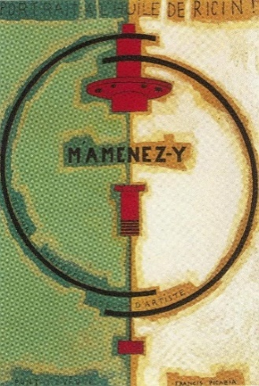
Case Study II: The learning outcome
The evaluations of the events indicated the Time Travel approach:
Developed inter-generational bonding
Strengthen the historical identity and sense of belonging
In general, the free, civic learning context, where different citizen groups worked and created together, helped:
to strengthen the recognition and understanding between the generations, from children, young people, adult and senior citizens; and
to build bridges between the past and the present, and
to promote mutual recognition as being part of the same bigger history.
Picabia, M`Amenes-y, 1919

Slide 24

Case Study III: A new community centre in Ejby
Context – an Erasmus+ Strategic Partnerships for adult education, innovation: “Bridging social capital by participatory and co-creative culture”, Sept 2017 – Aug 2019 with 8 partners from 7 countries: DK, UK, PL, AT, LT, SI, NL.
Interfolk was coordinator.
Aim – to bridge social capital and to promote inclusion, cohesion, and trust by strengthening the participatory and co-creative culture activities
Activities - included a state of arts survey, pilot work with inter-social, inter-generational, inter-regional, inter-cultural, and inter-European bridging, publish five thematic Compendia, test curricula by seven national pilot courses and two European pilot courses, provide a Curriculum Report, launch a Communication Portal, and complete seven national conferences.
The case study - a Danish pilot work, provided
by the National Association of Cultural Councils
with the Cultural Council in Køge Municipality;
entitled ““A new community centre in Ejby”.

Slide 25
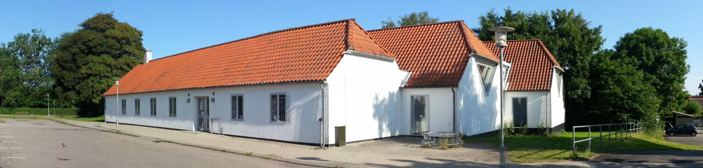
Case Study III: A new community centre in Ejby
Background:
The background for this pilot work was the trend with immigration from the countryside to bigger cities, which are a challenge in all developed countries.
One of the reasons for this immigration is to get better leisure time and culture opportunities.
To counter this trend, the president of the local cultural council in Ejby succeeded in March 2013 to acquire the disused library and to create a community centre in cooperation with Køge municipality and the residents of the city Ejby.
Ejby Medborgerhus: http://www.ejby-medborgerhus.dk/

Slide 26
Case Study III: Activities
The cross-sector cooperation:
The municipality agreed to cover the cost of the renovation of the building, and cost of idle operation and maintenance of the alarm system and the exterior.
The public culture institution, the library agreed to let most furniture and books stand to make it possible to continue to borrow books. The collection of books was also supplemented with books from a disused library nearby.
On the other hand, the local Cultural Council and related citizen groups agreed to organise the activities in the old library on a voluntary basis.
The activities:
Are initiated and controlled by the members, and they consist for the most part of artistic and cultural activities such as the following:
Art exhibitions, theatre performances, concerts, and lectures on a variety of topics throughout the year.
Courses in genealogy and IT.
Throughout the summer workshops with theatre and music for children.
Throughout the year the member can borrow all the books. It is up to the members themselves to arrange for the return, and many leave their own books on the library shelves, so others can benefit from them.
In addition, there are meeting rooms, reading rooms and kitchenette available to members, and all associations in the city can for free book a place in a meeting room.

Slide 27
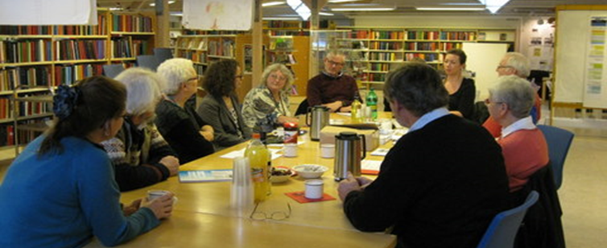
Case Study III: Learning Outcome
Active citizenship and democratic learning
The Community and Culture House in Ejby were based on forming a democratically structured association and developed by democratic community values.
The case study indicates that
a strong participatory culture can strengthen the social capital and mutual trusts in the community; and
culture volunteers in the field of arts, culture and heritage can help to promote the community bonding and local identity in their communities.
Meeting in Ejby Culture and Citizen House

Slide 28
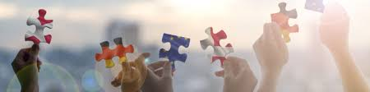
Perspectives from the case studies
The cultural NGOs represent a free civic area for lifelong learning, where citizens and associations beyond public control and market pricing organise myriad of arts and culture activities with strong added values for
Personal development and Bildung
Active citizenship and democratic values.
Mutual trust and social cohesion between different social groups.
Social inclusion and empowerment of vulnerable groups.
Local identity and community bonding.
The most transformative activities may be:
not only to promote social capital between rather similar social groups of individuals,
but to bridge former segregated social and cultural groups
as a mean to promote mutual trust, social inclusion, and recognition among different groups of people in our communities.
And thereby promote a shared community spirit and respect for the common good.

Slide 29
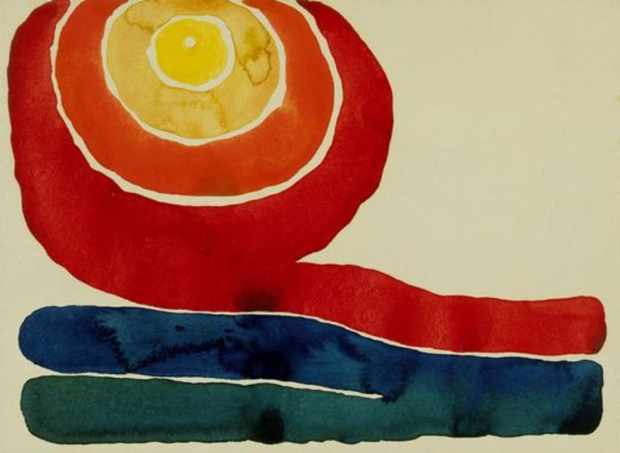
Perspectives from the case studies
Maybe most important:
Successful local cultural activities implies cross-sector cooperation between stakeholders both from the civil society and public institutions and municipality authorities.
Such cross-sector cooperation, labelled “co-creation” is today part of the development strategies in most Danish municipalities and an accepted goal for the civil society actors as well.
Ideally seen, the co-creation shall be based on open and equal terms, where the citizens groups and civil society associations are engaged
not only as co-implementers of aims defined by the public authorities,
but also, as initiators and co-designers of new welfare services in our local communities.
Georgia O'Keeffe:
Evening star iv, 1917

Slide 30

Thank you for your attention!

