Slide 1


Good practice of co-creation:
3-day European pilot course
9 – 11 October 2019 in Copenhagen
1st day: 14:30 – 15:00 / presentation
Project idea and innovative value of co-creation
Hans Jørgen Vodsgaard
Interfolk
Institute for Civil Society

Slide 2

CO-CREATE / Project summary
Project type:
Erasmus+ strategic partnership, development of innovation
Project title
Co-creative cooperation in the field of culture and heritage (CO-CREATE)
Period
Sept 2018 – Jan 2020 (17 months)
Budget
57.521 euro
Project idea
to compile good practice and innovative approaches and develop curricula and in-service training packages for co-creation in the culture field.

Slide 3
Work programme:
Sept 2018 - Jan 2020 (17 months)
FIRST PHASE: INITIATE & FOUND, SEPT 2018 – MAR 2019
WP 01: Start-up management
WP 02: First 2-day partner meeting, 11-12 Oct 2018 in Vienna
WP 03: Compile good practice and publish Survey Report
SECOND PHASE: DEVELOP & TEST, APRIL 2019 – OCT 2019
WP 04: Second 2-day partner meeting, 11 – 12 March 2019 in Helsinki
WP 05: Develop curricula guidelines
WP 06: Assess curricula by three national pilot courses, Sept 2019
WP 07: Assess curricula by European pilot course, 9 – 11 Oct 2019 in Copenhagen
THIRD PHASE: VALORISE THE RESULTS, NOV 2019 – JAN 2020
WP 08: Third 1-day partner meeting, 12 Oct 2019 in Copenhagen
WP 09: Publish Curricula report, Nov 2020.
WP 10: Complete three national 1-day multiplier events. Nov 2019 – Jan 2020
WP 11: Final dissemination of the project results. Nov 2019 – Jan 2020
WHOLE PERIOD: TRANSVERSAL WORK
WP 12: Transversal dissemination, incl. project website, whole period.
WP 13: Transversal Evaluation, whole period
WP 14: Project Management, whole period

Slide 4
Definition of “co-creation” and “co-production”
At the core of the concept of social innovation lies the active involvement of citizens into public service delivery.
This involvement is often referred to as ‘co-creation’ or ‘co-production’, and the concepts are often used interchangeably – but we can distinct the concepts: *)
‘co-creation’:
  a shorter period / ad hoc involvement of citizens,
  to clarify a need and design an innovative solution
‘co-production’:
  a longer period / ongoing activity with citizen involvement
  to implement continuous welfare services
NB: The Danish concept is “sam-skabelse” (in English “co-creation”),
but in fact it rather refers to the meaning of “co-production”
*) See reference list for publications by Helle Hygum Espersen:
https://www.coi.dk/fakta-og-cases/innovationstilgange/samskabelse/

Slide 5
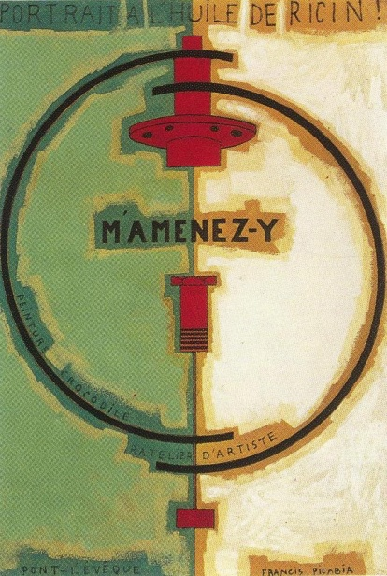
Definition of “co-creation”
Overall definition of co-creation / co-production:
a public actor develops and/or produces welfare services together with non-public actors.
These can be citizens, citizen groups, associations or other civil society organizations.
See, fx key research reviews in the field;
Verschuere, Brandsen and Pestoff 2012, Löffler 2009, Parks et al. 1999
as well as Agger and Tortzen 2015).

Slide 6
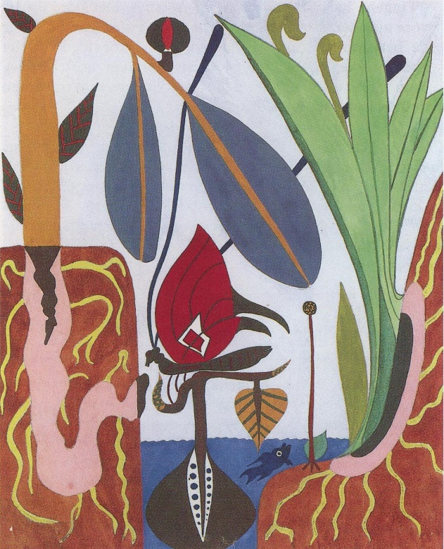
Defining co-creation / continued
When you co-create, you create something
new together - hence the name.
The parties' differences, ie the total amount of
competencies, values ​​and networks,
are mixed together in new ways
to create new solutions to common challenges.
Here citizens and professionals can be equal partners in defining, developing, implementing and evaluating the welfare services.
See fx
Andersen & Espersen, 2017a;
Andersen et al., 2018; Espersen & Andersen, 2017).

Slide 7

Co-creation can create different forms of value
According to Jens Ulrich, associate professor at VIA University College, Denmark
Co-creative collaboration can create value on three bottom lines:
The financial: Money can be saved by enabling citizens to take part in the solutions or by letting the citizens solve their own needs.
The innovative: A free dialogue between citizen and public institutions can lead to new creative and alternative solutions.
The democratic: Concerns the very involvement of the citizen as a legitimate contributor to the project, so they get more influence on the welfare services.

Slide 8
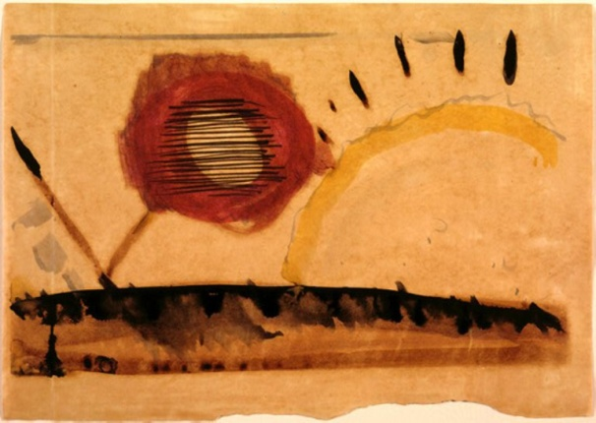
Background 1970s – 1980s
Social democratic period – new left after 1968 / grassroots movements in the 70s
1970s:
The idea of "co-creation" was first described by economist Elinor Ostrom and her colleagues at Indiana University, where studies showed that police efforts were
cheaper and more effective in small and medium-sized police departments,
where the closer connection to and dialogue with the citizens contributed to reducing crime.
1980s:
Some forms of co-creation with focus on user involvement, bottom-up initiatives, local self-management, fx the SUM-programme in Denmark 1988
SUM: Socialministeriets Udviklingsmidler
NB: Self-management is different from co-creation

Slide 9
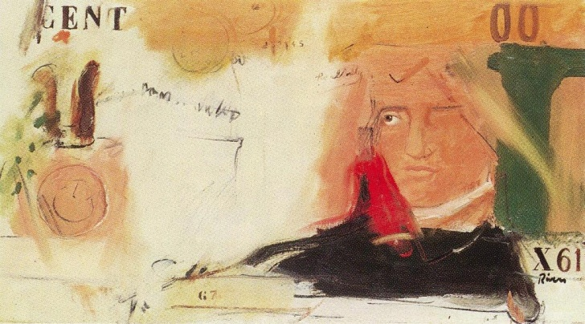
Background 1990s – 2000s
Liberal 80s: Reagan, Thatcher, Schlüter (yuppies)
Berlin Wall: Nov 1989 / Gorbachev: Dec 1991 / Baltic singing revolution
New labour 90s: Clinton, Blair, Nyrup Rasmussen (human capital)
Neoliberal 00s: Bush, Blair, Fogh Rasmussen
1990s - 2000s:
new trends focusing on marketing and outsourcing of public services
new public management began to define the agenda of the public administration.
The civil society got more integrated in public controlled performative strategies

Slide 10
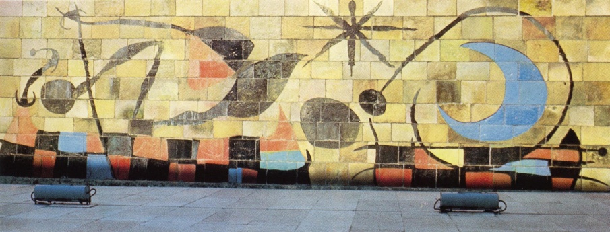
Background 2010s - current transition period
Neo-liberal – neo-conservative – neo-social-democracy – neo-left (identity policy)
Populism and neo-nationalism at the left, middle and right
  9/11 (2001): new conflicts
  2007-2009: Financial crises
  August 2015: Immigrant crisis / Merkel, Wir schaffen das
2010s
Limits for Globalisation & the Competitive State /
democratic demands of national sovereignty
New welfare state on the agenda & empowerment of civil society
From New Public management to New Public Governance

Slide 11
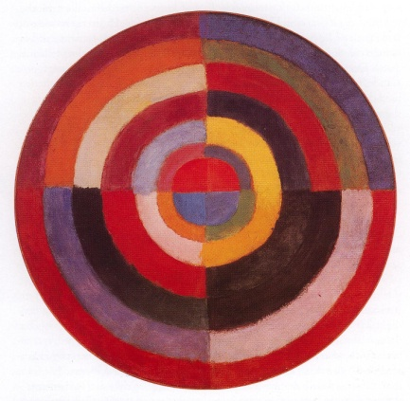
The last years a collaborative turn
The concept "co-creation" (in Danish “samskabelse” – if you wish to search at the internet)
has the last years marked the municipal agenda for the delivery of welfare services, both in Denmark and other Western European and Nordic countries.
It seems like a "collaborative turn" – as a new mantra
used by municipal employees and politicians for new initiatives such as
'Kommune 3.0' (Skanderborg Municipality),
'Kommune Forfra' (Aarhus Municipality)
'Future Welfare Alliances' (Local Government Denmark).
In recent years, a new 'market' has emerged,
where consultants, think tanks and researchers
offer analyzes, competence development, counselling
and promotion to support the agenda of co-creation.

Slide 12
Mega-trends: Need for a third way
The former traditional social democratic agenda / crisis in 1980s
The neo-liberalism /market-oriented reforms / crisis in 2010s
Need for a third way
Not traditional social democratic public management and control (priority of first sector)
Not New public management with market control
(priority of second sector)
But New Public Governance / empowerment of civil society
(priority of third sector )
The agenda tends now to shift from New Public Management
to New Public Governance (Bovaird & Löffler 2012, Pestoff 2012).
Co-creation is now seen by many as a supplement or even viable alternative to government and market-based production of public services.
The state, the first sector / The market, the second sector / The civil society, the third sector

Slide 13
Habermas – Model of Society
Technical -instrumental rationality
(How - on effective means)
market state
Democracy
Public sphere
civil society
Private sphere
SYSTEM
LIFE WORLD
Communicative og expressive rationality
(Why - on purpose and meaning)

Slide 14
Habermas – Life spheres and life roles
System
State Market
Parliament
Democratic public
Civil society
Personal sphere
Life world
Employee
Customer
Client
Citizen
Fellowman
Person / human
Bourgeois
Citoyen
L’Homme
The good life implies
A balance between the roles as bourgeois, citoyen and l’homme

Slide 15
Habermas – The system colonises the life world
System
Market State
Spectator democracy
Civil society is privatised
Persons looses autonomy
Life world
The neoliberal system
The competitive state
New public management
Commercialization
Instrumentalisation
The colonised life world
Media: Public service to Infotainment
University: Free thinking to Invoices
Education: Bildung to competences
Culture: Experience economy
NGO’s: private volunteering
Key words:
One-dimensional society
Civil society looses learning capacity
Citizens looses autonomy
Less ”Liberty, equality, fraternity”

Slide 16
New Public Governance help to resurrect Civil society
Technical -instrumental rationality
(How - on effective means)
market state
Democracy Public sphere
CO-CREATION
civil society
Private sphere
SYSTEM
LIFE WORLD
Communicative og expressive rationality
(Why - on purpose and meaning)

Slide 17
A balanced Tricolore
The main value from the French Revolution 1789
The tricolore:
Liberty, (Blue) - Bourgeois - market
Egality (White) - Cityoen - state.
Fraternity (Red) - L’Homme - civil society
The socialist have used the red colour, but in reality they were whites.
We may not need more egality, but more fraternity / a stronger civil society
It means:
  more communicative rationality / more deliberative democracy / more free public debate
  more mutual recognition / more individuality / accept of differences (fx Alex Honneth)
  more social capital / more mutual trust
  more well-functioning societies / more happiness
A clue to Danish history -- fraternity is relative strong
  After 1660 / defeat to Sweden: Lost Southern part of Sweden / strong alliance between King and people against the noble men
  After 1864 / defeat after Napoleon Wars – bankrupt and lost Norway / followed by golden age in arts and culture
  After 1864 / defeat to Germany and Austria: Lost Schleswig Holstein / What is lost outwardly must be won inwardly /folk high schools,/ cooperative movement / new grass-roots movements

Slide 18
Co-creation in practice / the gap
Unfortunately there is a gap between ideals and reality in the practice of the municipalities.
The many fine words will often not correspond to the real practice.
A recent Danish study of co-creative practises in three municipalities (Tortzen, 2016) concluded that they represented top-down initiatives presented as 'co-creation'
On the one hand, the municipal leaders use an empowerment tale of co-creation, emphasizing equal cooperation.
On the other hand, in practice the public actors do not seriously provide room for the solutions or resources that citizens wish to bring.
Another Danish study (Ibsen & Espersen, 2016) showed the same picture
Even though the municipalities want to strengthen democracy in public services,
they cooperate with volunteers on specific tasks in the implementation phase, rather than involving them in identifying challenges and developing new possible solutions

Slide 19
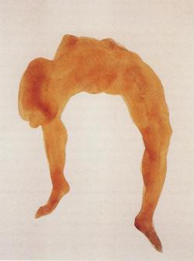
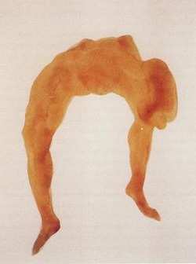
Different forms of co-creation
The researchers distinguish between different types of co-creation depending on
the role of the civil society actors and where in the process they get influence.
They can either be involved from the start or later, and
take the role of co-initiator, co-designer or co-implementer.
When the civil society actors
Are involved late in the process and only as co-implementers,
- 1st form of co-creation (control and top-down) – the reality
  Represent the agenda of New Public Management
Are involved from the start and also as co-initiators and co-designers on equal terms,
- 2nd form of co-creation (empowerment and network) - the ideal narrative
Represent the agenda of New Public Governance
.

Slide 20
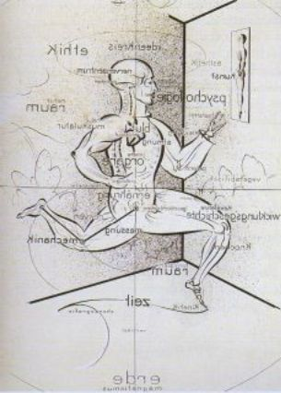
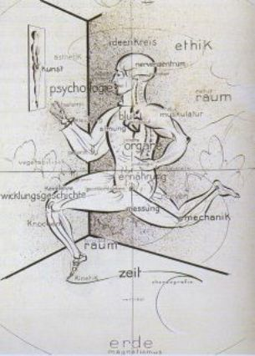
Conflicting positions of co-creation
So the co-creative practice is far from unambiguous.
We have two conflicting forms of "co-creation", respectively within the framework of
New Public Management with priority of economic gains and political control
where citizens are seen as relatively 'passive' co-implementers of services with focus on individual citizens and not on civil society associations
New Public Governance with priority of empowerment and democracy, where citizens are seen as more active and equal co-producers of services with focus on involving groups and communities (and not just individuals)

Slide 21
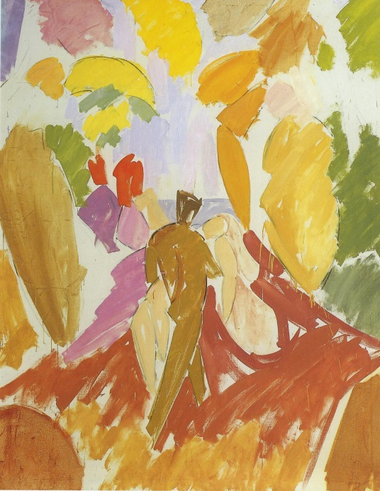
Co-creation in practice / the poor results
The conclusion of these two key surveys of the gap between narrative and reality:
The municipalities define in advance the framework and objectives of the co-operation, and they assume a dominant role in the cooperation,
So they are constantly failing to act as facilitators,
No room for the resources and ideas the citizens and civil society can bring.
It ends as 'top-down' partnerships,
So we need more pilot work
with co-creation on more equal terms.

Slide 22
Need for co-creative development work
– also in the cultural field
In Denmark sports, culture and leisure time associations together account for
half of all associations in the country (approx. 100.000 associations)
The sports associations constitute about a quarter and the cultural and leisure associations also represent about a quarter, while welfare associations (social, humanitarian and health associations) account for less than one fifth of all associations.
In addition, cultural associations are the sector, which has the greatest growth in the number of new associations and new members.
Not least outside the larger cities, cultural associations are crucial to ensuring a wide range of cultural and leisure facilities for the citizens.
(Ibsen & Espersen, 2016).

Slide 23
Co-creative development work in the cultural field
/ special opportunities
In our opinion, cultural association has special opportunities to engage in an innovative development work, because
There are not the same legislative bindings for municipal welfare services as in the social and health field (not same risk of wrong service due to “unprofessional” associations and volunteers).
The cultural associations and institutions can be seen as the most free area and as such have the best possibilities to engage in innovative as well as equal forms of cooperation,
The public administrations and institutions can to a higher degree in the cultural field release their control and give room and influence for initiatives, resources and contributions from civil society associations and citizens.

Slide 24

Thank you for your attention!

Slide 25
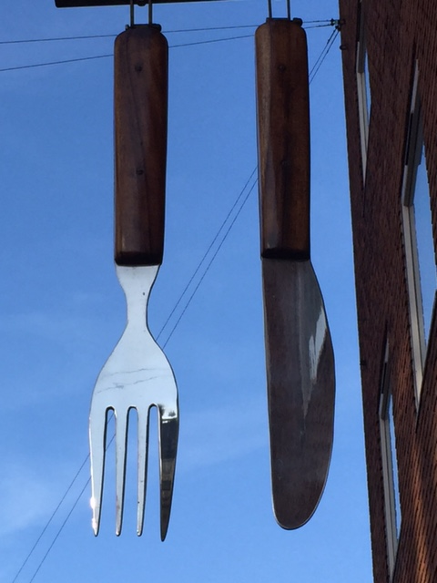
DINNER

Slide 26
References
Agger, A., & Tortzen, A. (2018). Hvilken værdi skaber vi med samskabelse og hvordan kan den måles og dokumenteres? [Roskilde]: Professionshøjskolen Absalon.
Andersen, L. L., Espersen, H. H., Kobro, L. U., Kristensen, K., Iversen, H., & Skar, C. (Eds.). (2018). Demokratisk innovasjon. teorier og modeller for samskapende sosial innovasjon. Oslo: Høgskolan i Sørøst og Kommunernes Sammenslutning (KS).
Boje, T. (2017). Civilsamfund, medborgerskab og deltagelse. København: Hans Reitzel.
Ibsen, B., & Espersen, H. H. (2016). Kommunernes samarbejde med civile aktører: Forskelle og ligheder i forventninger, praksis, samarbejdspartnere og oplevet udbytte. København: Syd-dansk Universitet & KORA. Det Nationale Institut for Kommuners og Regioners Analyse og Forskning.
Loga, J. (2018). Sivilsamfunnets roller i velferdsstatens omstilling. Norsk Sosiologisk Tidsskrift, 2(01), 58-73.
Löfffler, Elke (2009). Public governance in network society. In T. Bovaird & E. Löffler (Eds.), Public Management and Governance, Oxford: Routledge.
Parks, Roger B. et al. (1999): ”Consumers as co-producers of public services. Some institutional and economic considerations. Polycentric governance and development” i McGinnes (ed) - Reading from the workshop in political theory and policy analysis, Michigan University Press
Tuurnas, S. (2016). The Professional side of Co-Production. Ph.D-afhandling (Acta Universitatis Tamperensis 2163). Tampere: Tampere University.
Ulrich, Jens (2016). Samskabelse - en typology. CLOU Skriftsserie.
Verschuere, Bram, Taco Brandsen og Victor Pestoff (2012): ”Co-production: The State of the Art in Research and the Future Agenda” i Volubtas: International Journal of Voluntary and Nonprofit Organizations, 23. årg., pp 1083–1101
Voorberg, William, Victor Bekkers og Lars Tummers (2013): Co-creation and Co-production in Social Innovation; A Systematic Review and Future Research Agenda, EGPA Annual Conference, Edinburgh, 11-13. september

