Slide 1

NATIONAL CONFERENCE
18 October 2011 in Ljubljana, Slovenia
LOAC
Learning Outcome of Amateur Culture
Hans Jørgen Vodsgaard
Interfolk
Institute for Civil Society

Slide 2
The project concept
Overall aim
to promote a humanistic learning perspective
on amateur art and voluntary culture
Objectives
A survey on learning outcome
Double online tools for learning validation
Two pilot Grundtvig courses
Three reports
Dissemination and exploitation

Slide 3
Problem formulation
Initial question:
What is the raison d'être of amateur culture
On the one side – views of the amateurs and volunteers
Personal fulfilment - the joy of the amateur
An end in itself - has its own meaning
Personal formation, democratic experience, social capital
On the other side – views of the politicians and administrators
Social policy: Social inclusion, empowerment , integration
Health care: Art as preventive health care
Economic Affairs: Experience economy, Creative labour, cultural industry,
Humanistic view on the core service (a goal)
contra
Instrumental view on the peripheral services (a mean)

Slide 4
Lead questions about raison d'être
Main paradigm dispute
Humanistic and instrumental discourses
Derivative paradigm disputes
Lifelong learning
Art and culture
Civil society
Main answers
Critical Theory contra Neoliberalism
Part answers
Bildung before competence
Bildung before
culture industry
Civic rights before
state raison

Slide 5
Habermas – Modern Society
Technical -instrumental rationality
(How - on effective means)
market state
Democracy
Public sphere
civil society
Private sphere
SYSTEM
LIFE WORLD
Communicative og expressive rationality
(Why - on purpose and meaning)

Slide 6
Kant/Habermas – Rationality forms
System
Market State
Parliament
Democratic public
Civil society
Personal sphere
Life world
instrumental rationality
- Economic rationality
- Bureaucratic rationality
Communicative rationality
- Cognitive reason (basic science)
- Moral reason (ethics, law, politics)
- Aesthetic reason (art and culture)
Grundtvig:
To find the song behind the plough
To know the difference between sunshine and lightning

Slide 7
Kant/Habermas – Life spheres
System
Market State
Parliament
Democratic public
Civil society
Personal sphere
Life world
Value in world of necessity
- Efficiency and usefulness
Employee
(client and customer)
Citizen
Fellowman
Person
Value in world of freedom
- Autonomy and authenticity

Slide 8
Habermas – The system colonises the life world
System
Market State
Spectator democracy
Civil society is privatised
Persons looses autonomy
Life world
The neoliberal system
The competition state
New public management
Commercialization
Instrumentalisation
One-dimensional society
Civil society looses
learning capacity

Slide 9
Modern man – neoliberal man
Free person
Employee
Active Citizen
Fellow human being
Employee
Client
Consumer

Slide 10
Lifelong Learning – an old concept
Ancient Greeks
Socrates (469 –399 BC)
Italian renaissance
Leonardo da Vinci (1452 - 1519)
Dutch Humanism
Erasmus of Rotterdam (1466 - 1536)
French Enlightenment
Comenius (Czech) (1592 –1670)
German neo-humanism
Humboldt (1767 - 1835)
Danish liberal adult education
Grundtvig (1783 - 1872)

Slide 11
Paradigm struggle on Lifelong Learning
UNESCO introduced ”lifelong learning” in 70s
Access to knowledge and culture as a human right
Learning for human and democratic development
A humanistic paradigm
OECD promoted ”lifelong learning” in 80s
Qualification for competiveness on the global market
Learning as an investment in “human capital”
A economic-instrumental paradigm
Edgar Fauré: Learning to be, 1972
UNESCO: United Nations Educational, Scientific and Cultural Organization
OECD: Organisation for Economic Co-operation and Development

Slide 12
Lifelong Learning on EU’s agenda
The new meta-narrative
EU Commission: White Paper, 1993
Growth, Competitiveness and Employment. Challenges and Pathways to the 21th Century.
EU Commission: White paper, 1996
Teaching and Learning. Towards the Learning Society
Council: Luxemburg declaration, 1997
The European employment strategy included the definition of lifelong learning,
Council: Lisbon strategy, March 2000
European Union shall become the most competitive and dynamic knowledge-based society in the world.
EU Commission,
Memorandum on Lifelong Learning, Nov 2000
Communication: Making a European area for lifelong learning, Nov 2001
The Parliament and the Council, December 2006
The European reference framework on key competences for lifelong learning,

Slide 13
Inner tensions in EU’s aims of lifelong learning
Memorandum, 2000
employability contra active citizenship
Communication, 2001
employability contra active citizenship
  personal fulfilment
  social inclusion cultural cohesion
Opposite aims
the instrumental aim of the system world
the humanistic and democratic aims of the life world

Slide 14
Implementation of Lifelong learning
New legislation in EU and member states
In EU, for example
Lifelong learning programme
Culture programme *
Youth programme
Europe for citizens
In the Nordic Baltic region, for example
Nordplus
Nordic Culture Fond
Nordic Culture Point
*) Culture as a catalyst for creativity in the framework of the Lisbon Strategy for growth and jobs.

Slide 15
Paradigm dispute on art and culture
The humanistic agenda for art and culture
Universal Declaration of Human Rights, 1948
Article 26.
Education shall be directed to the full development of the human personality and to the strengthening of respect for human rights and fundamental freedoms
Article 27
Everyone has the right freely to participate in the cultural life of the community, to enjoy the arts and to share in scientific advancement and its benefits

Slide 16
The humanistic agenda after Second World War
The totalitarian experiences - abuse of art and culture
John Maynard Keynes - the arm's length principle
The Nordic Cultural model
Purpose
- art and culture essential for personal formation (Bildung)
- free and enlightened individuals the basis for a democratic culture
Means
- Art and culture - a welfare benefit and a right for all citizens
- Public support to inner values of art and culture
- Secure freedom from the state and the market
Phases
- 60s democratization of culture (high art to the people)
- 70s cultural democracy (amateur culture)

Slide 17
The instrumental agenda from the 90s
The competitive Nation State
will use the art and culture to solve systemic goals
focus on civil society disappear
The Neoliberal model
Purpose
- Use art and culture to solve social problems
- Use art and culture to improve economic competitiveness
Means
- Experience economy and business development
- Creative workers for cultural industry
- Event culture and branding
- Mayor-culture (pavarottisation),
Phases
- 90s quantitative regulations
- 00s qualitative regulations

Slide 18
Paradigm dispute on civil society
Premodern civil society = the republic of the state
Classic modern civil society - A free area outside the state
- The basis for fundamental rights
The catalogue of rights
In civil society:
First set: Protection of the individual and the privacy of the home
Second set: Freedom of thought, and expression and freedom of the press
Third set: Freedom of assembly and freedom of associations
Between civil society and the market
Fourth set Property rights, civil contracts and labour law
Between civil society and the state
Fifth set Democratic rights and welfare rights.
The chain of rights
Civil rights economic and political rights welfare rights

Slide 19
Ideals of a free civil society
Civil society as base for
Individual freedom and autonomy
Free voluntary associations
Free public debate
Main aims
To secure personal and democratic formation
To secure independent learning capacity in civil society
To secure communicative rationality in the lifeworld
Means
Liberal adult education
Voluntary associations / NGOs
Free arts and voluntary culture

Slide 20
Pressure on the civil society
New agenda of instrumentalisation
Civil society as a servant for the market and the state
No respect for an independent civil society
Means
liberal adult education
Still less public support to general adult education
Subcontractor for vocational training or formal education
Voluntary associations / NGOs
More political control by contracts, project funding, evaluations, etc
New demands of cooperation with the private sector
From voluntary associations to individual volunteering
Amateur culture
Resources moved to event culture
From active to audience

Slide 21
Conclusions - theory
The humanistic agenda (with reference to Critical Theory)
An effective system world as well as a rich lifeworld
With relations to fundamental modern European ideals
Learning in context
A freedom-oriented civil society theory
With a high independent learning capacity
And a communicative rationality incl. the expressive and aesthetical reason
A Bildung-oriented learning theory
Human freedom (autonomy and authenticity)
Communicative reason as unity of cognitive, moral and aesthetical reasons
A Bildung-oriented culture theory
Aesthetic practise has high level of personal formation
Quality criteria for art and amateur culture may be the Bildung-potential.

Slide 22
Conclusions – policy
The raison d'être
Amateur culture represent a societal activity that
promotes aesthetic learning processes with a high potential of personal and democratic formation.
Have reference to the European traditions of Enlightenment and Bildung
The core service is
to strengthen the communicative reason of the lifeworld in the societal totality.
Culture policy strategy / perspectives for profiling
Try to change agenda and gain the ideological initiative
The zeitgeist may - after the finance crisis - be more open for a humanistic agenda

Slide 23
NATIONAL CONFERENCE
18 October 2011 in Ljubljana, Slovenia
Learning methodology
&
the framework of the online tool
Hans Jørgen Vodsgaard
Interfolk
Institute for Civil Society

Slide 24
The change of pedagogical frame
  The classic Curriculum, some decades ago
  Double aim
  Education for the work life
  Formation for the social and personal life
  Main components
  Hard qualifications - Knowledge & skills
  Soft qualifications - Personal skills
  Personal formation - Bildung perspective
  Bildung dialectic
  The verb / to bild (to form oneself freely)
  The noun / a Bild (to have role models)
  Self-reflexion and social reflexion is related
  Freedom for the common good
  First a person and a citizen – then a employee

Slide 25
The change of pedagogical frame
  The new mainstream Curriculum
  Background – Knowledge economy and management theory
  The learning organisation
  Human capital
  Flexible competences
  One aim
  Education for the work life
  Adaptable, flexible, full commitment with body and soul, no leisure time
  To work for the firm is to live
  Main components
  Soft qualifications - Competences
  First and foremost – be at committed employee

Slide 26
Learning in context
The application perspective
For the work life as employee
For the social life as citizen
For the personal life as a human
For interrelated life spheres
EU’s aims of lifelong learning
Employability
Active citizenship
Personal fulfilment
Social inclusion / cultural cohesion
The context of art and amateur culture
Is primarily the cultural, social and personal life
Where the dimension of Bildung is essential

Slide 27
LOACs learning frame
A broad view on learning including three dimensions
  Personal formation
  Knowledge & skills
  Competences
  The three dimensions are interrelated*
  Their importance will vary in different contexts
  *)
  Personal formation will be empty without knowledge-anchoring and act-weak without competence.
  Knowledge will be directionless without personal formation and impractical without competence.
  Competences will be useless without knowledge and bewildered without personal formation.

Slide 28
The dimension of personal formation
  This dimension includes six elements:
  authenticity
  autonomy,
  reflexive knowledge
  moral judgement
  aesthetic sense
  integration (a versatile personality or the whole person).
  Each element is described by three key attributes, e.g. Aesthetic sense
  Sensitive of moods and feelings
  Poetic imagination
  Artistic sense

Slide 29
The dimension of knowledge & skills
  This dimension includes three elements:
  General knowledge about man, society and culture
  Specific knowledge and skills in a cultural subject
  Didactical insight in the specific topic
  Each element is described by four key attributes, e.g. Didactical insight in
  Pedagogical techniques of teaching
  Learning methods
  Awareness of personal learning stile
  Responsibility of own learning

Slide 30
The dimension of competences
  This dimension includes six competences:
  Cooperative
  Communicative
  Creative and innovative
  self-management
  intercultural understanding
  general learning ability
  Each element is described by three key attributes, e.g. Social competence
  Empathic and participatory
  Responsible and Cooperative
  Tolerance and respect of diversity

Slide 31
The double online tool
One tool for the learners
to validate their own learning profile and outcome
Another tool for the learning providers
to clarify their own goals and priorities for the learning activity
to validate the outcome for a group of learners (e.g. a class)
to compare the learners outcome with the schools goals

Slide 32
The purpose of the double tool in amateur art and voluntary culture
Focus on the learning dimension for learners and providers
Help the learners to document their learning profile
Help the organisations to evaluate their learning activities
Collect cross-border data on learning outcome for research

Slide 33
Try the tool
http://grundtvig.netschooltools.com/
Enjoy yourself

Slide 34
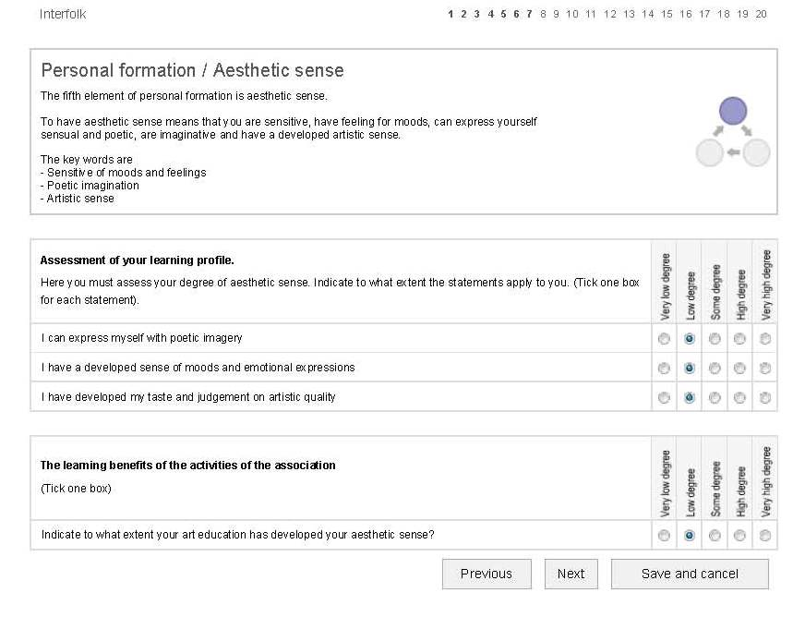
y

Slide 35
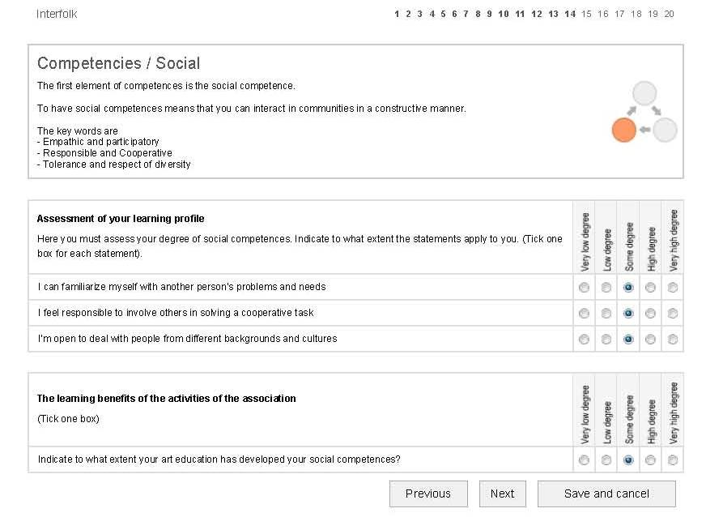
y

Slide 36
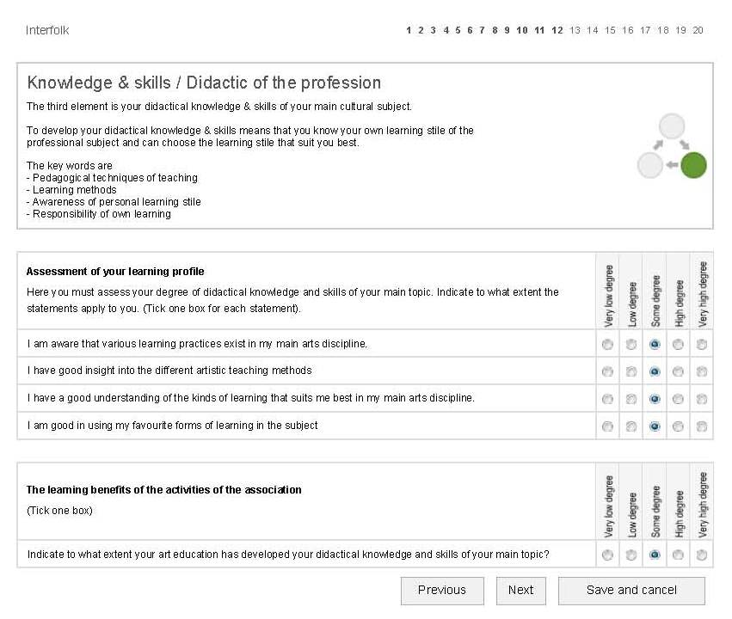
y

Slide 37
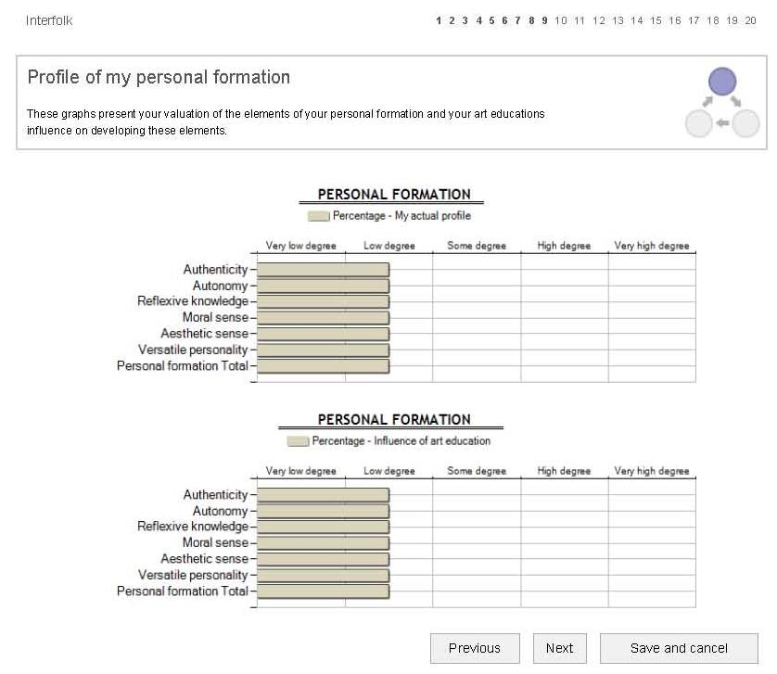
y

Slide 38
Lifelong Learning on EU’s agenda
The EU Commission’s
Memorandum on lifelong learning, 2000
Life long
From cradle to grave
Life wide
Formal learning
Non-formal learning
Informal learning

