Slide 1
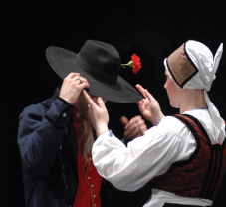
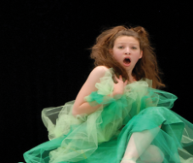
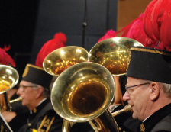
Marjeta TURK
The Grundtvig Multilateral Project
Ljubljana, Slovenia 29. 5. – 3. 6. 2011
Cross-national cooperation and cultural policies

Slide 2
MAIN FUNCITONS OF
AMATEUR CULTURE
The Grundtvig Multilateral Project
Ljubljana, Slovenia 29. 5. – 3. 6. 2011
Cultural creativity and performance
Culture education
Integration of less privileged groups
Accessibility of cultural goods
Spending quality free time
Interdepartmental cooperation

Slide 3
EUROPEAN CULTURAL
POLICIES
The Grundtvig Multilateral Project
Ljubljana, Slovenia 29. 5. – 3. 6. 2011
Agenda for culture
Lisbon strategy
UNESCO Convention on the
Protection and the Promotion of the Diversity of Cultural Expressions
Lilfelong learning programmes
Year of Volunteering 2011

Slide 4
EU OBJECTIVES
The Grundtvig Multilateral Project
Ljubljana, Slovenia 29. 5. – 3. 6. 2011
Cultural diversity
Intercultural dialogue
Culture as a catalyst for creativity
Culture as a key component in international relations

Slide 5
INTERSECTION BETWEEN
FUNCTIONS AND OBJECTIVES
The Grundtvig Multilateral Project
Ljubljana, Slovenia 29. 5. – 3. 6. 2011
mobility of artists and workers in cultural sector
Cross-border cooperation and dissemination of works of art
Use of ICT technologies in culture and arts

Slide 6
CROSS NATIONAL
COOPERATION
The Grundtvig Multilateral Project
Ljubljana, Slovenia 29. 5. – 3. 6. 2011
Exchange of cultural groups
Festivals, competitions
International projects
European networks

Slide 7
NETWORKS
The Grundtvig Multilateral Project
Ljubljana, Slovenia 29. 5. – 3. 6. 2011
Field networks (IFCM, AITA/IATA, CIOFF, CISM…)
Advocacy networks (CAE)
General networks (AMATEO)

Slide 8
AMATEO
The Grundtvig Multilateral Project
Ljubljana, Slovenia 29. 5. – 3. 6. 2011
ENVAA – European network for Voluntary / Amateur Arts
AMATEO – European network for active participation in cultural activities

Slide 9
AMATEO
The Grundtvig Multilateral Project
Ljubljana, Slovenia 29. 5. – 3. 6. 2011
established 2008 in Ljubljana, Slovenia, and formally registered as an international organisation in Ghent, Belgium by 5 organisations from Belgium, Denmark, Croatia, Nederlands and Slovenia.
Currently AMATEO has 18 member organisations from 12 EU states (10 members of EU and 2 candidates)
Member organisations of Amateo can be national or state or minority organisations within the fields of theatre, music, choirs, arts and crafts, film, dance, etc, and also community arts and sociocultural activities

Slide 10
AMATEO PRINCIPALES
The Grundtvig Multilateral Project
Ljubljana, Slovenia 29. 5. – 3. 6. 2011
Active participation in Cultural Activities should be:
better acknowledged for its importance for art, society and individuals by politicians, bureaucrats, researchers, opinion leaders and professional artists
recognised as worthy of support from national and EU institutions
encouraged by the reduction of bureaucratic obstacles for its importance for society
better respected for its importance in a society, for better understanding of the role it can play in development, for better understanding among nations in EU and worldwide

Slide 11
AMATEO is a network for enchanchig
The Grundtvig Multilateral Project
Ljubljana, Slovenia 29. 5. – 3. 6. 2011
the information flow within the member organisations
exchange of information and practice among the memeber organisations
international cooperation projects (festivals, exhibitions, exchange programmes, etc.)
gathering of initiatives for development projects, exchange programmes and support in the search for partners from participating countries
joint research into the field of the active cultural participation
transnational mobility of people working in cultural acitivities

